Slide 1
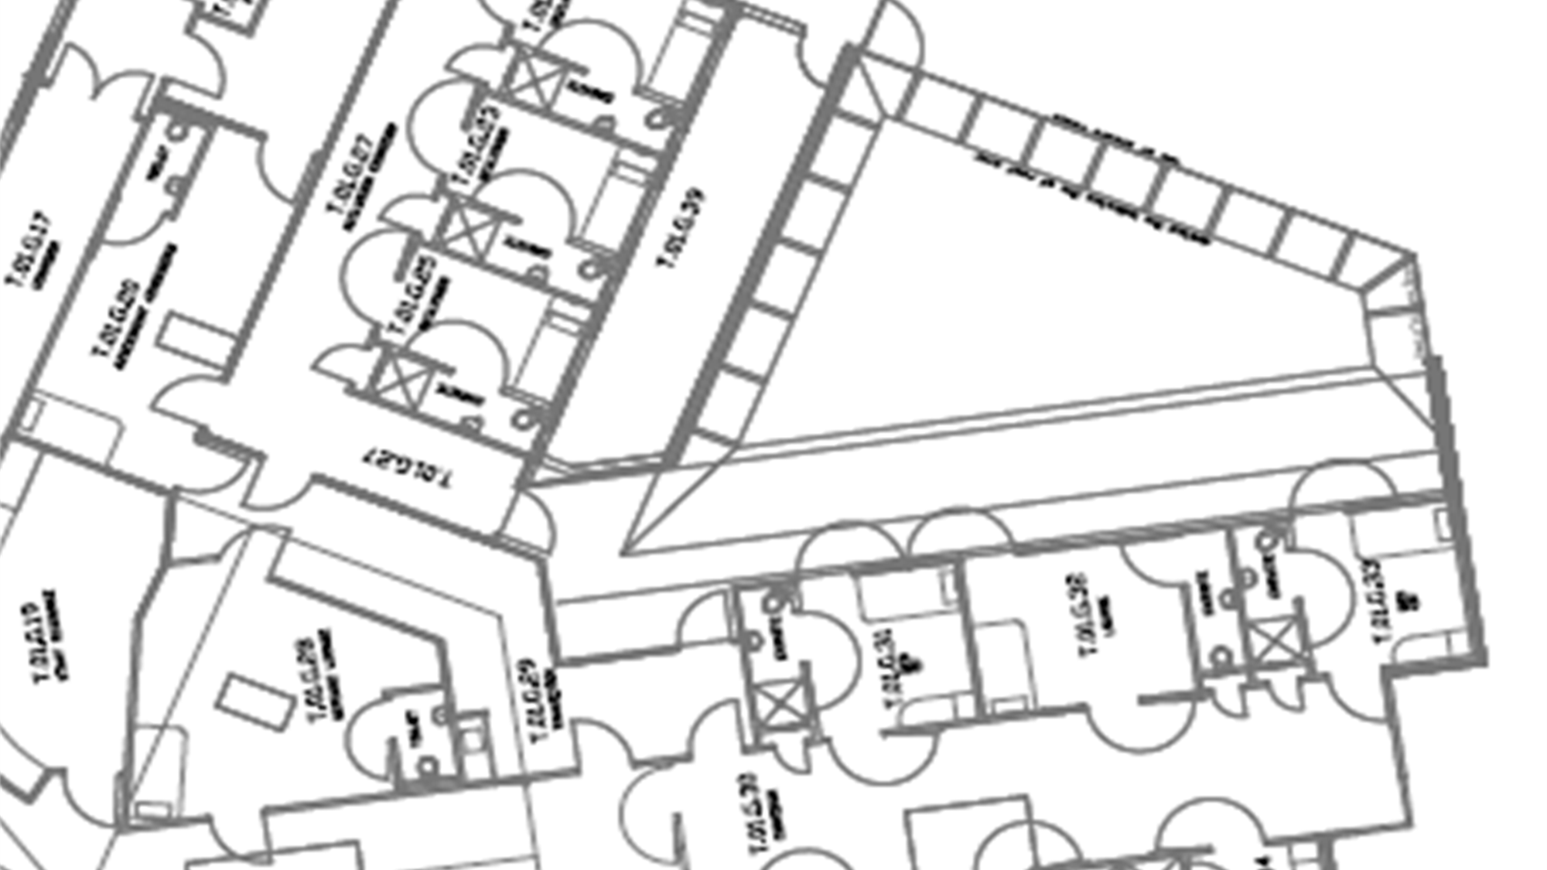
The Zero-Seclusion Project
Te Whare Maiangiangi
Tauranga Acute Adult Inpatient
Mental Health Unit

Slide 2
Defining the Criteria for Seclusion
“Severe and imminent risk to others…..after all other interventions have been explored” (Ministry of Health, 2023)
Holds no therapeutic value
Psychological and physical harm to tangata whaiora, whānau and staff
Training around what this means and what an assessment of this entails
Value alignment throughout the service
Focus on nurse-led decision making

Slide 3
Investing in Admissions and Use of Environment to Provide a Safe Alternative to Seclusion
Focus on having the right people available to manage an admission
Crisis team consider
providing treatment prior to admission
Culturally responsive and trauma informed welcoming process
ACNM or leadership led admissions.

Slide 4
CIWAA and drug screening on admission – commencing on a withdrawal pathway ASAP
Focus on having the right people available to manage an admission
Manaakitanga
Kai/Food available 24/7
Crisis team consider
providing treatment prior to admission
Culturally responsive and trauma informed welcoming process
Management of agitation and behavioural disturbance protocol
ACNM or leadership led admissions.
Provide training on the cycle of meth use and different stages, often we manage the crash.

Slide 5
CIWAA and drug screening on admission – commencing on a withdrawal pathway ASAP
Focus on having the right people available to manage an admission
Remove beds, close/decommission seclusion rooms
Manaakitanga
Kai/Food available 24/7
Ask the
question
“are we all safe?”
Crisis team consider
providing treatment prior to admission
Culturally responsive and trauma informed welcoming process
Management of agitation and behavioural disturbance protocol
Address issues of overcrowding –
staff can often work safely if staff ratios are appropriate
Modify the intensive psychiatric environment to provide multipurpose rooms i.e. sensory modulation
Quiet/de-escalation rooms
ACNM or leadership led admissions.
Provide training on the cycle of meth use and different stages, often we manage the crash.

Slide 6
PDSA Trials
Driver diagrams using the IHI model
Seclusion Champions
Fun trials for staff e.g. Pizza night, movie night, fish & chip night
Vapes
Phone use in IPC
Blue tooth headphones and tablets
Whānau inclusion
Creating a culture of change
If seclusions are high on certain days/times look at creative interventions to address this
CIWAA and drug screening on admission – commencing on a withdrawal pathway ASAP
Remove beds, close/decommission seclusion rooms
Manaakitanga
Kai/Food available 24/7
Ask the
question
“are we all safe?”
Plan
Do
Study
Act
Management of agitation and behavioural disturbance protocol
Address issues of overcrowding –
staff can often work safely if staff ratios are appropriate
Modify the intensive psychiatric environment to provide multipurpose rooms i.e. sensory modulation
Quiet/de-escalation rooms
Provide training on the cycle of meth use and different stages, often we manage the crash.

Slide 7
No leadership will often lead to seclusion
Support leaders to be able to work towards being seclusion free
Address all seclusion episodes as a failure in care, where did it go wrong?
When themes have been identified look at addressing them e.g. low staffing, overcrowding, cultural supports, skill-mix etc
Value alignment throughout the organisation – Drs, allied health, community teams - all aware of the project and the criteria for seclusion
Support staff to open the door – if we can't open the door, what do we need to open the door? (seclusion hui)
Leadership into seclusion or leadership out?
PDSA Trials
Driver diagrams using the IHI model
Seclusion Champions
Fun trials for staff e.g. Pizza night, movie night, fish & chip night
Vapes
Phone use in IPC
Blue tooth headphones and tablets
Whānau inclusion
Creating a culture of change
If seclusions are high on certain days/times look at creative interventions to address this
Remove beds, close/decommission seclusion rooms
Ask the
question
“are we all safe?”
Plan
Do
Study
Act
Leadership
Address issues of overcrowding –
staff can often work safely if staff ratios are appropriate
Modify the intensive psychiatric environment to provide multipurpose rooms i.e. sensory modulation
Quiet/de-escalation rooms

Slide 8
Leadership
No leadership will often lead to seclusion
Support leaders to be able to work towards being seclusion free
Address all seclusion episodes as a failure in care, where did it go wrong?
When themes have been identified look at addressing them e.g. low staffing, overcrowding, cultural supports, skill-mix etc
Value alignment throughout the organisation – Drs, allied health, community teams - all aware of the project and the criteria for seclusion
Support staff to open the door – if we can't open the door, what do we need to open the door? (seclusion hui)
Leadership into seclusion or leadership out?
PDSA Trials
Driver diagrams using the IHI model
Seclusion Champions
Fun trials for staff e.g. Pizza night, movie night, fish & chip night
Vapes
Phone use in IPC
Blue tooth headphones and tablets
Whānau inclusion
Creating a culture of change
If seclusions are high on certain days/times look at creative interventions to address this
Plan
Do
Study
Act

Slide 9
Leadership
No leadership will often lead to seclusion
Support leaders to be able to work towards being seclusion free
Address all seclusion episodes as a failure in care, where did it go wrong?
When themes have been identified look at addressing them e.g. low staffing, overcrowding, cultural supports, skill-mix etc
Value alignment throughout the organisation – Drs, allied health, community teams - all aware of the project and the criteria for seclusion
Support staff to open the door – if we can't open the door, what do we need to open the door? (seclusion hui)
Leadership into seclusion or leadership out?
Nurses strongly advocate for
zero-seclusion
Nurse Led
All seclusions are nurse driven and rarely involve the decision to seclude from the medical team
Create a culture of compassion and flexibility

Slide 10
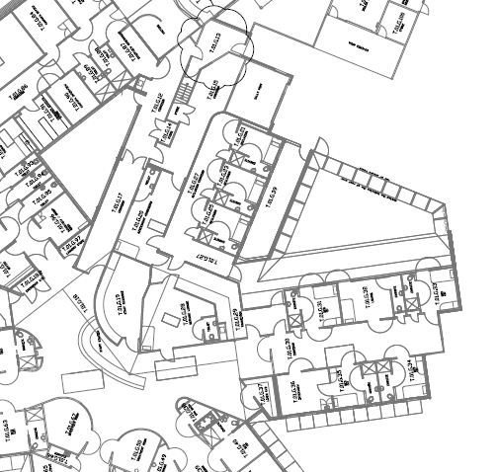
Leadership
No leadership will often lead to seclusion
Support leaders to be able to work towards being seclusion free
Address all seclusion episodes as a failure in care, where did it go wrong?
When themes have been identified look at addressing them e.g. low staffing, overcrowding, cultural supports, skill-mix etc
Value alignment throughout the organisation – Drs, allied health, community teams - all aware of the project and the criteria for seclusion
Support staff to open the door – if we can't open the door, what do we need to open the door? (seclusion hui)
Leadership into seclusion or leadership out?
Nurses strongly advocate for
zero-seclusion
Nurse Led
Use of environment
All seclusions are nurse driven and rarely involve the decision to seclude from the medical team
Create a culture of compassion and flexibility

Slide 11
Nurses strongly advocate for
zero-seclusion
Nurse Led
Use of environment
All seclusions are nurse driven and rarely involve the decision to seclude from the medical team
Create a culture of compassion and flexibility
Notes:
The current IPC unit is a four bed locked unit with 1 dining room, lounge area, dining room, courtyard, and de-escalation lounge. Tangata whaiora are either transitioned into this unit in via the courtyard or the sallyport – depending on their presentation and level of cooperation or ability to follow direction.

Slide 12
Seclusion Debriefs
Tangata Whaiora – led by the social worker, consumer consultant and other supports i.e. whānau
Use of environment
Implemented seclusion debriefs as per Te Pou best practice guidelines
Staff
Tangata whaiora
Whānau
Staff Immediate ‘post’ seclusion safety-check
3-7 days later - staff wellbeing and reflection debrief
Notes:
Using areas for pod nursing
Separating new admissions from the general IPC population until a thorough assessment has been completed. This requires resources, staffing and space.
The new refurbishment will contain two garden areas and an increase to 10 beds, allowing the IPC to pod nurse without limiting space for tangata whaiora

Slide 13
Tangata Whaiora
Whānau
Staff
Evaluation
Seclusion Debriefs
Whanau - whakapapa or kaupapa, Kaupapa Māori hui-a-whānau format, tikanga and whanaungatanga
Tangata Whaiora – led by the social worker, consumer consultant and other supports i.e. whānau
The D.I.
Implemented seclusion debriefs as per Te Pou best practice guidelines
Staff
Tangata whaiora
Whānau
Using a structured debrief we look at the appropriateness of seclusion, what could be done differently (reflection), different perspectives, learning, quality improvement
Staff Immediate ‘post’ seclusion safety-check
3-7 days later - staff wellbeing and reflection debrief
Service Improvement Recommendations

Slide 14
Tangata Whaiora
Whānau
Staff
Evaluation
Seclusion Debriefs
Reviews each episode including rationale, documentation, actions taken to end seclusion, the duration and the wellbeing of the whaiora
Whanau - whakapapa or kaupapa, Kaupapa Māori hui-a-whānau format, tikanga and whanaungatanga
Tangata Whaiora – led by the social worker, consumer consultant and other supports i.e. whānau
The D.I.
Implemented seclusion debriefs as per Te Pou best practice guidelines
Staff
Tangata whaiora
Whānau
Using a structured debrief we look at the appropriateness of seclusion, what could be done differently (reflection), different perspectives, learning, quality improvement
Staff Immediate ‘post’ seclusion safety-check
3-7 days later - staff wellbeing and reflection debrief
Actively investigates concerns/complaints raised by whaiora, whānau, and staff with regards to care and treatment
Service Improvement Recommendations

Slide 15
Tangata Whaiora
Whānau
Staff
Evaluation
Reviews each episode including rationale, documentation, actions taken to end seclusion, the duration and the wellbeing of the whaiora
Whanau - whakapapa or kaupapa, Kaupapa Māori hui-a-whānau format, tikanga and whanaungatanga
Outcomes are reported back to the clinical team
Show Me the Data
The D.I.
Using a structured debrief we look at the appropriateness of seclusion, what could be done differently (reflection), different perspectives, learning, quality improvement
Actively investigates concerns/complaints raised by whaiora, whānau, and staff with regards to care and treatment
Routine data is collected and analysed and monitored by the Zero-seclusion committee
Seclusion Focus Groups lea by the consumer consultant and CNS
Results Pending
Service Improvement Recommendations

Slide 16
Reviews each episode including rationale, documentation, actions taken to end seclusion, the duration and the wellbeing of the whaiora
Outcomes are reported back to the clinical team
Show Me the Data
The D.I.
Actively investigates concerns/complaints raised by whaiora, whānau, and staff with regards to care and treatment
Routine data is collected and analysed and monitored by the Zero-seclusion committee
Seclusion Focus Groups lea by the consumer consultant and CNS
Results Pending

Slide 17
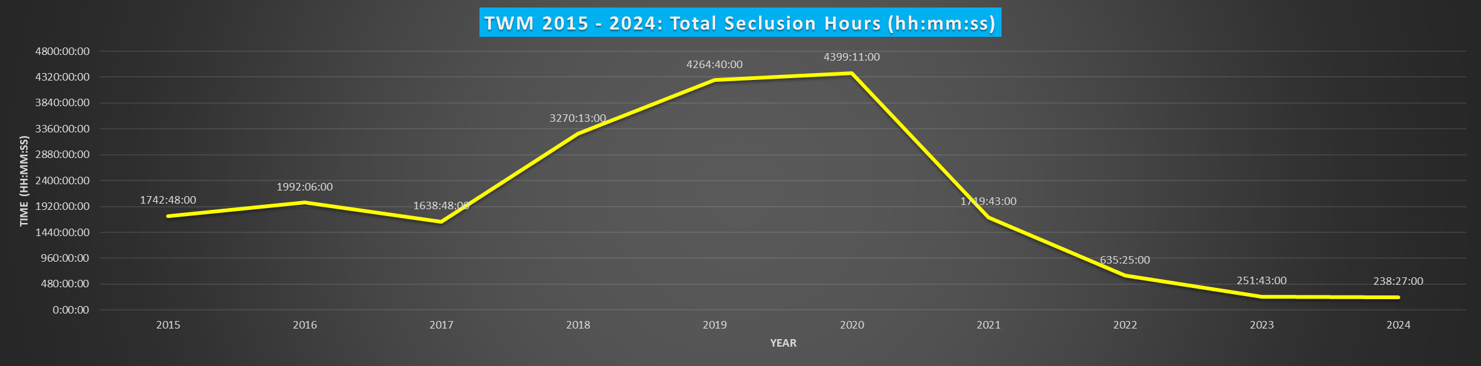
Outcomes are reported back to the clinical team
Show Me the Data
Routine data is collected and analysed and monitored by the Zero-seclusion committee
Seclusion Focus Groups lea by the consumer consultant and CNS
Results Pending

Slide 21
Fully implement and integrate the iwi endorsed, Kaupapa Māori Model of Care – ‘Toi Ora’
Support to Te Toki Maurere, Whakatāne acute MHU
What's next?
Continue education for staff around equity in mental health anti-racism

Slide 22
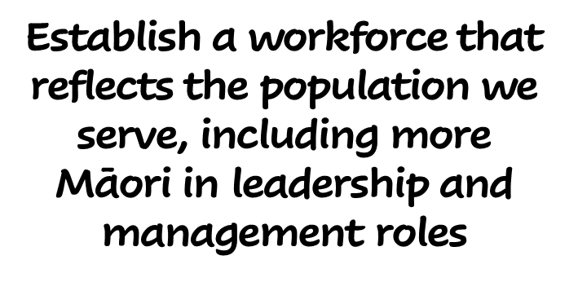
Fully implement and integrate the iwi endorsed, Kaupapa Māori Model of Care – ‘Toi Ora’
Improve responsiveness to whaiora with neurodevelopmental disorders (e.g. ADHD, ASD, BPD) and complex trauma. E.g. distress significantly worsens with detainment, low stimulus and authority.
Support to Te Toki Maurere, Whakatāne acute MHU
Increase lived-experience and peer support at all stages of the whaiora journey
What's next?
Develop and implement an assessment, treatment and management pathway for whaiora experiencing substance use withdrawal (e.g. methamphetamine, GHB, cannabis)
Continue education for staff around equity in mental health anti-racism

Slide 23

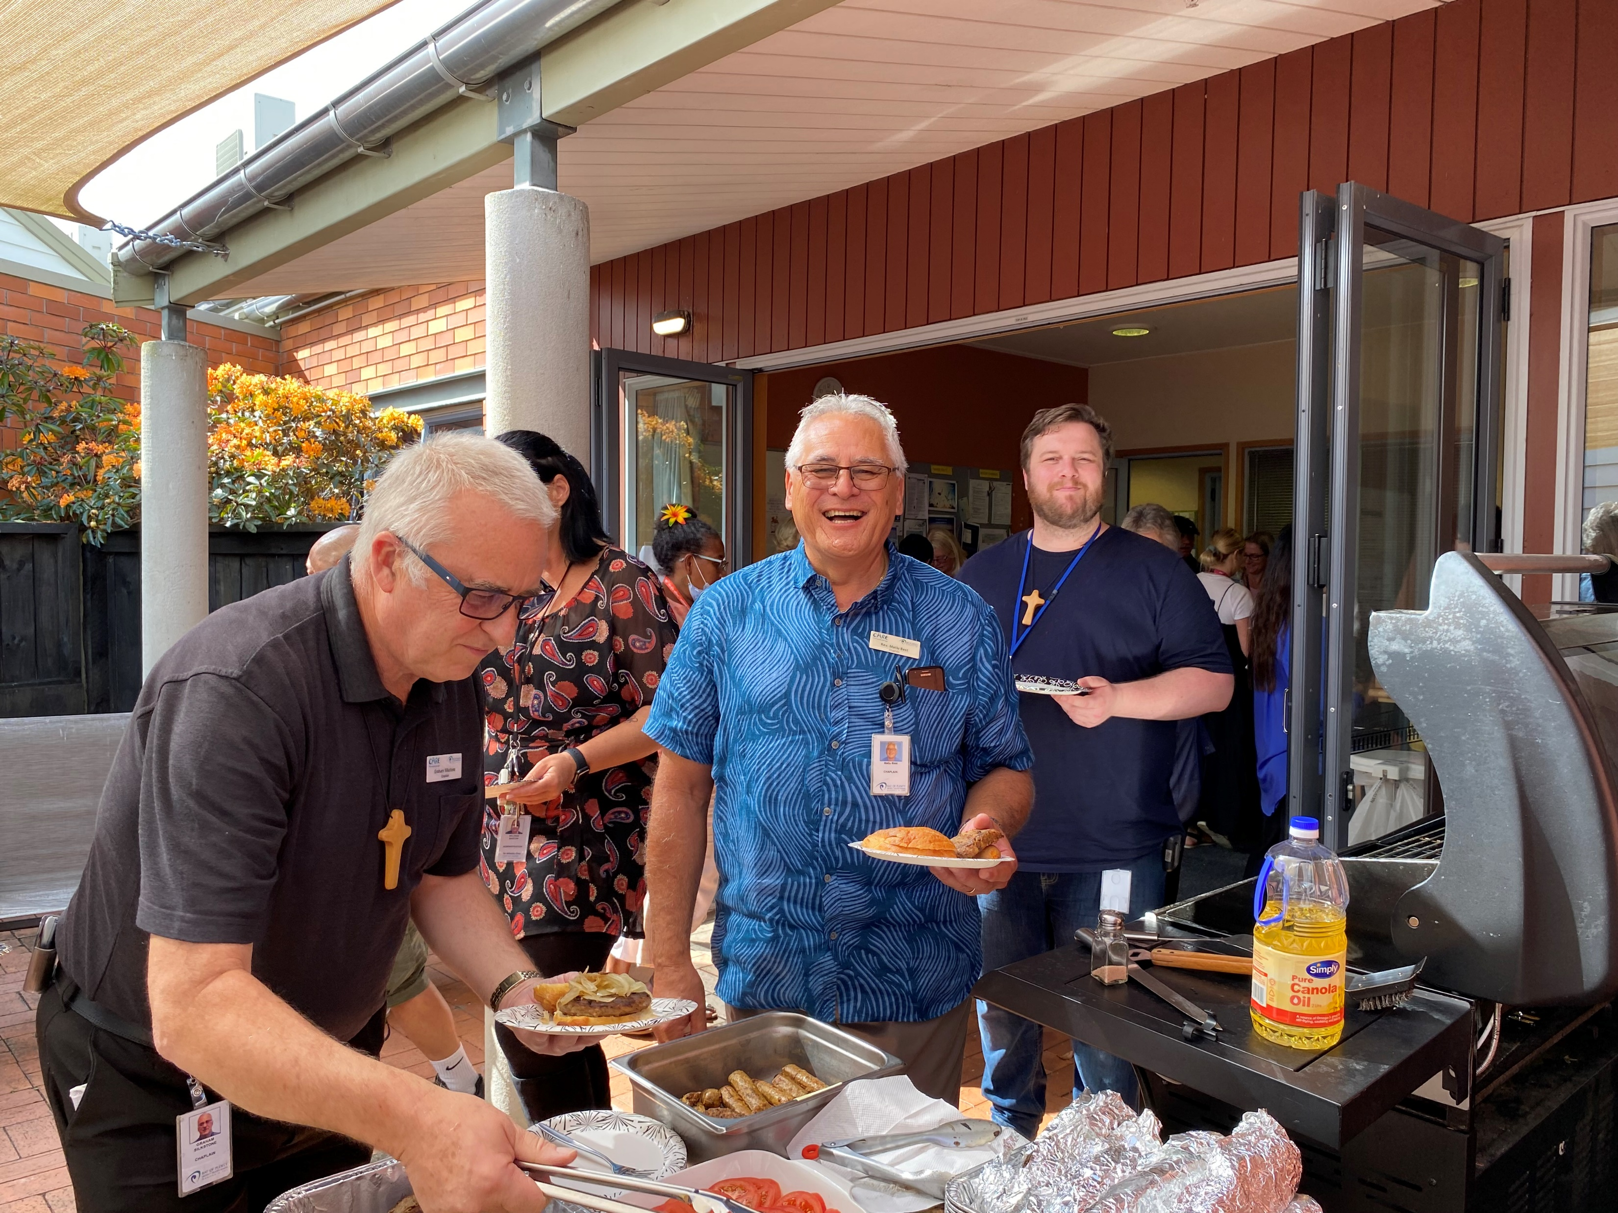
Fully implement and integrate the iwi endorsed, Kaupapa Māori Model of Care – ‘Toi Ora’
Improve responsiveness to whaiora with neurodevelopmental disorders (e.g. ADHD, ASD, BPD) and complex trauma. E.g. distress significantly worsens with detainment, low stimulus and authority.
Support to Te Toki Maurere, Whakatāne acute MHU
Increase lived-experience and peer support at all stages of the whaiora journey
Celebrate team
success
What's next?
Develop and implement an assessment, treatment and management pathway for whaiora experiencing substance use withdrawal (e.g. methamphetamine, GHB, cannabis)
Continue education for staff around equity in mental health anti-racism
Support staff wellbeing and…

Slide 24
Improve responsiveness to whaiora with neurodevelopmental disorders (e.g. ADHD, ASD, BPD) and complex trauma. E.g. distress significantly worsens with detainment, low stimulus and authority.
Increase lived-experience and peer support at all stages of the whaiora journey
Celebrate team
success
Ka mutu
Ngā mihi
Develop and implement an assessment, treatment and management pathway for whaiora experiencing substance use withdrawal (e.g. methamphetamine, GHB, cannabis)
Support staff wellbeing and…

Slide 25

Celebrate team
success
Ka mutu
Ngā mihi
Support staff wellbeing and…

