Slide 1
Through the looking glass and down the rabbit hole
Te Toka Tumai’s journey in telling our own story

Slide 2
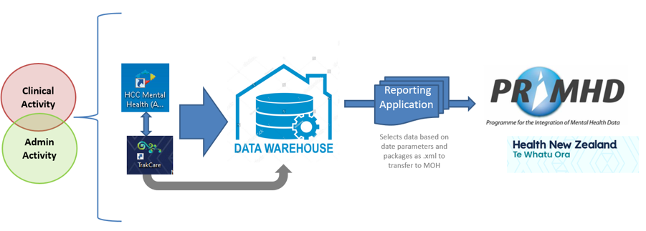
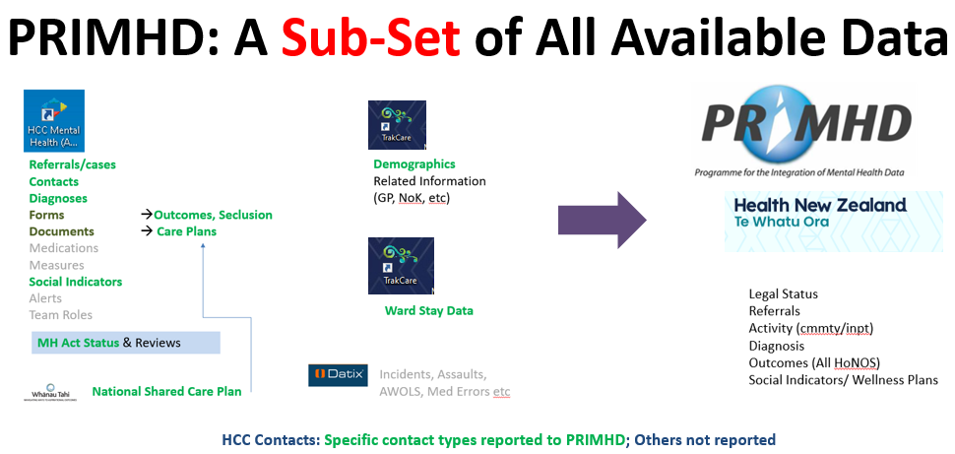
What is this thing called PRIMHD?

Slide 3
How data gets used
Locally
District Wide Reporting
Directorate
Service
Clinician
Audit
Local Data Quality
Nationally & Regionally
MoH & Te Whatu Ora
National Reporting (DAMHS)
PRIMHD Data Quality
Quarterly & Performance Reporting
National KPI Project
Mental Health & Wellbeing Commission
Health Quality & Safety Commission
Cross Agency
Cabinet/Ministerial
Other
OIA
Media
Research

Slide 4
Other people telling our story
Once the data leaves us, we lose control of the story
Locally
District Wide Reporting
Directorate
Service
Clinician
Audit
Local Data Quality
Nationally & Regionally
MoH & Te Whatu Ora
National Reporting (DAMHS)
PRIMHD Data Quality
Quarterly & Performance Reporting
National KPI Project
Mental Health & Wellbeing Commission
Health Quality & Safety Commission
Cross Agency
Cabinet/Ministerial
Other
OIA
Media
Research

Slide 5
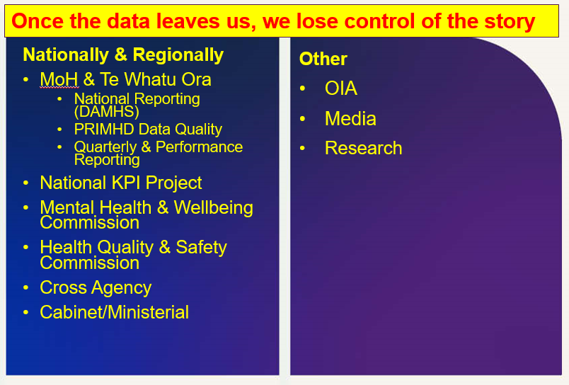
Telling our own story
If we want to tell our actual story we need data that captures and reflects what is happening
– telling our story involves better data as
one important aspect

Slide 6
Areas of focus
Outcomes
Initial Focus
  Cmmty: Current Caseloads
  Inpt: Matched Pairs
Coding Referrals
  Inpt & Cmmty
  Referrers
  Outcomes (Discharge Type)
  Discharge To
Diagnoses
  Cmmty only – 90 day + group
Social Indicators
  Inpt & Cmmty
  Living Situation
  Education
  Employment
Contacts (Activity)
  Cmmty only

Slide 7
Why these focus areas?
They offer ways to build our story so that it better reflects what we are experiencing

Slide 8
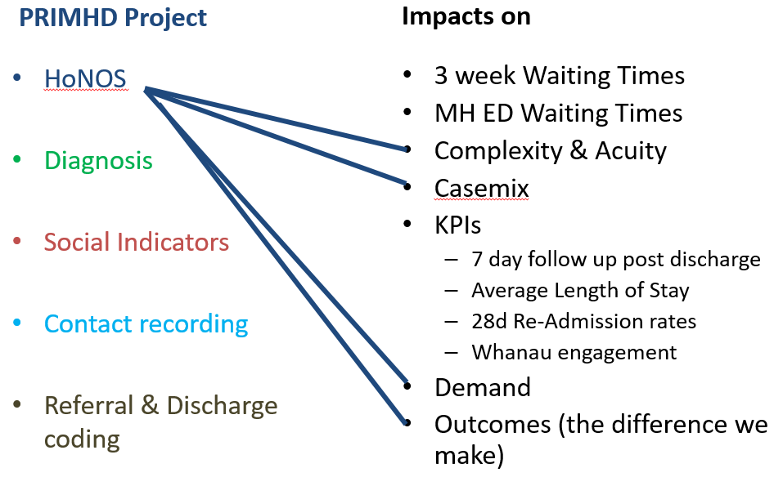
Why these?

Slide 9
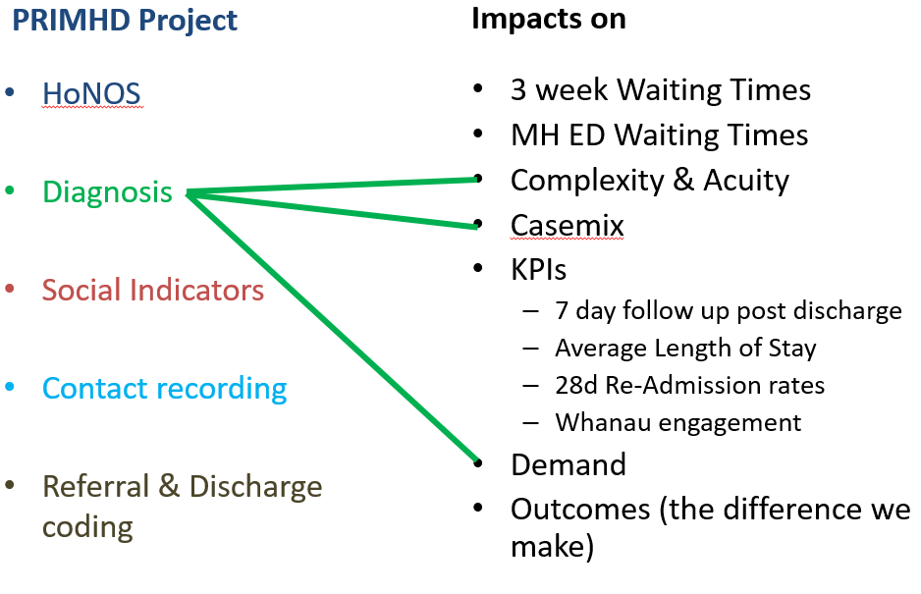
Why these?

Slide 10
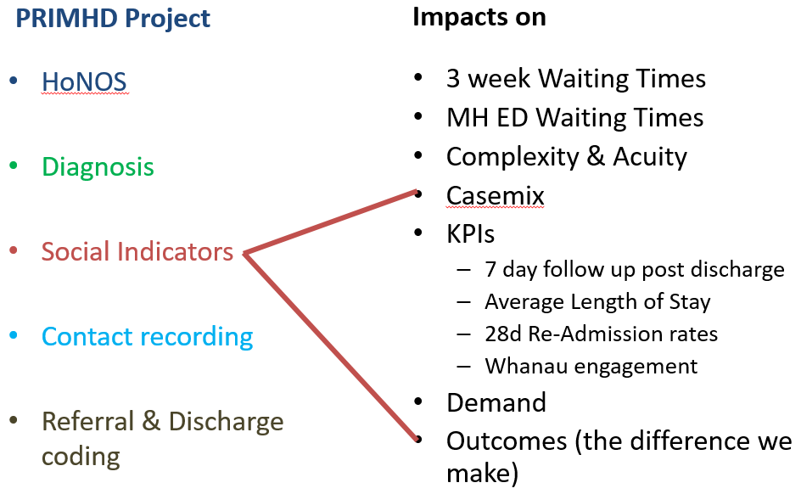
Why these?

Slide 11
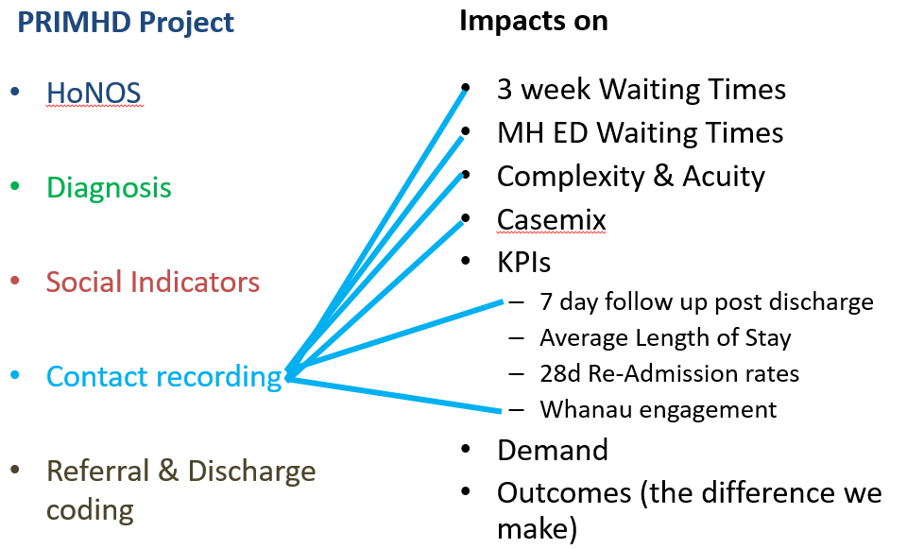
Why these?

Slide 12
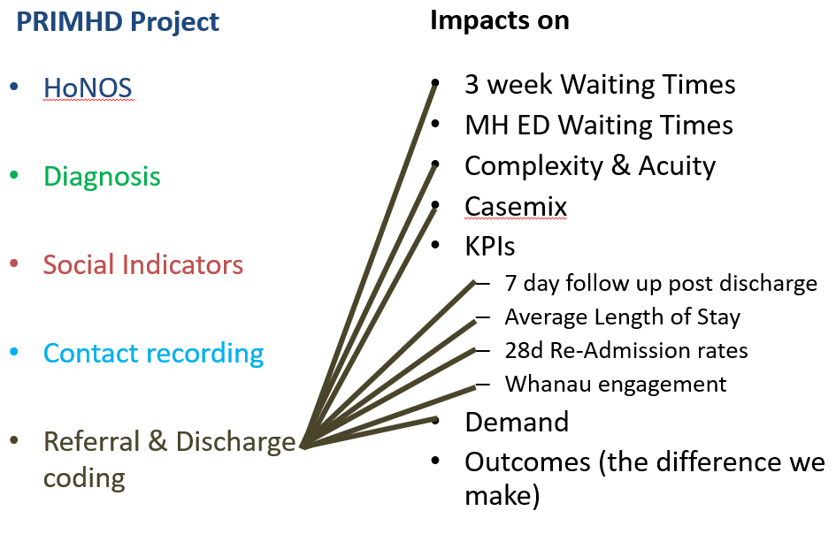
Why these?

Slide 13
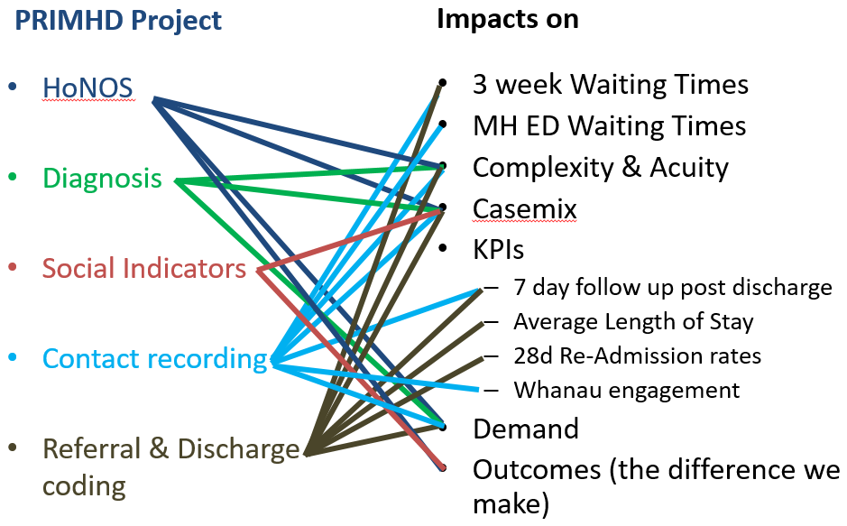
If we want to tell our actual story we need data that captures and reflects what is happening
Telling our story

Slide 14
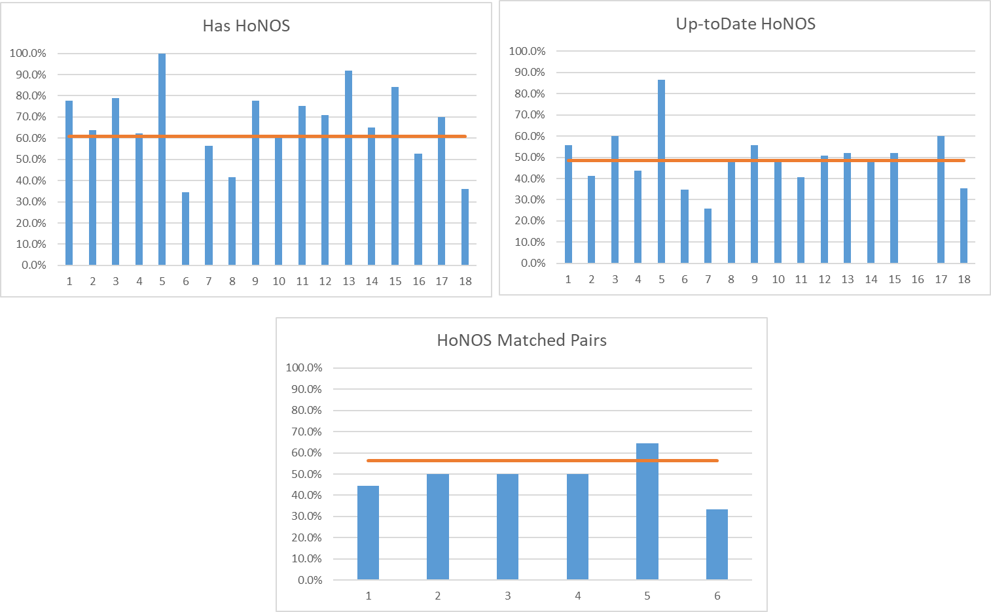
Where we started - Outcomes
Outcomes
Most challenging area
Poor understanding of how HCC supports this
Lots of clinical questions & uncertainty
Training a key issue
Less overt resistance

Slide 15
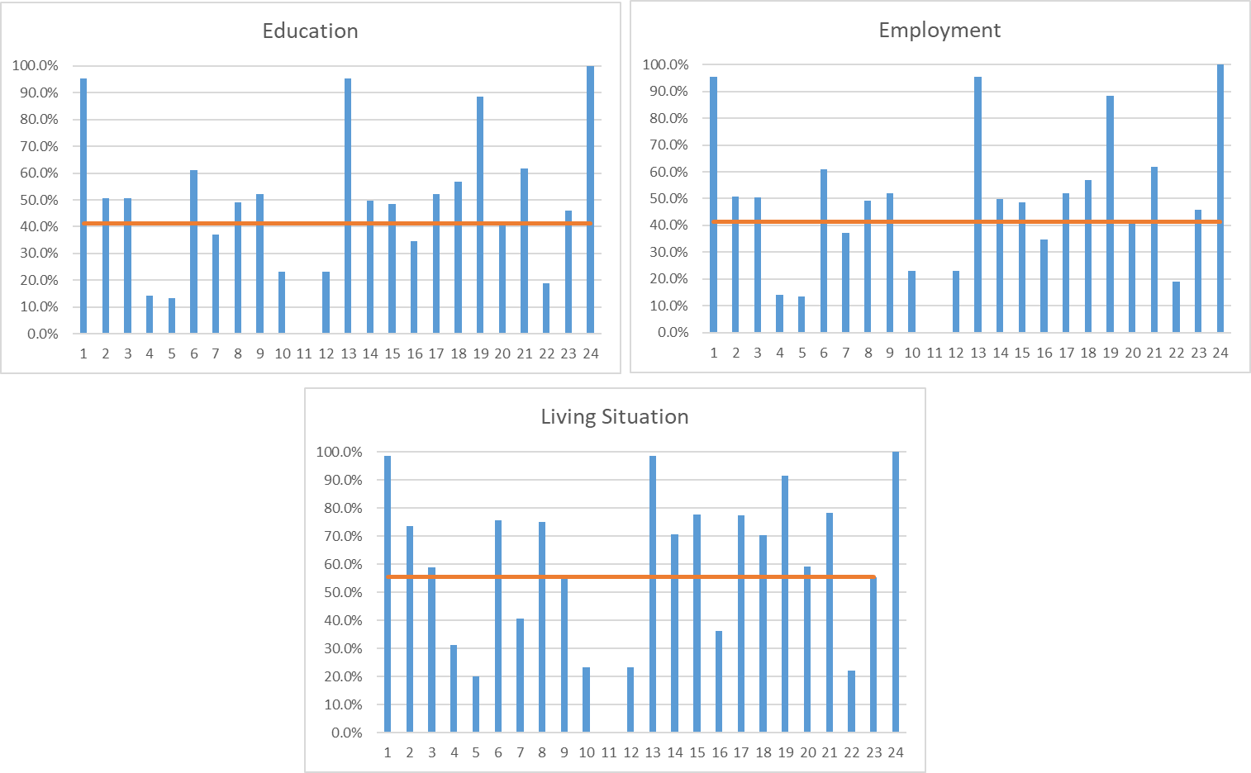
Where we started – Social Indicators
Social Indicators
Relatively easy to implement
Helped by employment & housing initiatives
Is not just current ratings but need for an ongoing on process

Slide 16
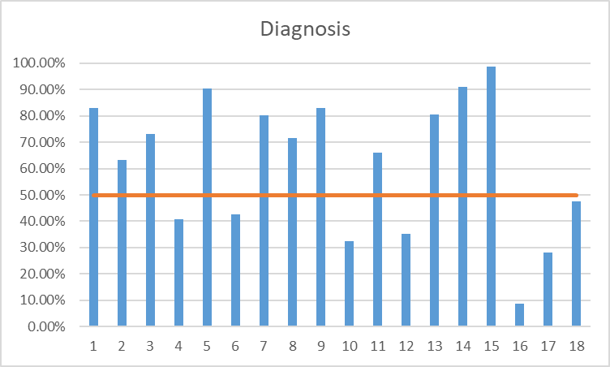
Where we started – Diagnosis (90d)
Diagnosis
Relatively easy to implement
Easy to support
Need for an ongoing on process

Slide 17
Where we started
Contacts – Activity
Always a particular challenge
A range of persistent issues
Lack of early and correct training
Referrer Details
  Some surprising issues
  Managing administrative work within HCC
Referral Closure
  Pairings sometimes illogical
  Ensuring clear understanding
  Shared understandings

Slide 18
What we did – people and process
ENGAGED SERVICE LEADERSHIP
Direct engagement with staff:
“Our story”
Clinical & Admin depending on issues
HCC Trainers
worked with them
PEOPLE
Working with others:
Data & Digital
Vendors
Regional Partners
Super-user Group
restored across all services

Slide 19
What we did – people and process
Training materials revised
Progress reports developed
PROCESS
Support materials
created
  e.g. Quickcards
PowerBI reports developed
Trouble-shooting issues
Quick-fix to significant solutions

Slide 20
What we did re: Outcome Trainers who have done Te Pou’s “Train the Trainers”
    TRAINERS
    Who are they?
    Are they inpatient or
    community focused (or both)?
    TRAINING
    Have they done any training?
    How often (if at all)?
    Who do they train?
    Which HoNOS do they train?
    Do they understand HCC?
    What resources do they have?

Slide 21
What we did to support Outcome Trainers
Generic support materials
Ensure they have clarity on HCC processes
Inpt & Cmmty
Ensure all groups covered
HoNOSI/HoNOSCA
HoNOS/HoNOS65+
  Inpt - Cmmty
Set up training timetable

Slide 22
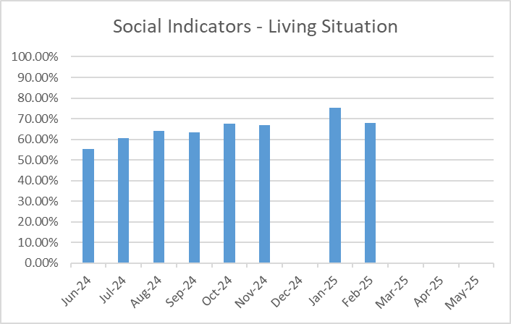
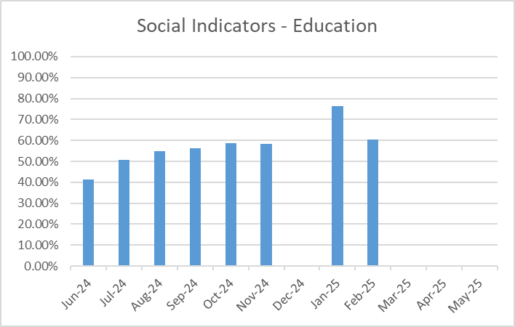
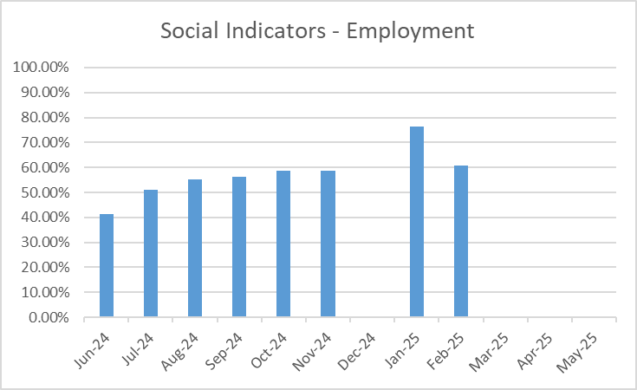
Where we are now – Social Indicators

Slide 23
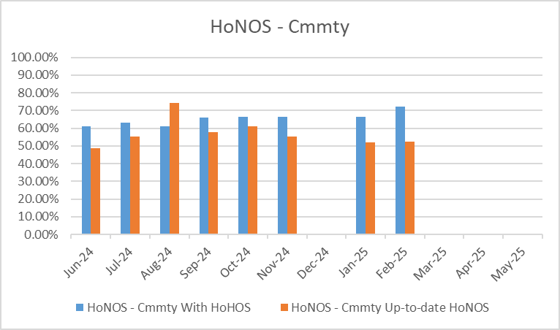
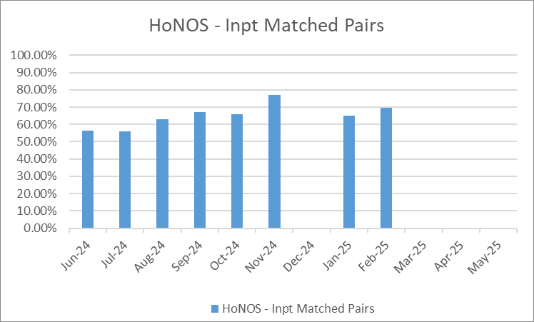
Where we are now – Outcomes
Community – Current Caseload
Inpatient – Matched Paris

Slide 24
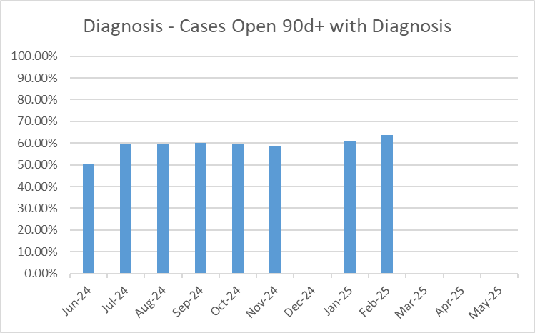
Where we are now – Diagnosis

Slide 25
Challenges
    Institutional “inertia”
    The failure of change processes
    The power of assumptions
    Reliance on informal training
Leadership & Accountability
Developing sustainable systems & processes
BAU

Slide 26
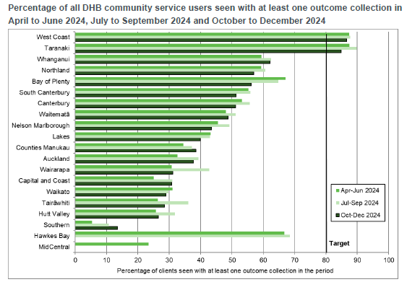
The challenge of business as usual

Slide 27
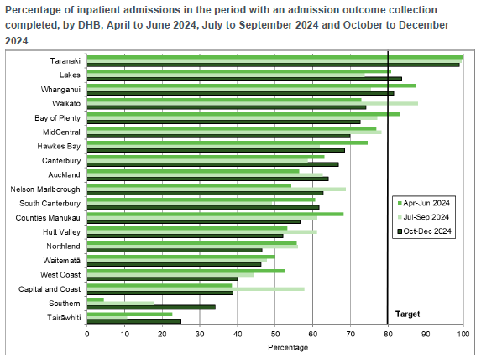
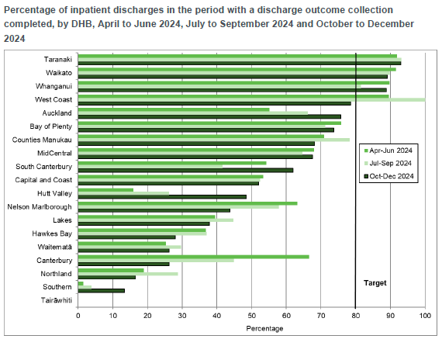
The challenge of business as usual
But struggling to get admission and discharges as matched pairs

Slide 28
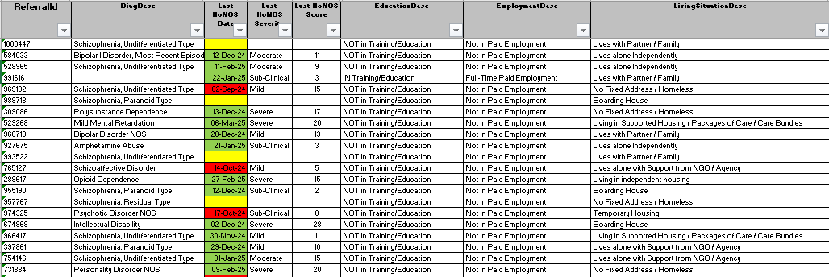
How we help
Detailed
Caseload
Reports

Slide 29
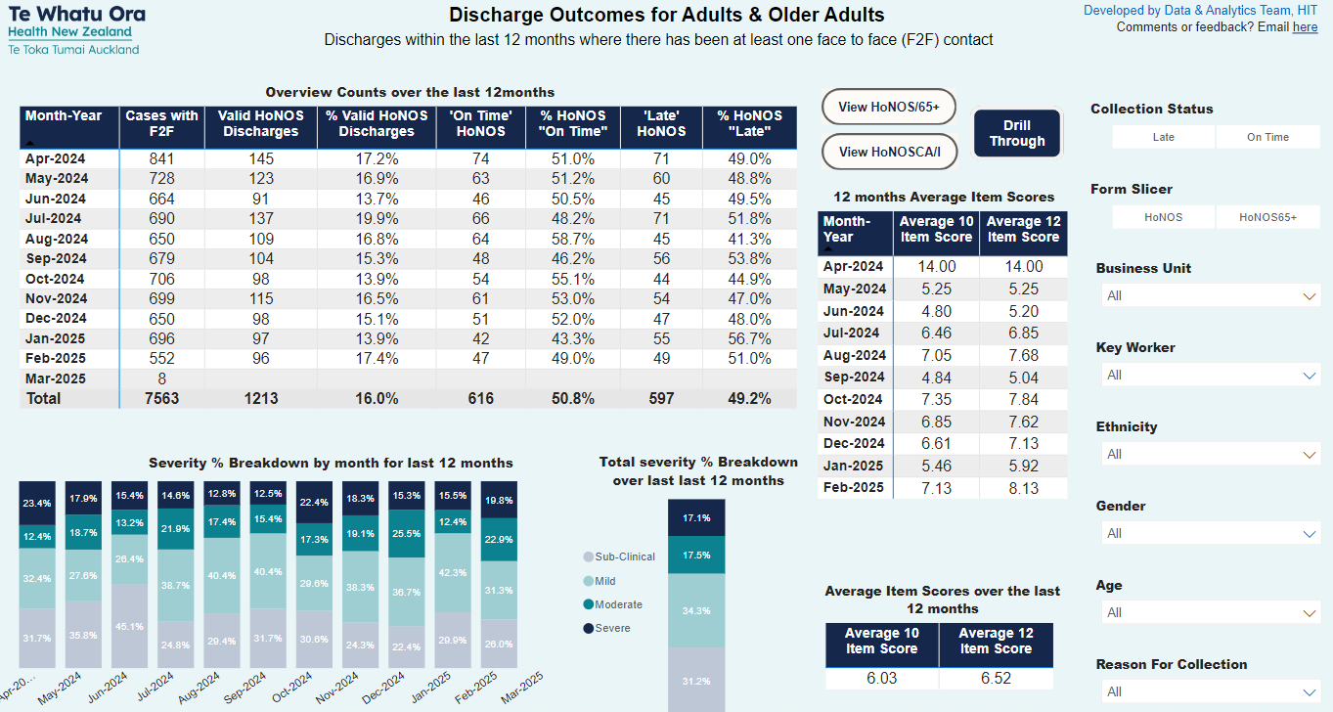
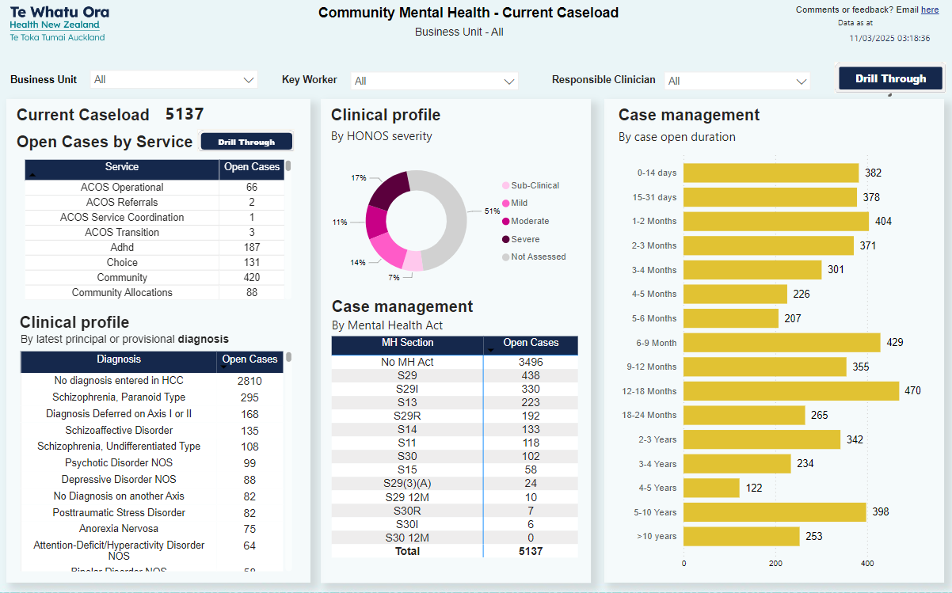
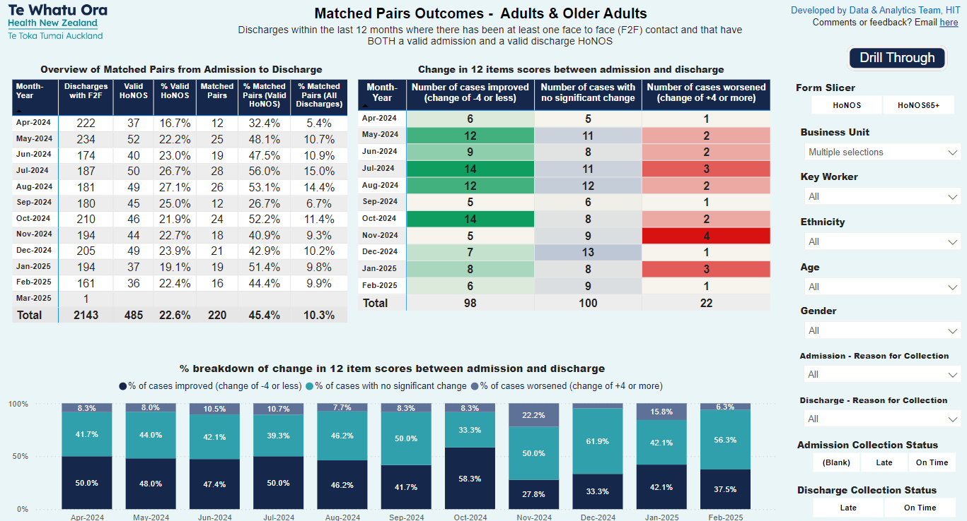
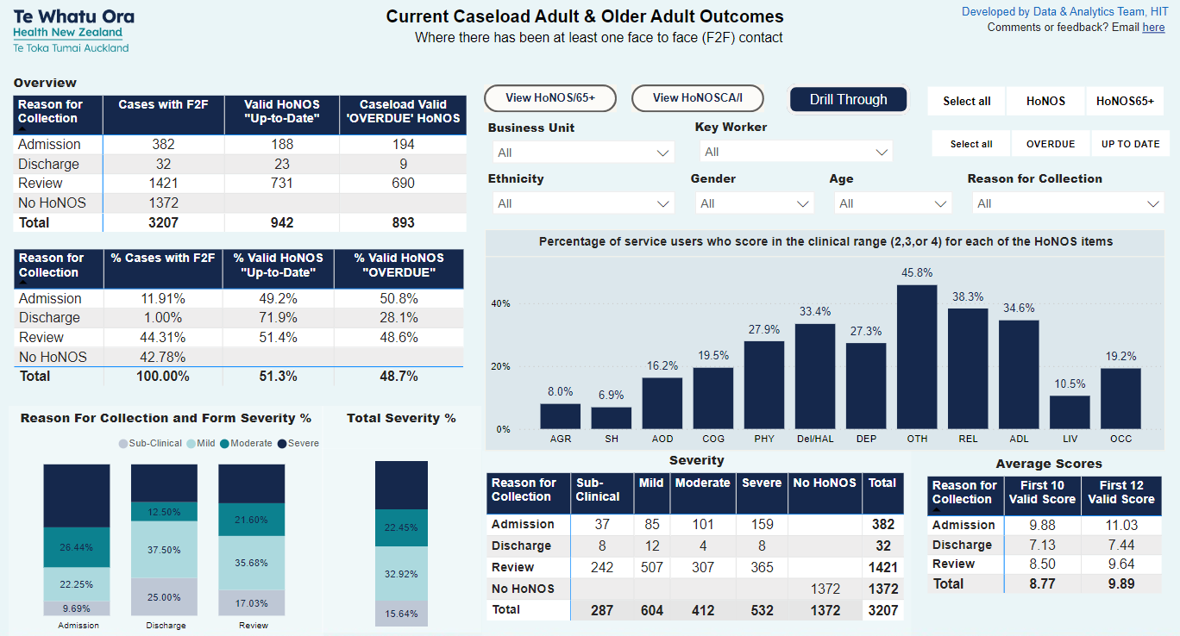
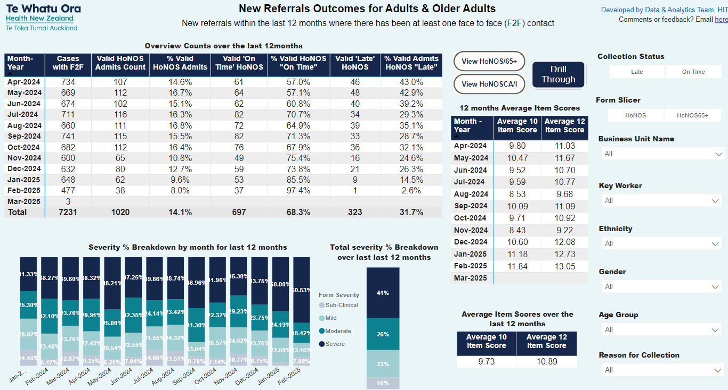
How we help
PowerBI
Caseload
Summaries

Slide 30
How we help
PowerBI Reports
HoNOS
Current Open Cases

Slide 31
How we help
PowerBI Reports
HoNOS
New
Referrals

Slide 32
How we help
PowerBI Reports
HoNOS
Discharges

Slide 33
How we help
PowerBI Reports
HoNOS
Matched
Pairs

