Slide 1

Kaupapa Maori Mental Health and Addiction Peer Support Service

Slide 2
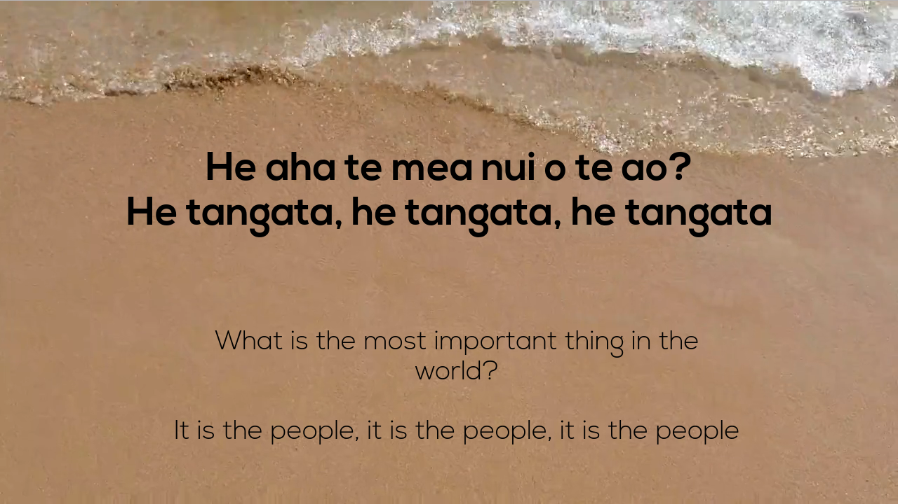

Slide 3


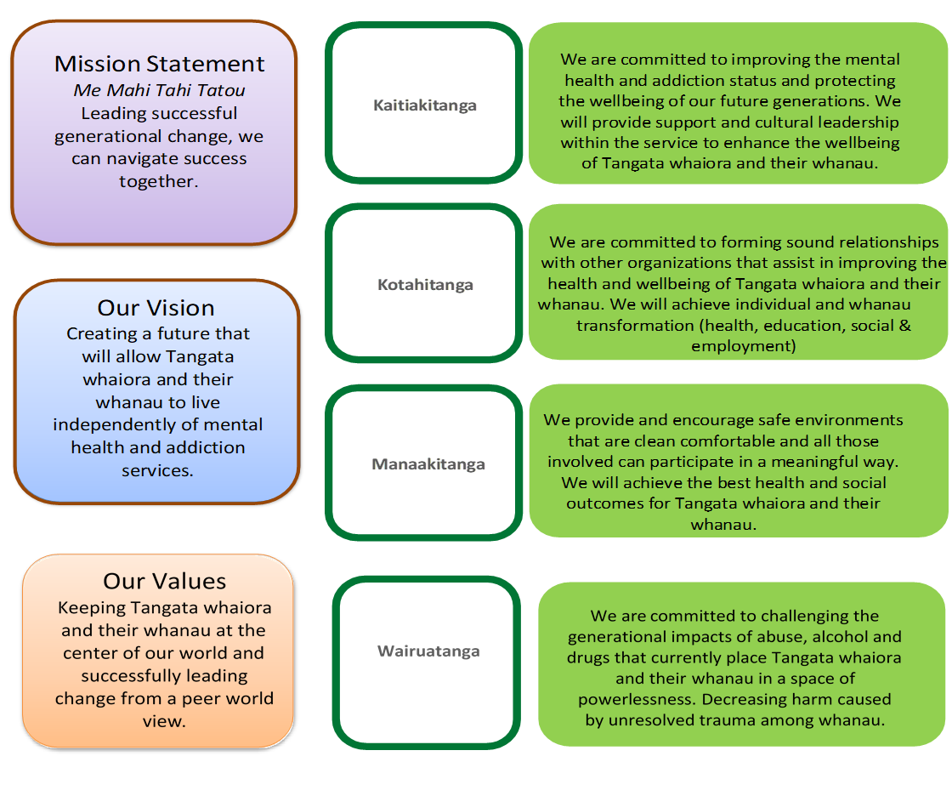
Strategic Plan 2020-2025

Slide 4
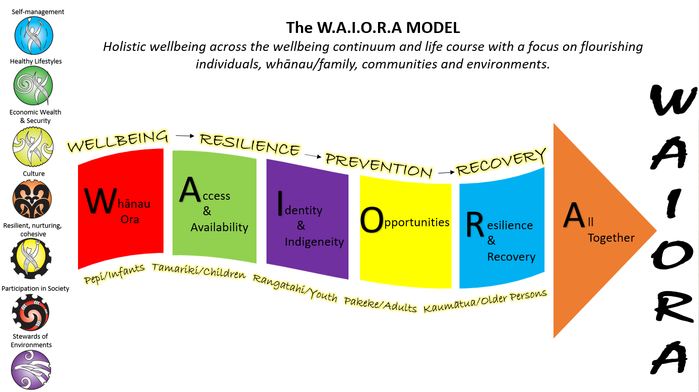

Slide 5
Current Services
Peer Support Adults
Peer Support Youth
Peer Support Adults (Kaupapa Māori)
Activity Based Recovery Support (Cultural Peer Support)
Activity Based Recovery Support (Non Clinical)
Day Activity Living Skills (Peer Support)
AoD Services for Community Offenders (SPOE & AoD Clinician)
Kaupapa Māori Whanau Peer Support
Out of Gate
Kaiwhakapuaki Waiora (Health Coach)
Te Puna Wai (Safe Haven Cafe)
Peer Support Specialist (Pou Arataki)
Workforce Coordinator and Cultural Supervisor
Project Coordinator (Central Region Crisis Cafes)
MSD Programme Facilitators

Slide 6






Toitu te Ora Single Point of Entry Service
Notes:
2014 The Toitu te Ora service takes a collaborative approach with referrals from the Department of Corrections Community Probation Services’ sites across the MidCentral District.
Toitu: To substantiate, to embed
Ora: Wellbeing, cycle of change, life changes, improvement

Slide 10
Notes:
86, 103, 7, 69, 62

Slide 11
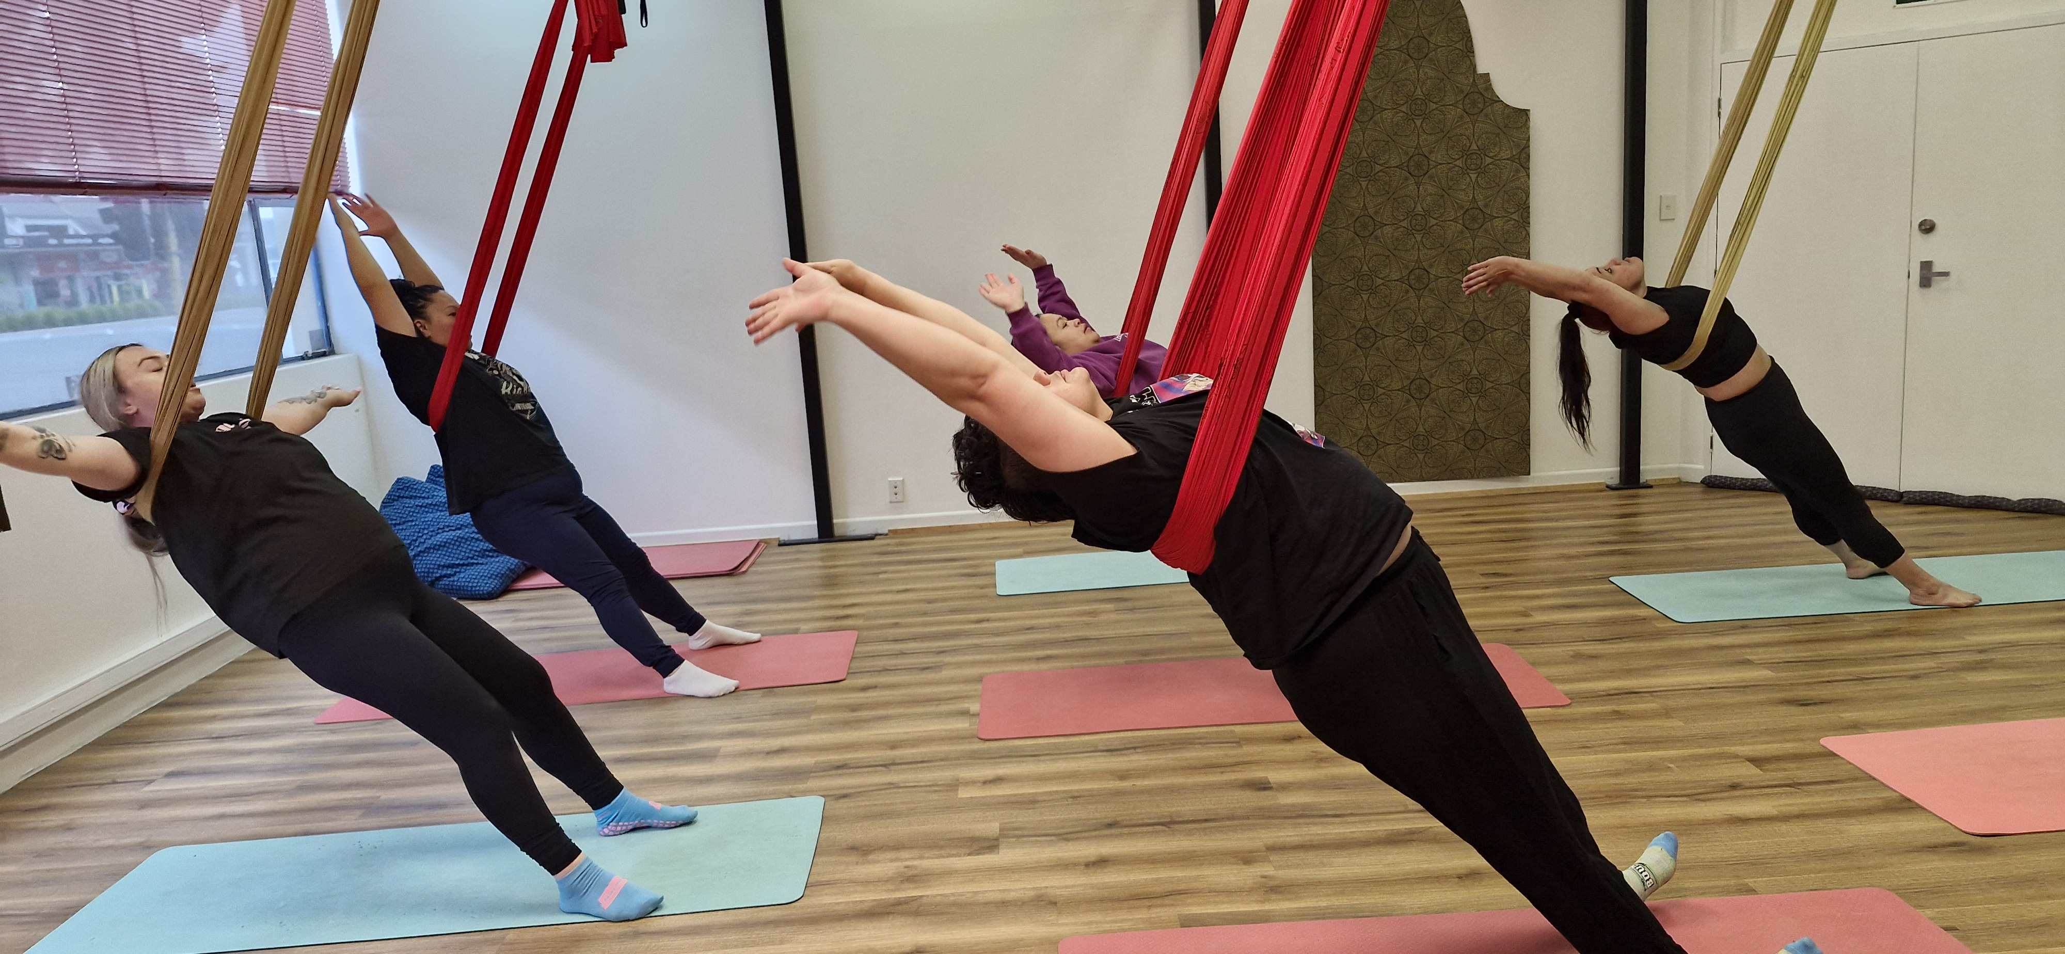
Priorities 2025
Focus on what will sustain recovery
Matauranga Maori
Access to whenua and whakapapa
Whanau Ora
Employment
Education
Achievement and purposeful activities
Being included in communities
Instill hope
Being responsive to Tangata Whaiora & Whanau
Promotion & prevention
Early intervention
Not about fixing things but building on strengths
Workforce/Community development
Notes:
Defining peer support: Peer support was said to be about relationships and mutuality. Part of making those connections rests in understanding peers’ worldviews, and in not judging them. Peer support was described as ‘recovery focused, not maintenance-focused”.
Focus on what will sustain recovery- employment, education , reconnection to whanau, achievement and purposeful activities, as well as being included in communities.
Instill hope
Not about fixing things but building on strengths

Slide 12
Improving Outcomes
Increasing skills to care for self
Meaningful, visible participation in the community
Decrease of stigma and discrimination
Functional, reciprocal relationships with whanau, and the community
Achievement of Tangata whaiora and whanau own goals and aspirations
Enhance the cultural identity of Maori
Providing access to Maori healing pathways
Being knowledgeable and possessing the required skills for Tangata whaiora and their whanau to reach better outcomes

Slide 13
Priority Outcomes
Decrease in suicide related events.
Improved access to broader supports to address coexisting mental health, addition and social issues.
Improved connection with whānau.
Improved service coordination with secondary mental health and AOD specialist service.
Increased psycho-social and literacy understanding for whai ora /whānau pathways to increase access.
Increased sharing and understanding of relevant Mātauranga to whai ora whānau wellbeing to build cultural equity.
Reduced rates of emergency department presentations and acute inpatient rehospitalisation.
Reduced substance-related harm.
Reduced wait times for community mental health and addictions support.
Improve well-being, self-esteem, and social functioning.

Slide 14
KPI # | Key Performance Indicator
1 | Number of unique whānau supported this year ¹
2 | Number of active whānau engaged and/or supported this quarter
3 | Number of whānau members supported in the above whānau ¹ Please provide a breakdown in the tables below
4 | Number of whānau who have been assessed to identify their needs and priorities ¹
5 | Number of whānau who have developed plans with goals ¹
6 | Number of whānau who have completed one or more goals within their plan ¹
7 | Number of whānau achieving at least one of their priority outcomes ¹
8 | Number of whānau achieving two or more of their priority outcomes ¹
9 | Percentage of whānau surveyed that report their priorities/needs have been identified and responded to ¹
10 | Percentage of whānau surveyed that report a positive experience ¹
11 | Number of whānau who have been referred to other services/programmes this quarter (Please provide a list of services/programmes in the table below)
12 | Number of Programmes delivered this quarter

Slide 15
Social Determinants
Employment
Housing
Education
Wellbeing Plans
Narrative

Slide 16
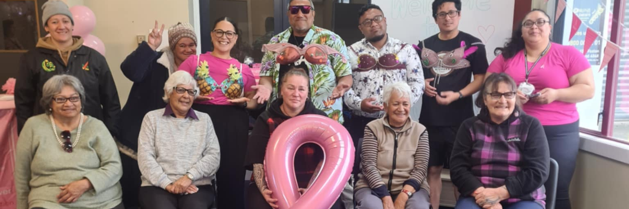
Mahi In Practice

Slide 17
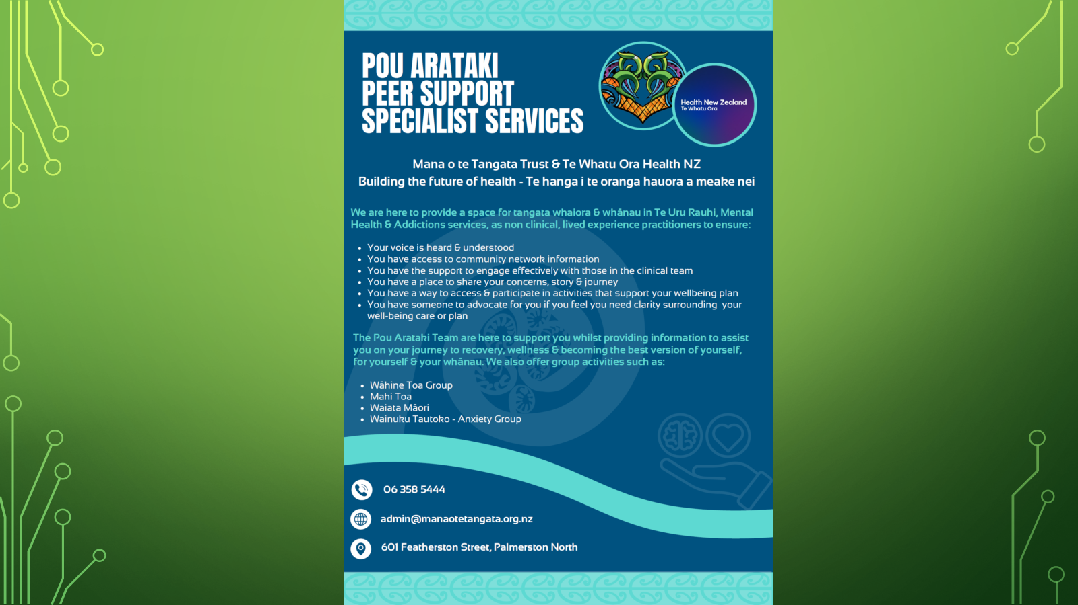

Slide 18
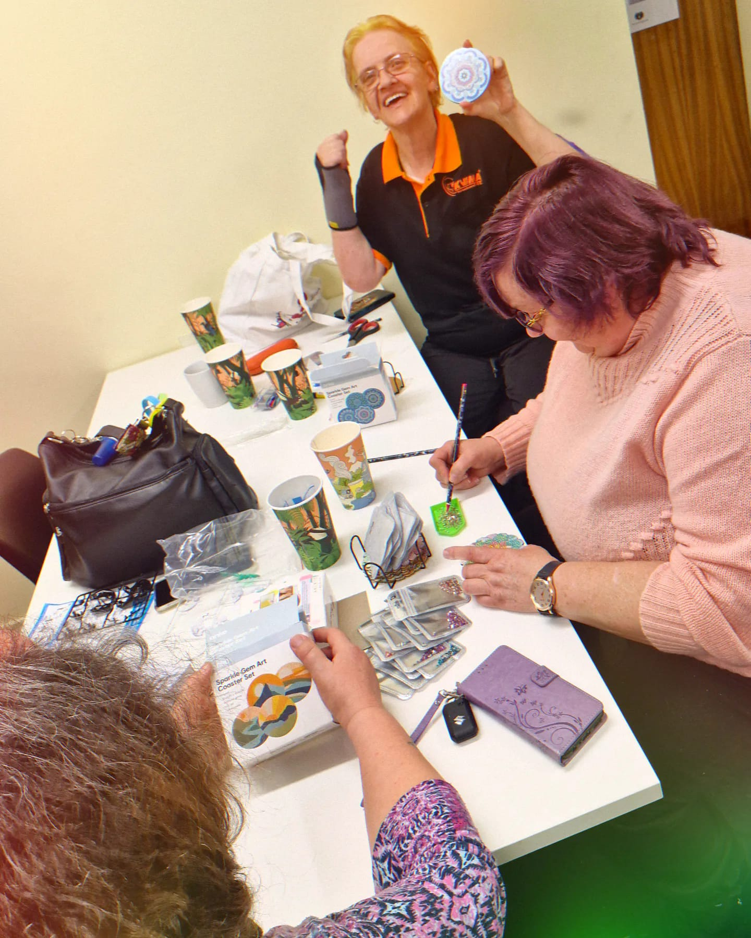
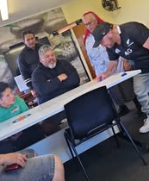
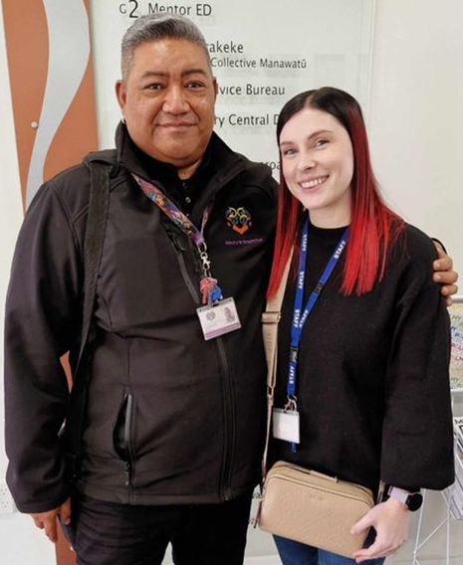
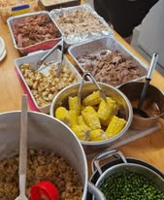
Te Puna Wai

Slide 19
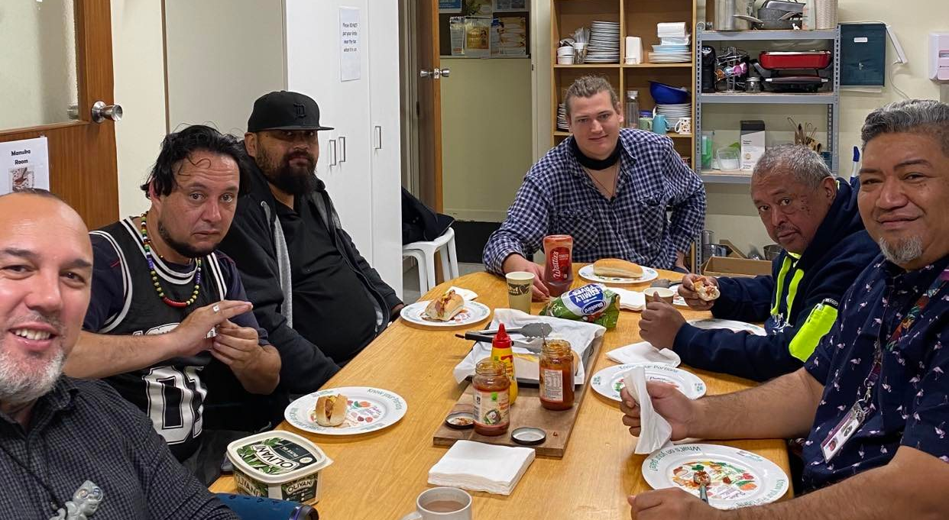
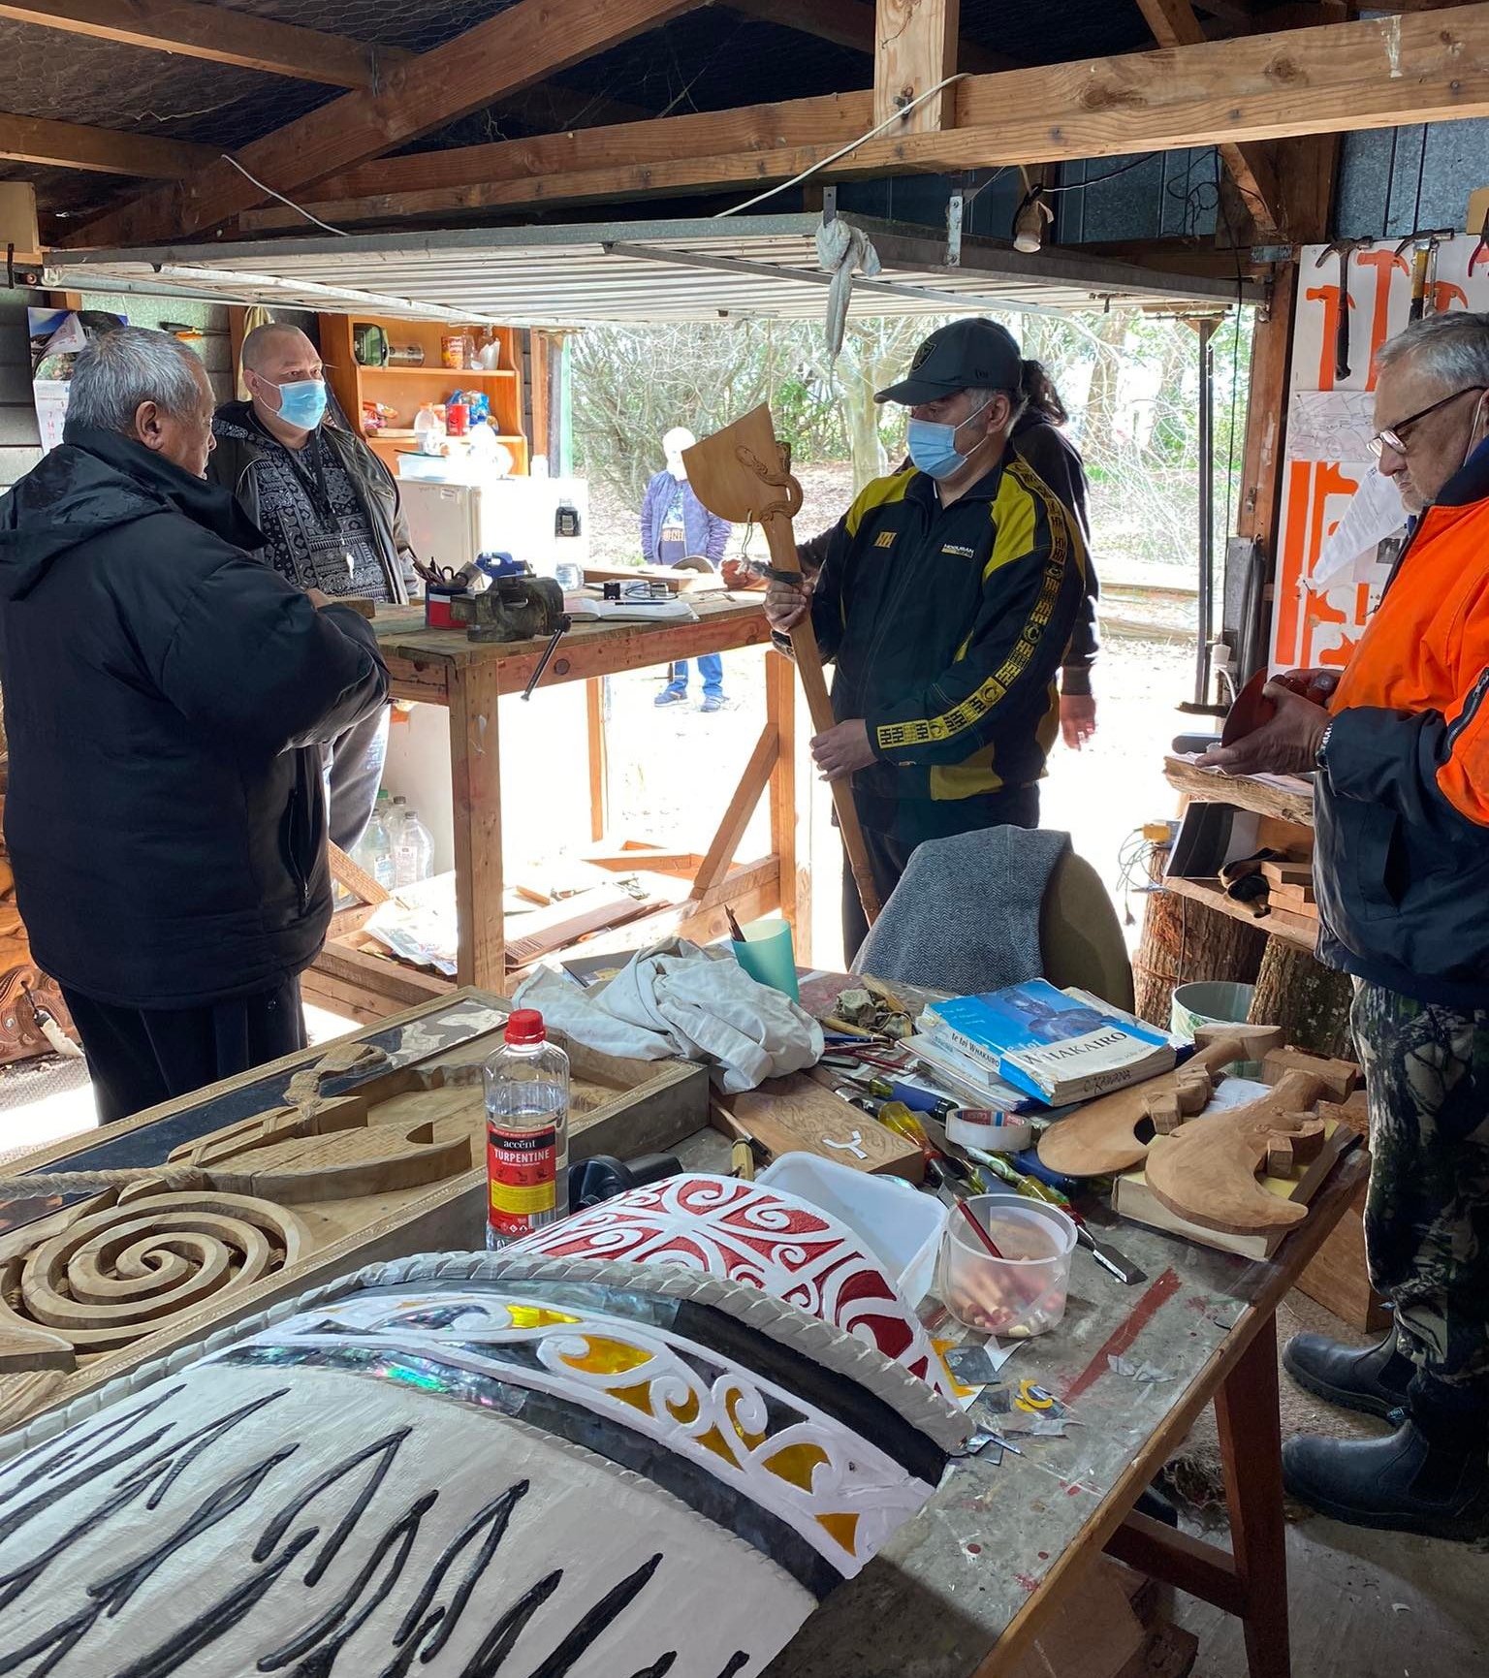
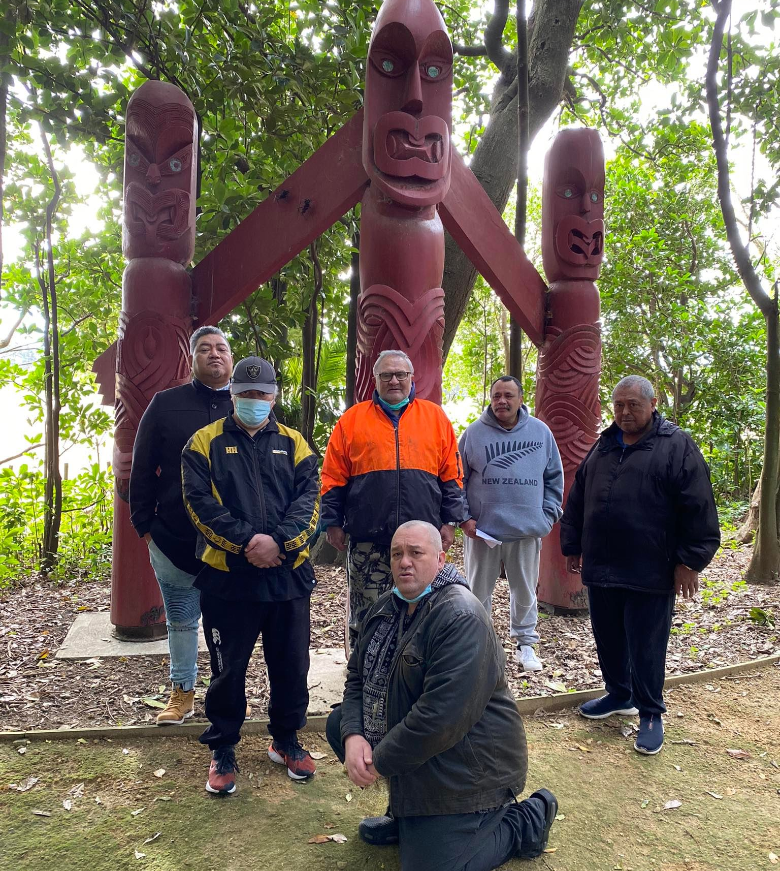
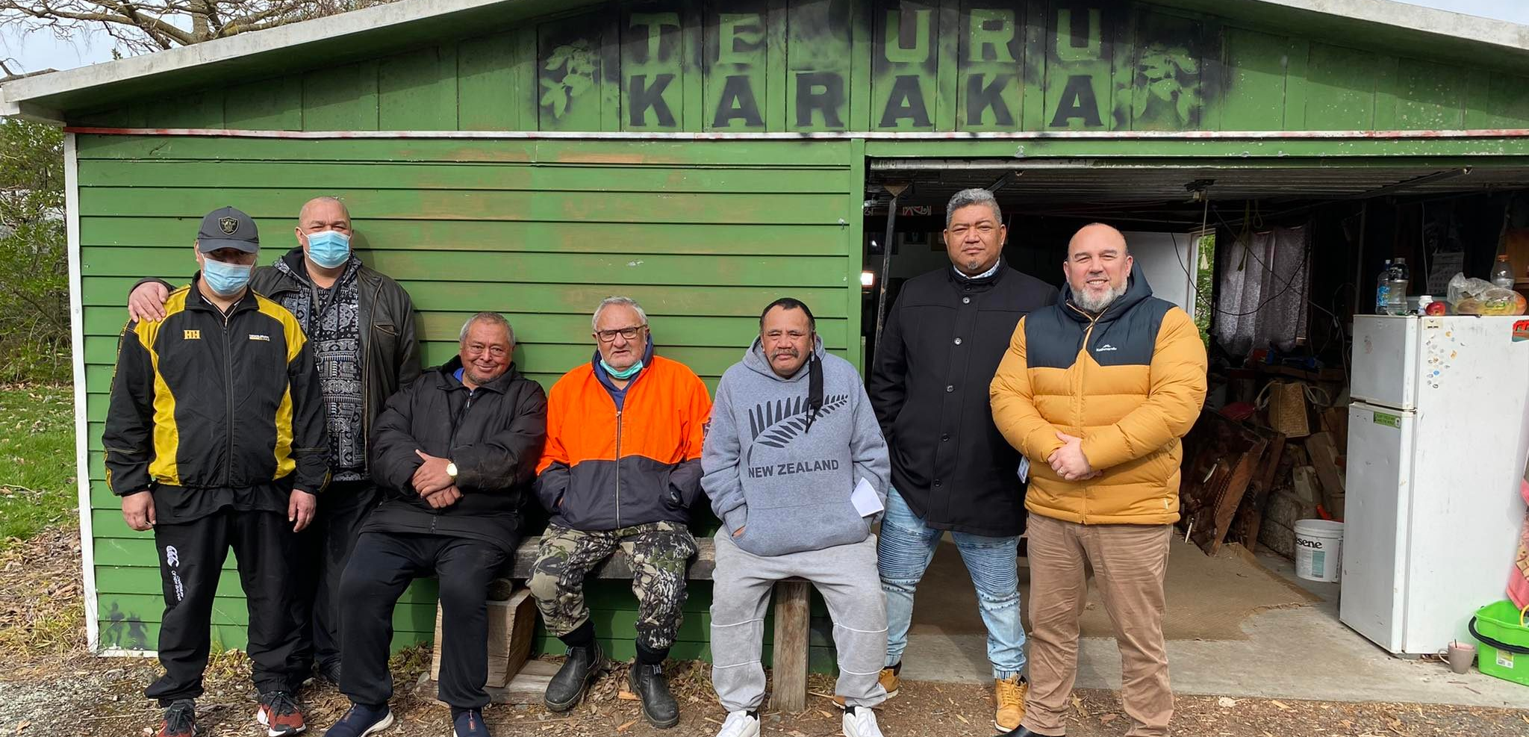
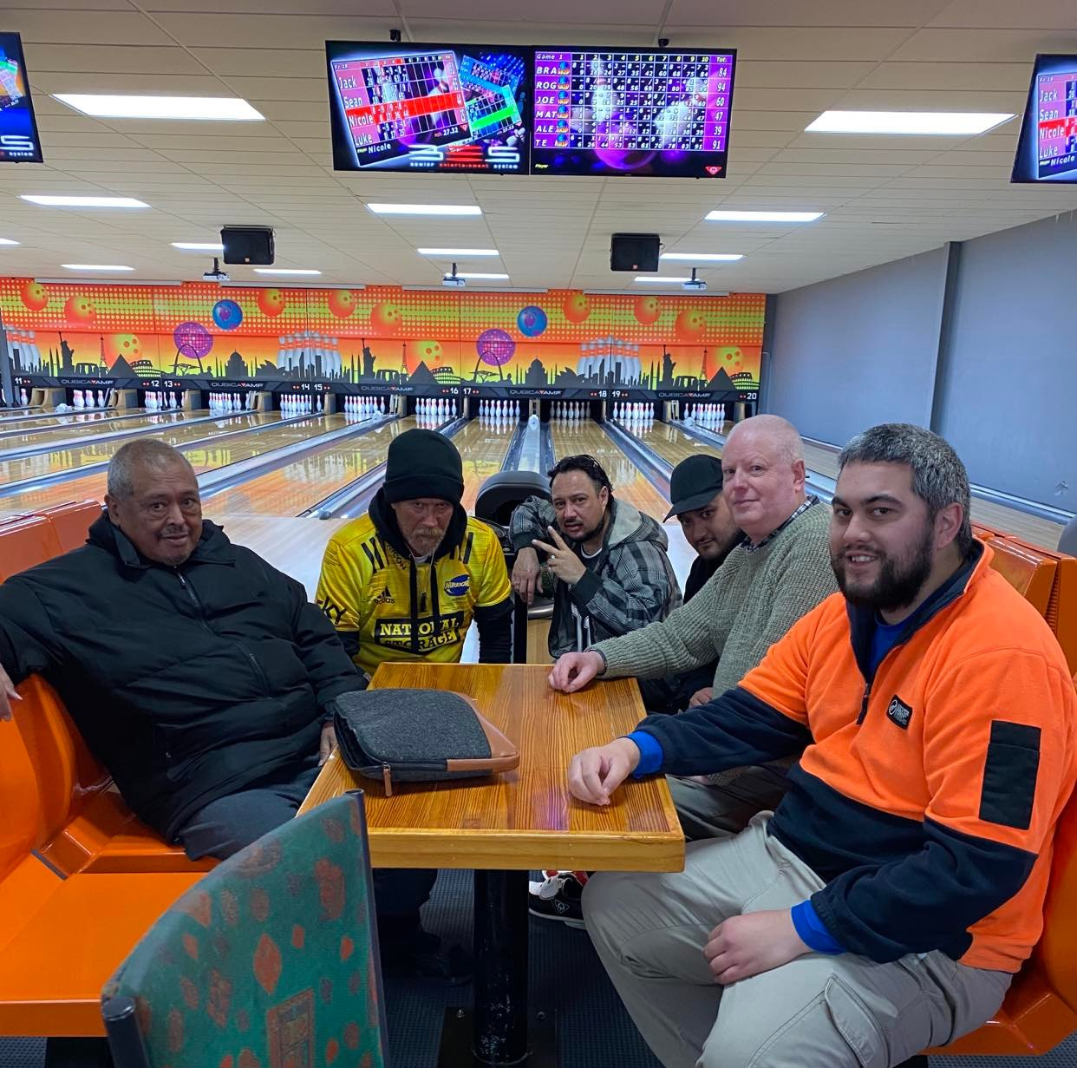
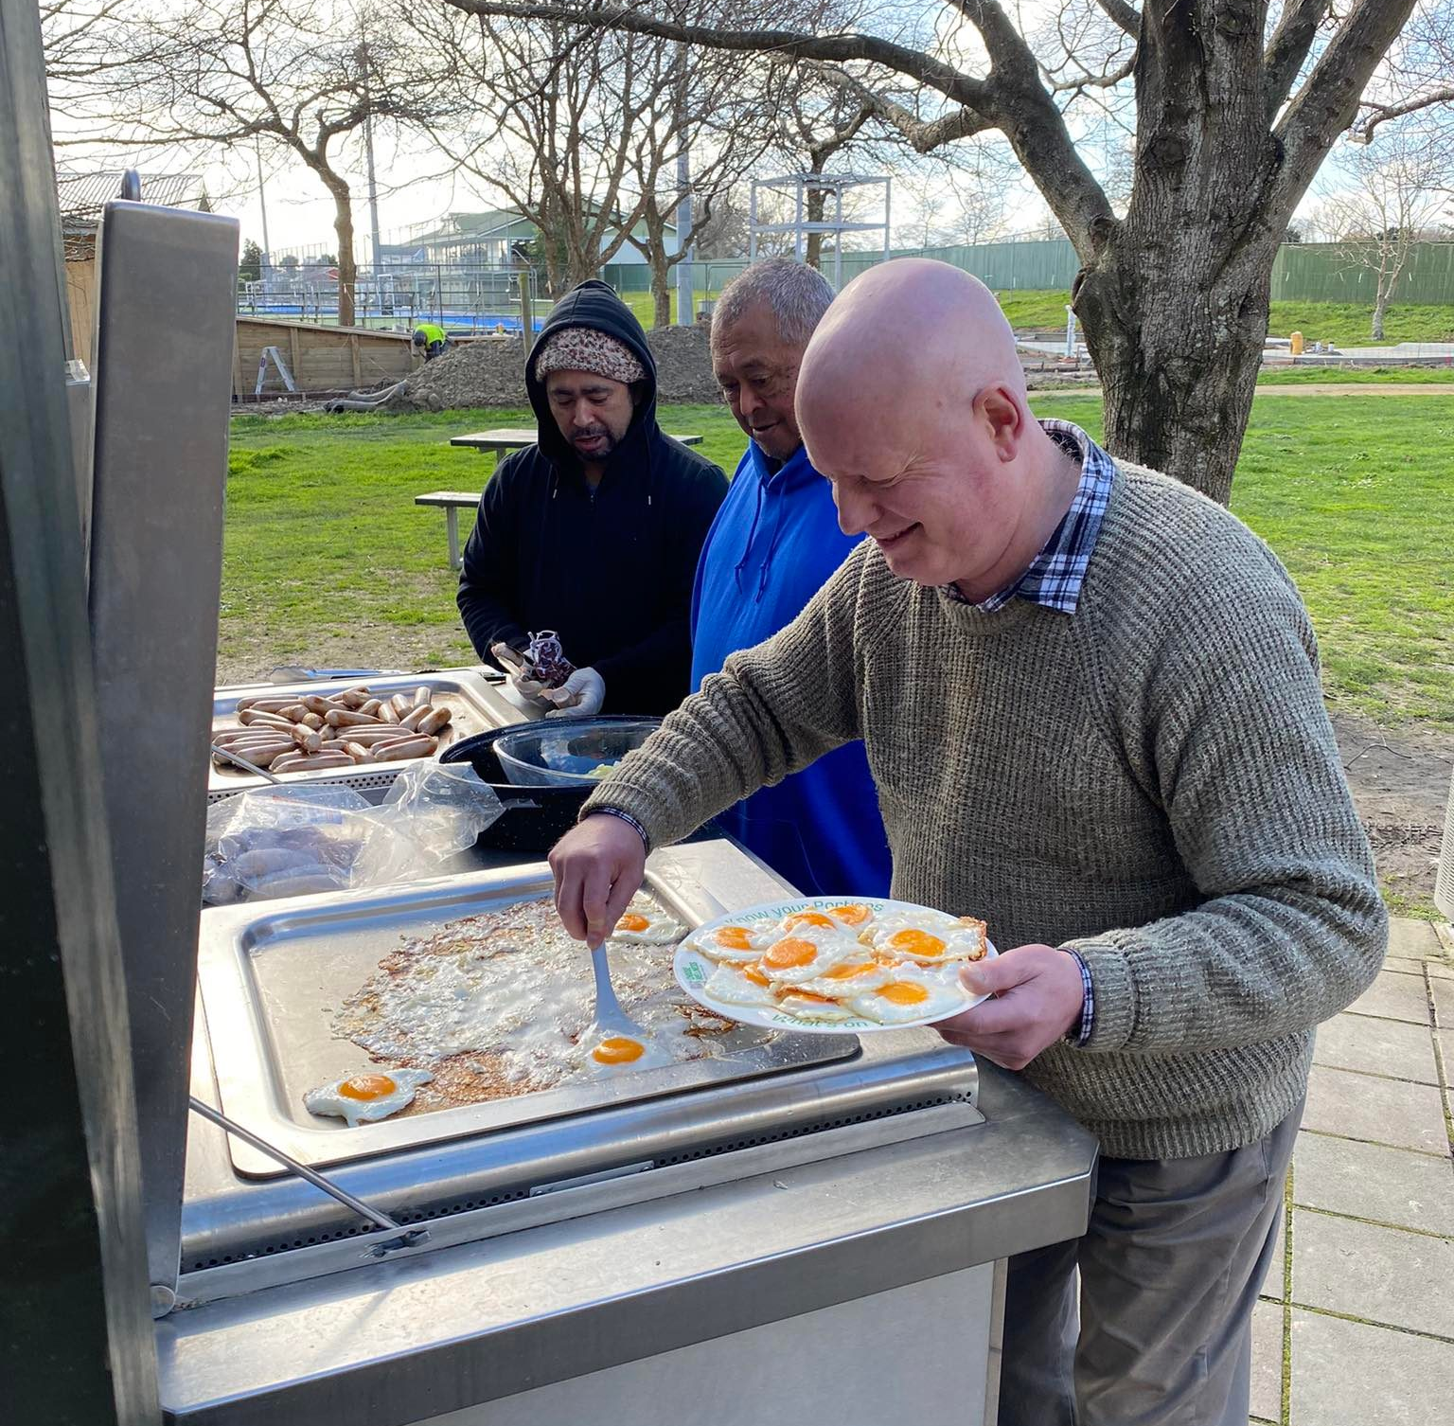
Tāne Tū Tāne Ora Mens Group

Slide 20
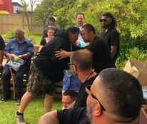
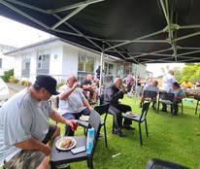
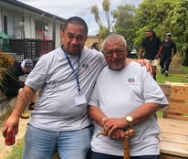
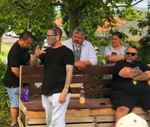
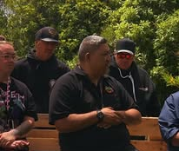
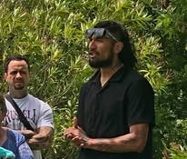

Slide 21
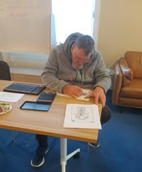
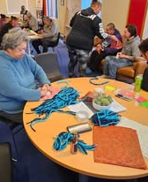

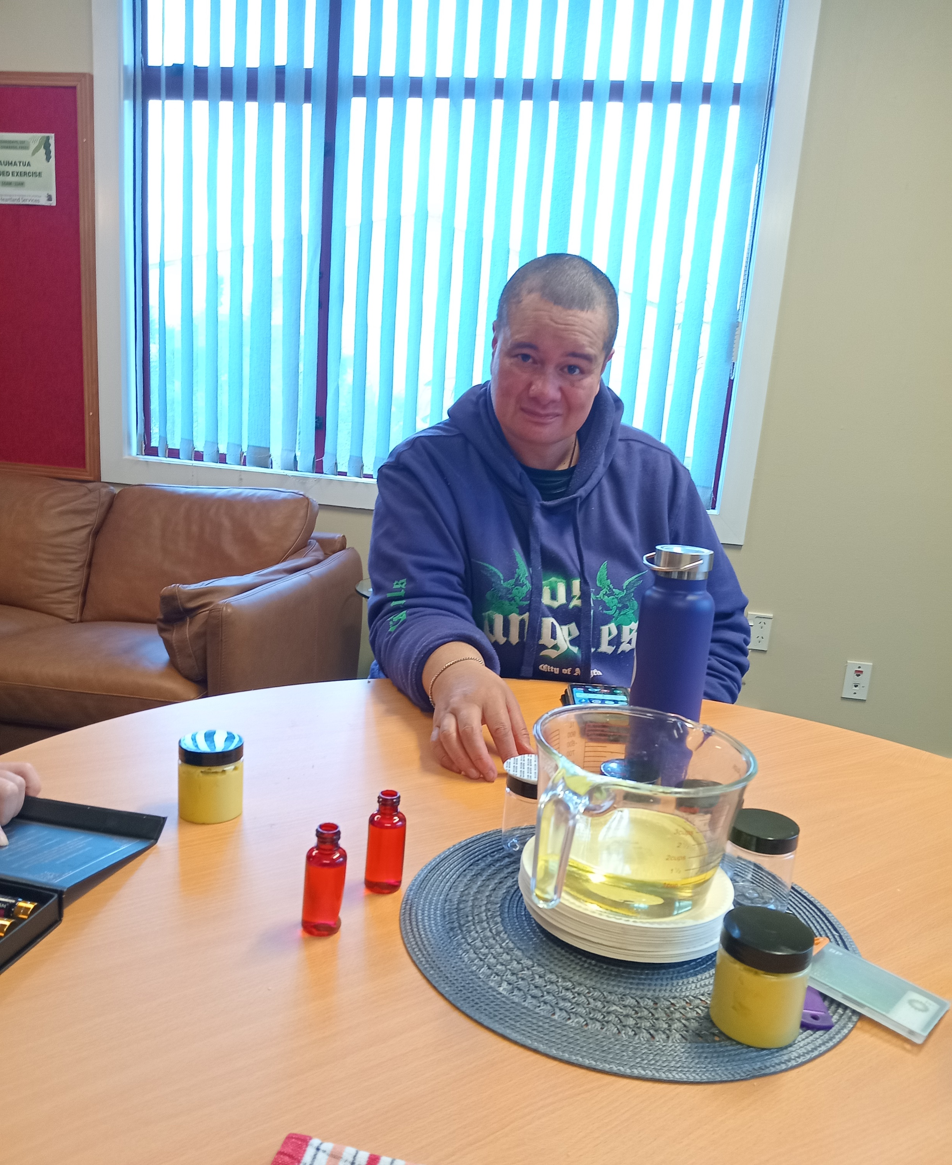
Horowhenua kaupapa

Slide 22
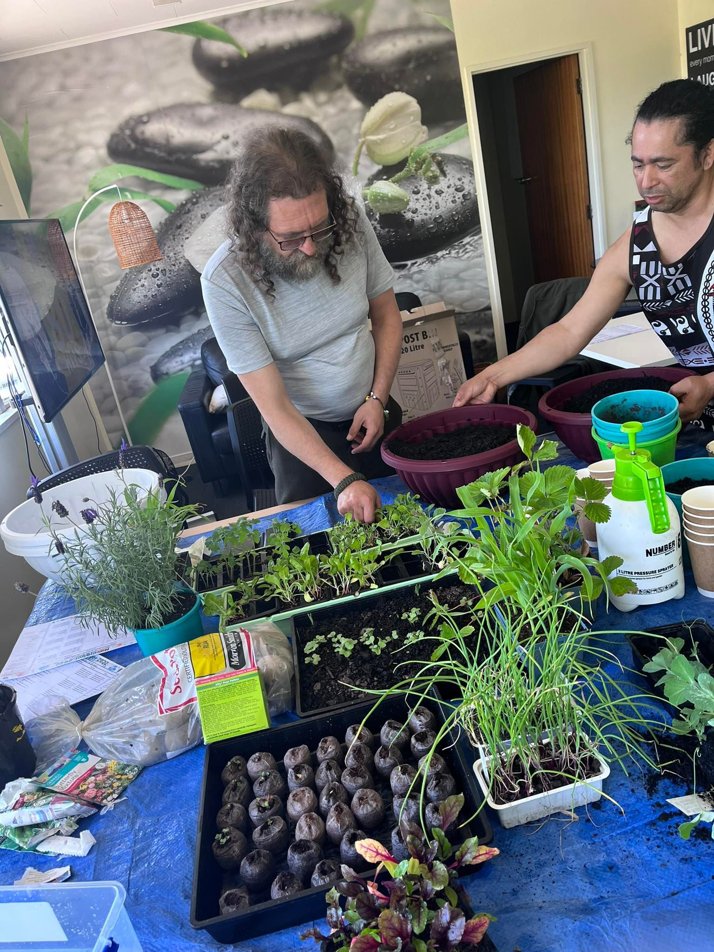
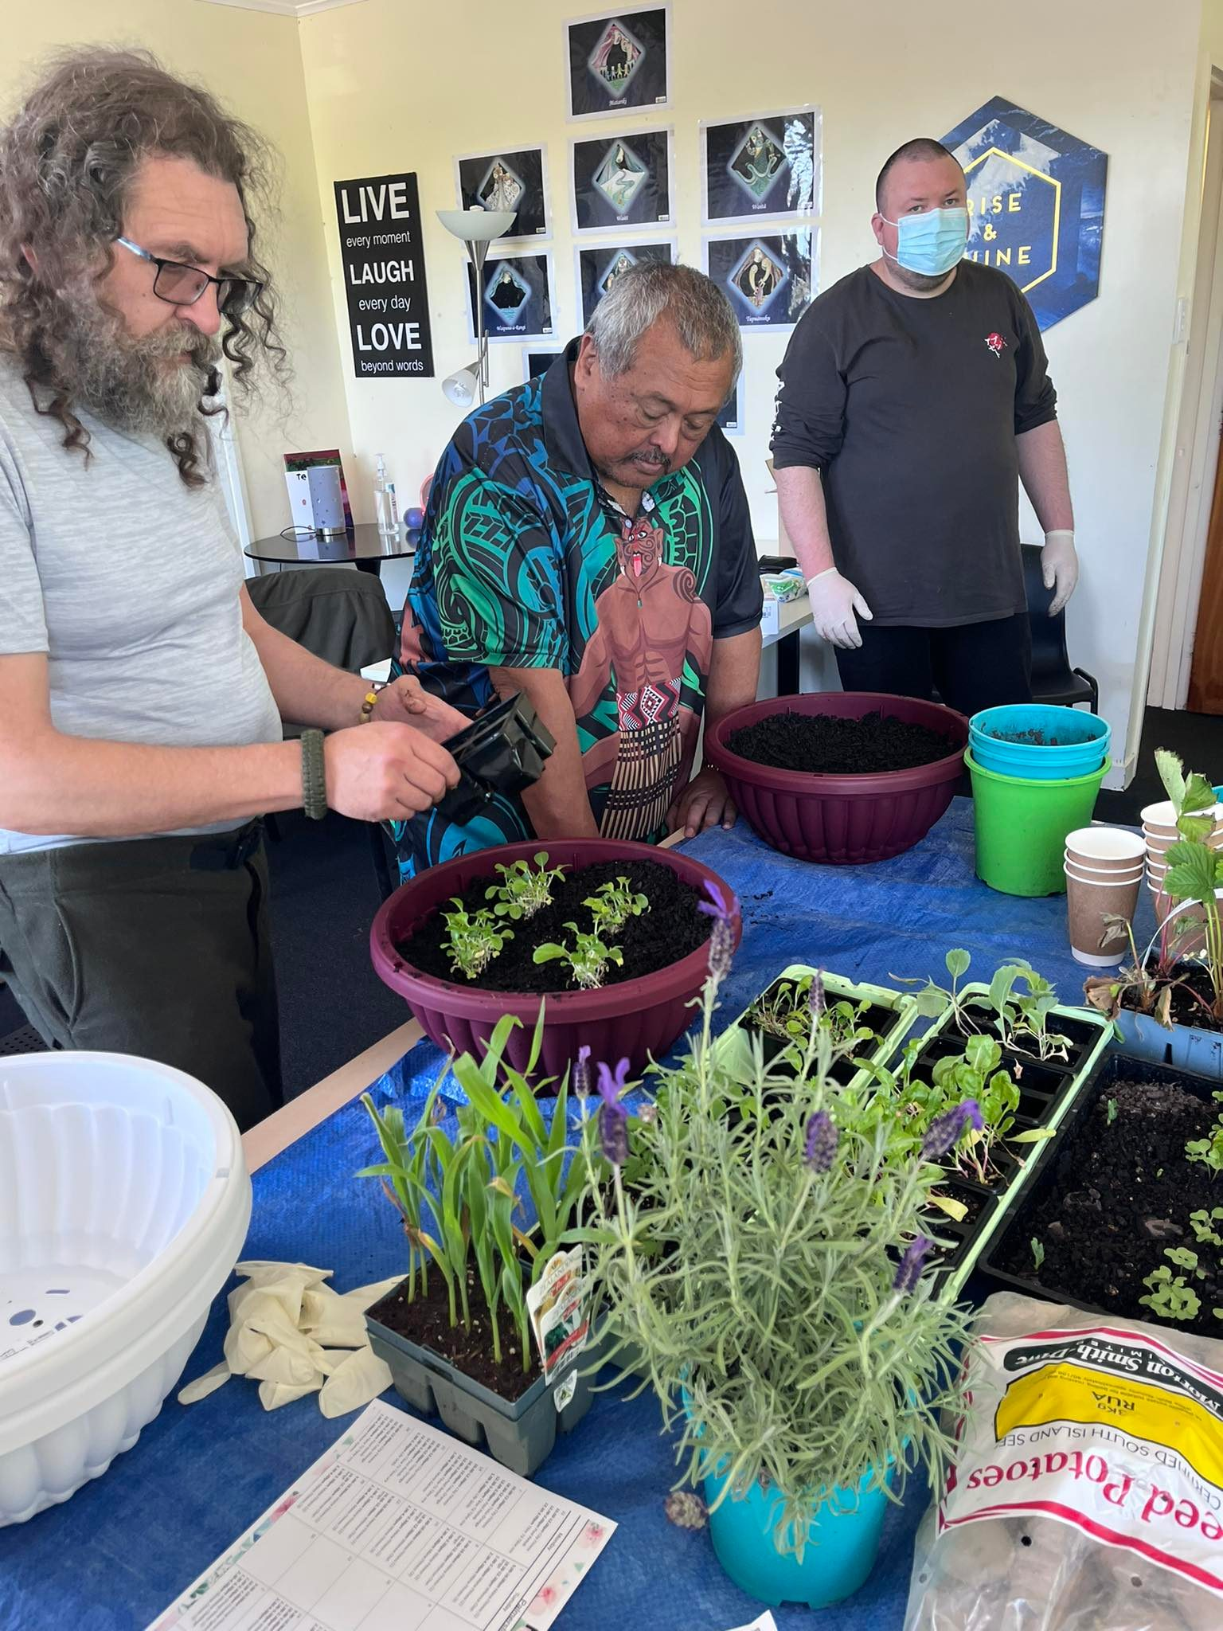
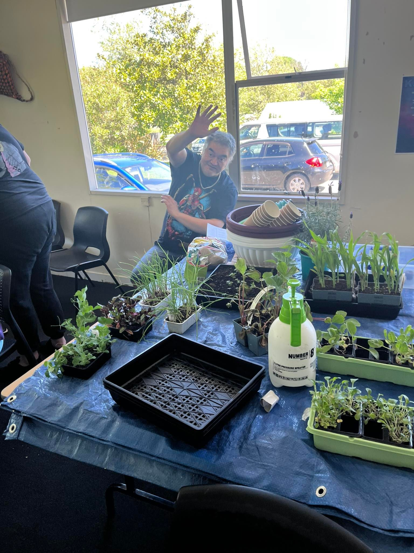
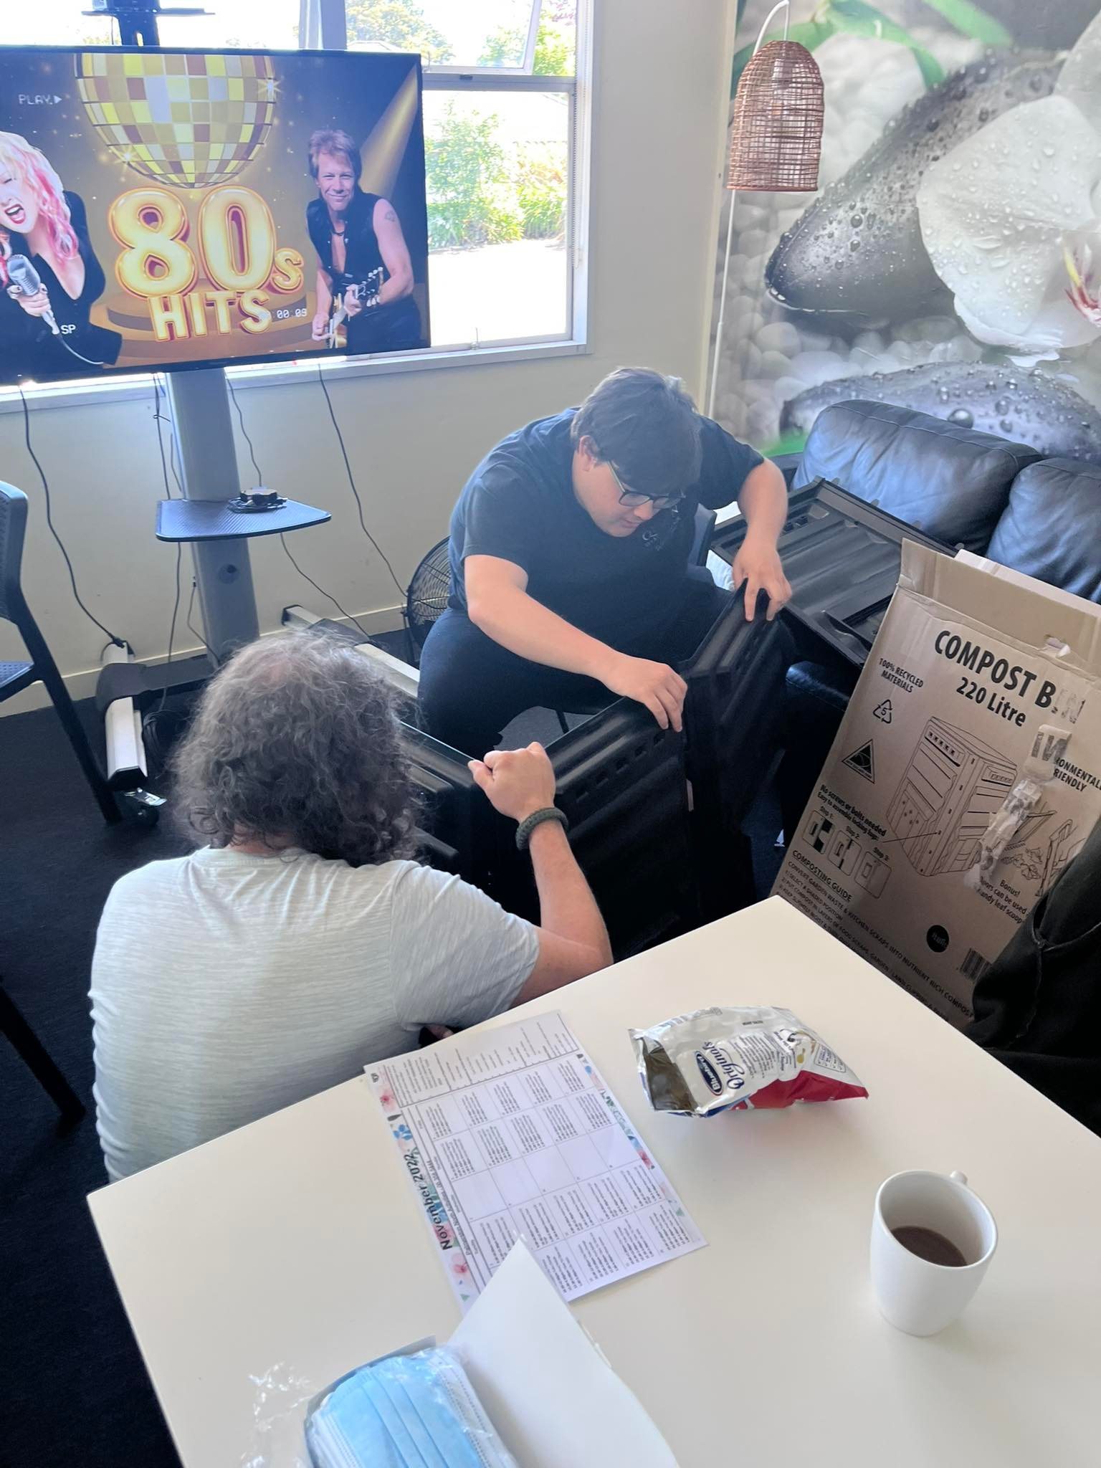
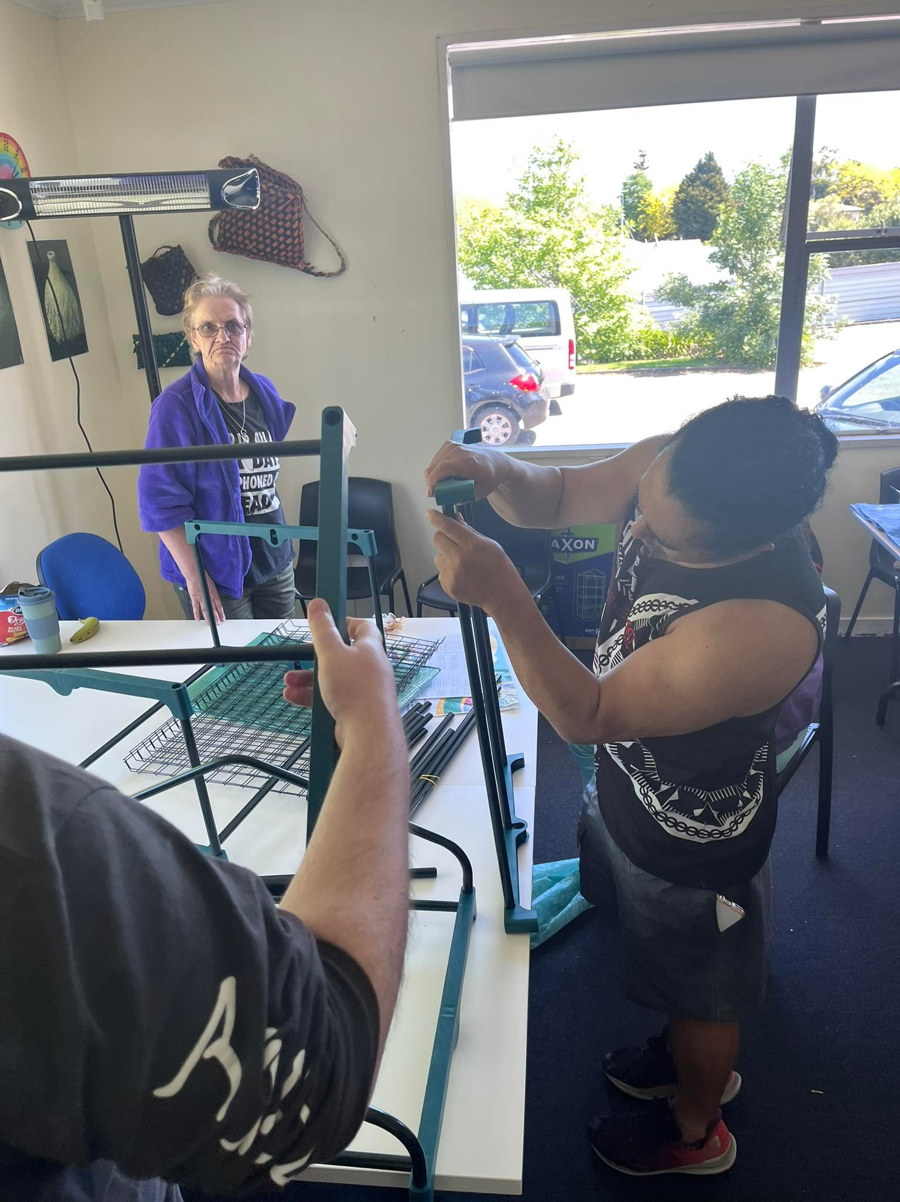
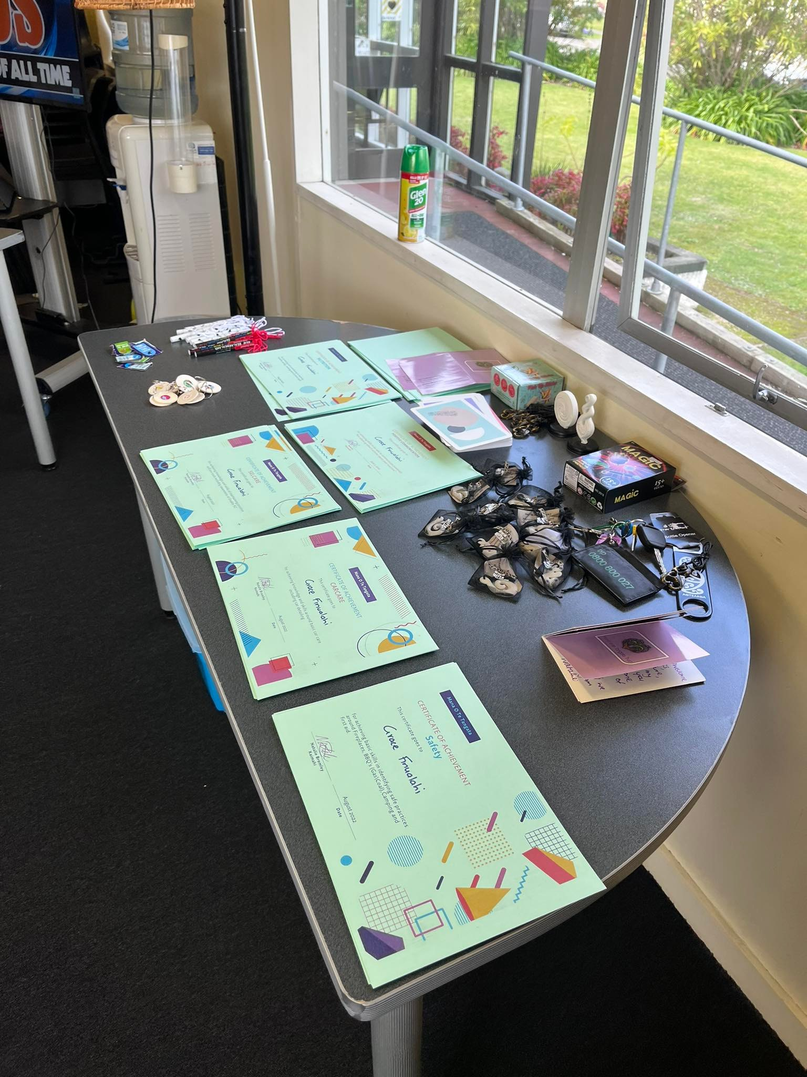
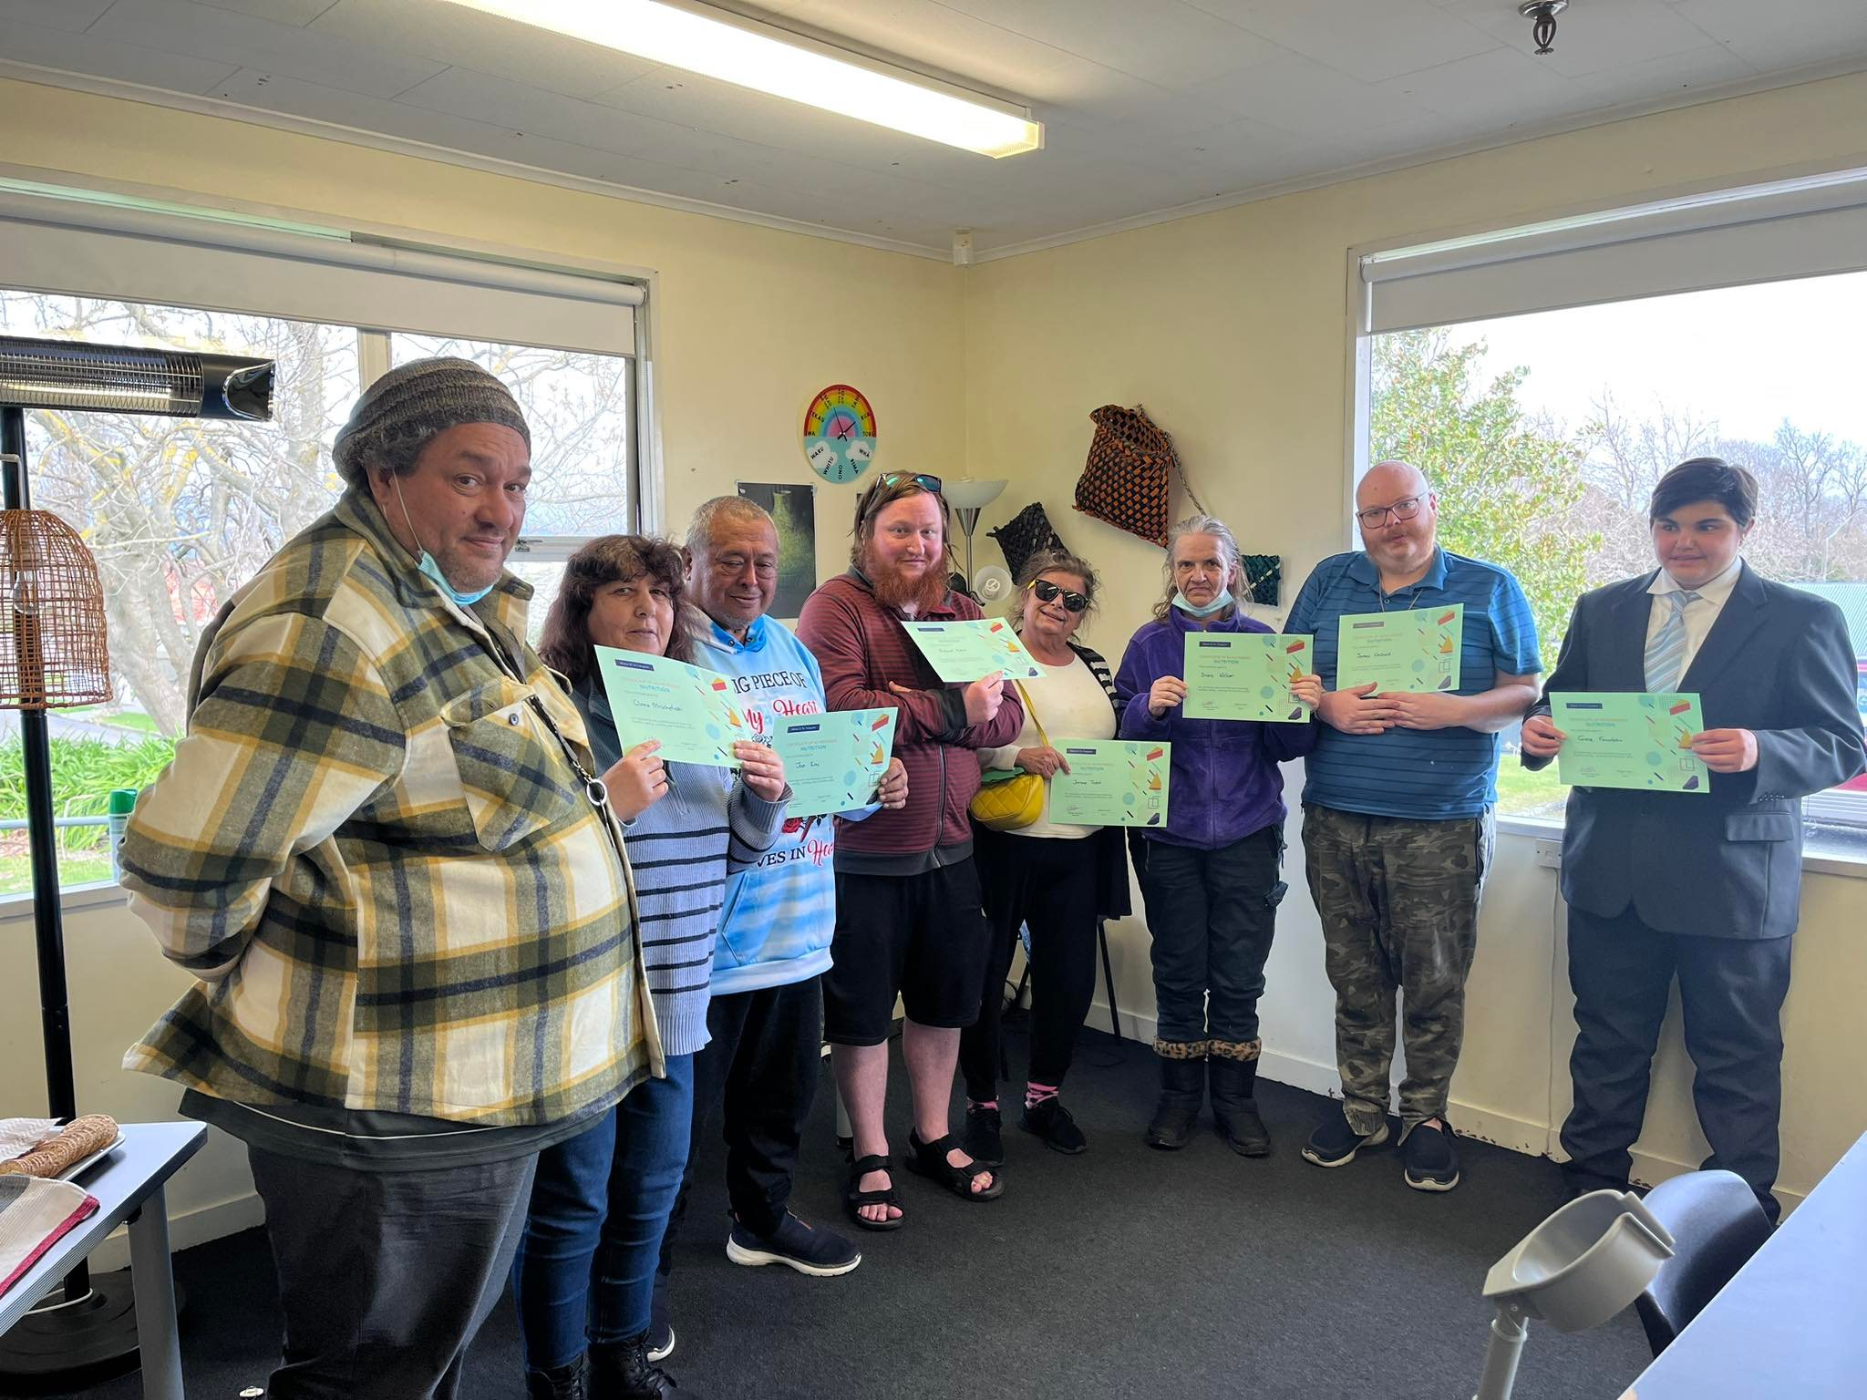
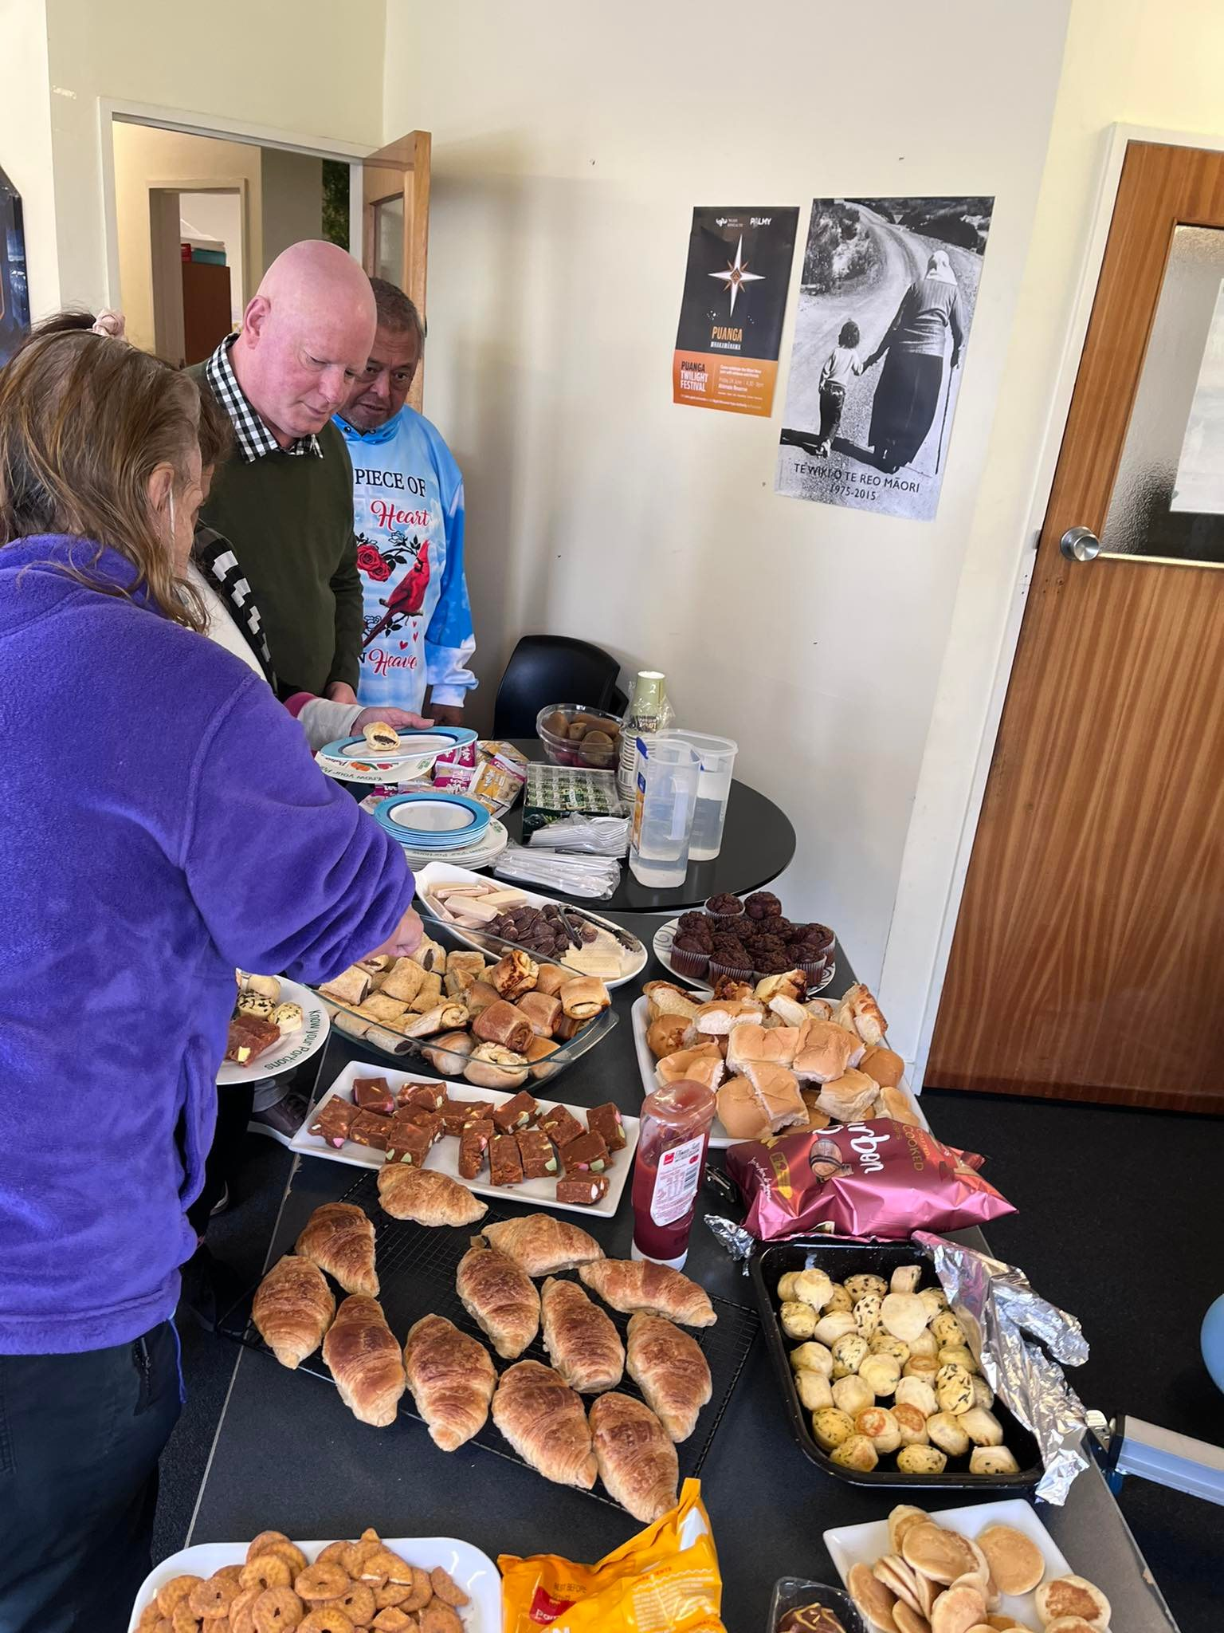
Whenua Challenge

Slide 23
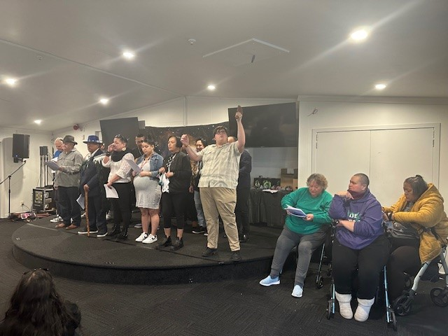
Waiata Maori

Slide 24
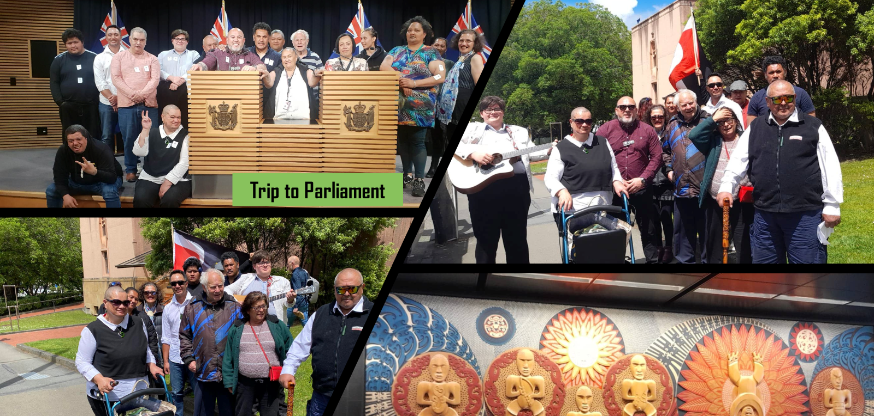

Slide 25
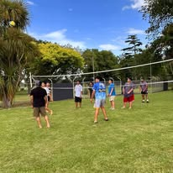
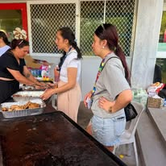
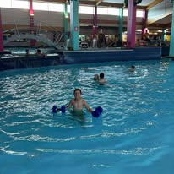
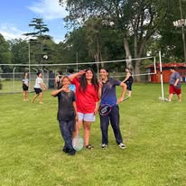
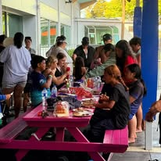
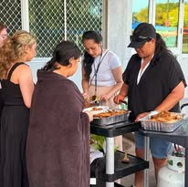
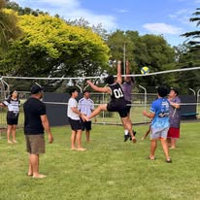
Rangatahi

Slide 26
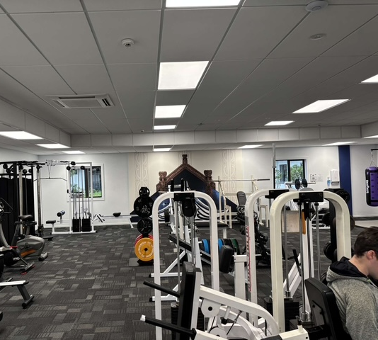
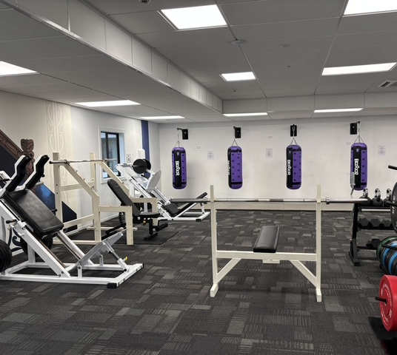
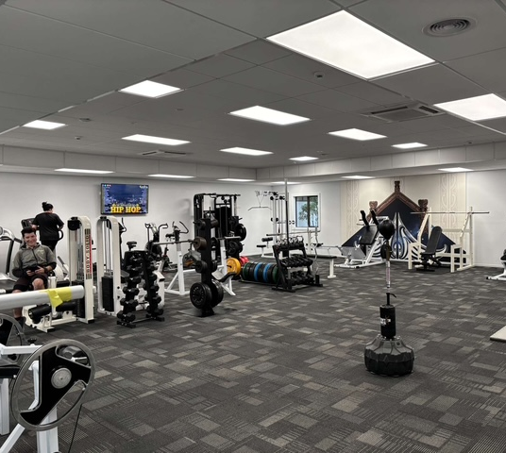
Te whare waimanawa

Slide 27
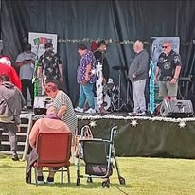
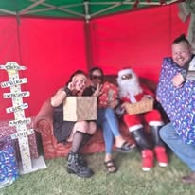
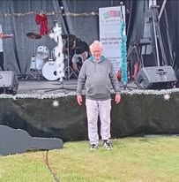
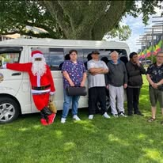

Community Events

Slide 28
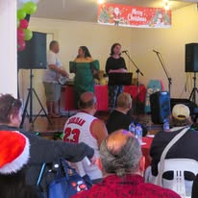








Christmas celebration

Slide 29






Slide 30




Team building

Slide 31








Lived Experience Symposium 2024

Slide 32



Networking & Collaboration

Slide 33

KOTAHITANGA

