Slide 1
Lived experience voice in Co-design and as part of system change.
“You are the expert of your experience”
By Jordyn Williams and Paul Clements

Slide 2
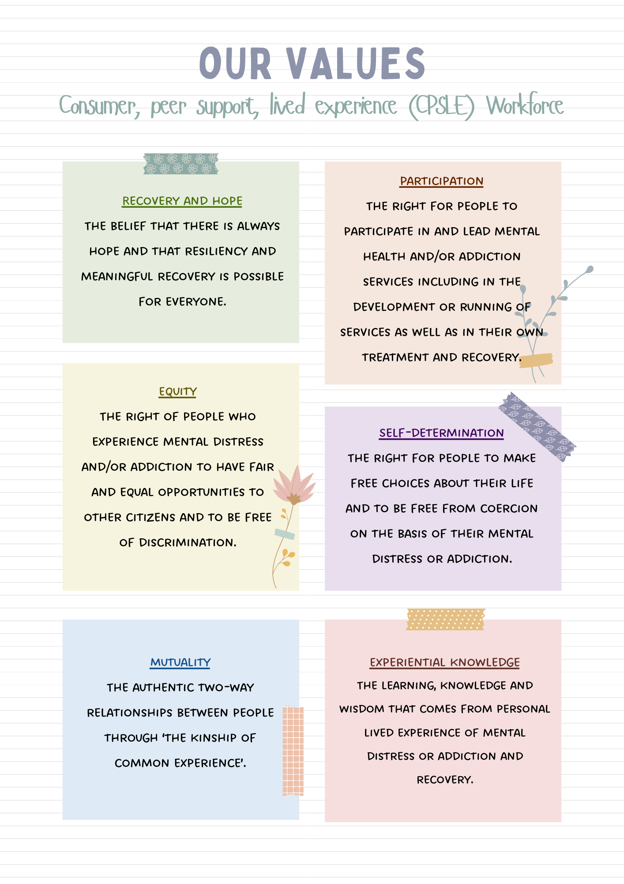
YCPSLE workforce
YCPSLE values
Youth
Consumer
Peer
Support
Lived
Experience

Slide 3
Whaiora / client centred approach
For us to better our outcomes and effectiveness of our service, we must shift to a “client – centred approach”.
To do that, we have to involve the service users in every step of the way!
It’s essential… if we want to hit our KPI’S - lol

Slide 4
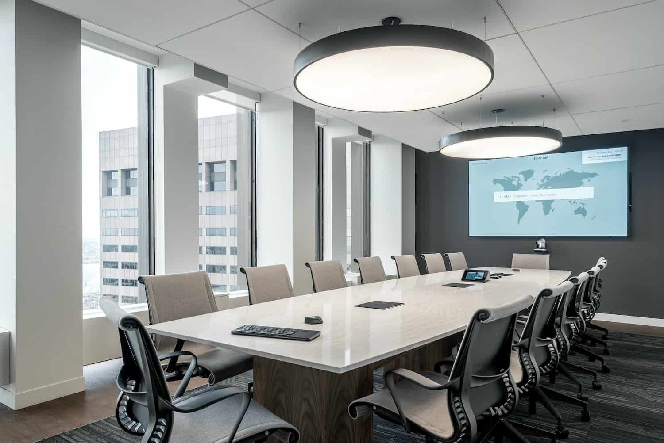
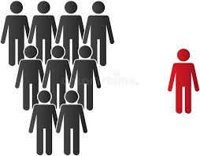
Service users excluded from the conversation

Slide 5

Co-design involvement
Involved in…
EVERY
step
of
the
way

Slide 6
How does this happen?
As a Youth Consumer Lead:
Creating and reviewing resources, ensuring relevance.
Advocating for youth needs and wants.
Bringing the youth lived experience perspective to process and service development and change.
Supporting and advocating for a consistent whaiora focused approach.

Slide 7
…

Slide 8

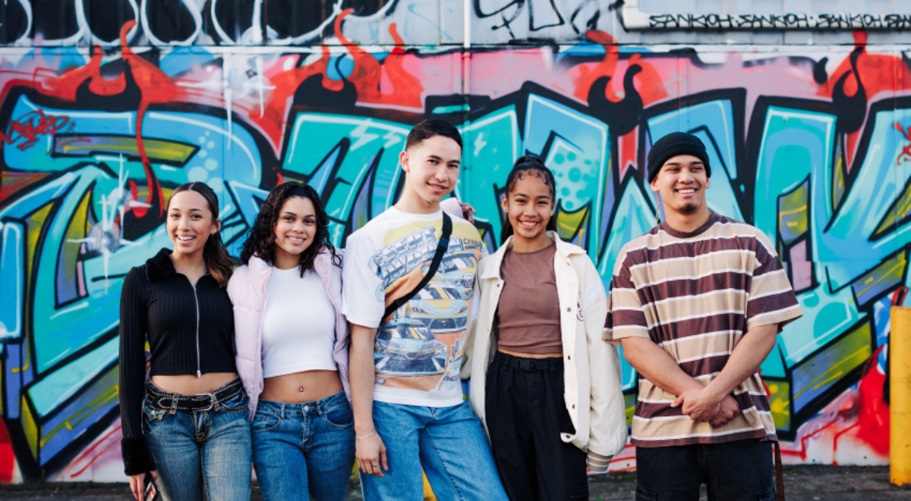
Whāraurau is one of the seven Impact Services within UniServices, a wholly-owned, not-for-profit entity of the University of Auckland.
Built on evidence-based research, these Impact Services are recognised as leaders in their field, delivering social, health and economic benefits through education, public health, innovation, and informing public policy.
NYCAN:
National
Youth
Consumer
Advisor
Network

Slide 9
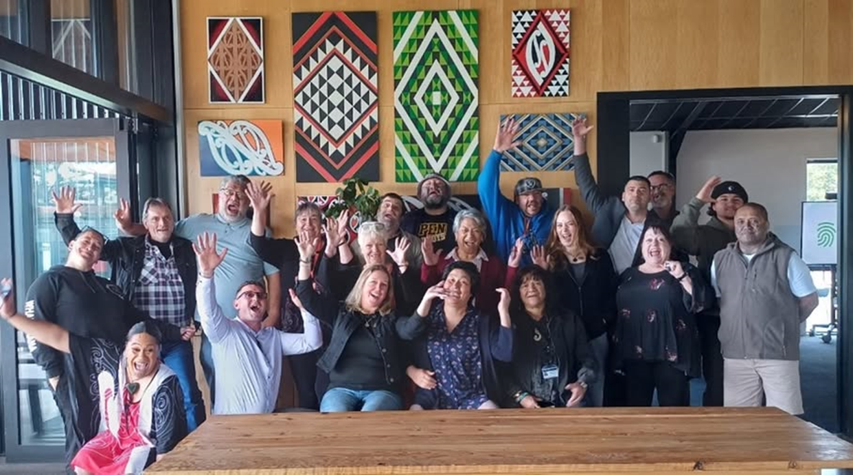
Te Pou – CPSLE workforce
Te Pou is a not-for-profit, national workforce development centre. We aim to improve the lives of people with mental health, addiction, and disability needs by connecting the people working with them, tāngata whai ora, tāngata Whaikaha and their whānau, with knowledge, resources, training, and information.

Slide 10

Local in-service sessions

Slide 11
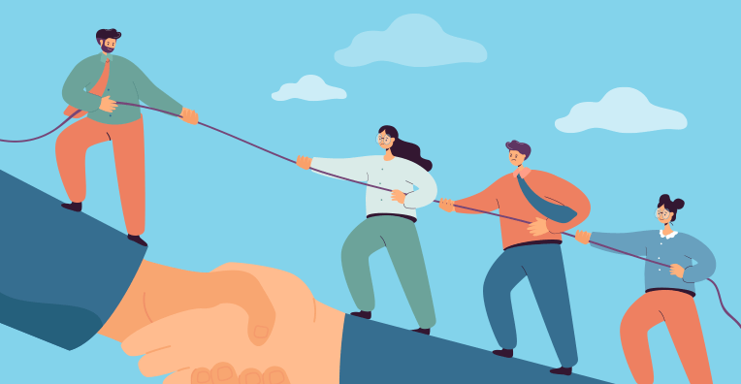
Gaining leadership support
Leadership support = Higher impact
Bringing ideas to leadership first, ensures that when they’re introduced to the wider team, they hold more weight and are more effectively embedded within the team.

Slide 12
Youth Peer Support Workers
Better engagement = better outcomes
Shifting clinician mind sets.

Slide 13
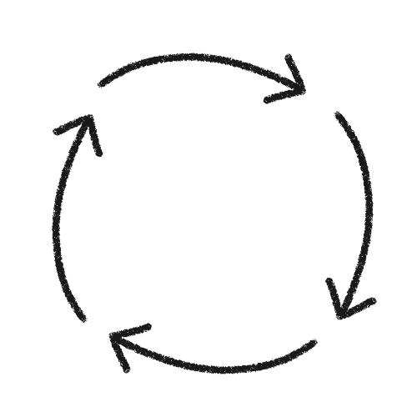
Cycle of continuous improvement
The person-centred mind set and goal oriented support of YPSW’s, means…
Client feels heard and appreciated, which leads to…
Better engagement, which leads to…
More effective therapy, which leads to…
Better whaiora outcomes and experiences, which leads to…
Better understanding of LE roles from kaimahi (staff/clinicians) due to seeing positive impact, which leads to…
Clinicians actively seeking out YPSW involvement
And then the cycle repeats…

Slide 14



Risk of ignoring lived experience
You may be thinking…
“Well, isn’t co-design just extra work for those who already know what they're doing??”
“What about the young people who are considered a risk – shouldn’t professionals being making the decisions for them?”
And I hear you. But…
What happens when we don’t listen… and a young person has to pay the price of our unintentional mistakes?

Slide 15

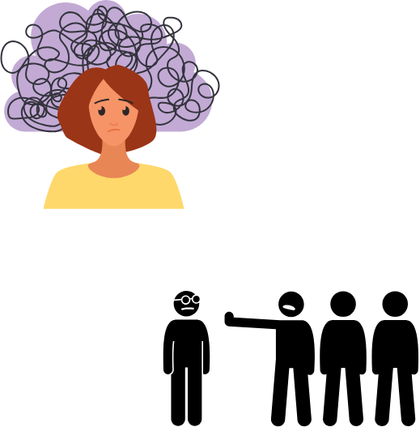
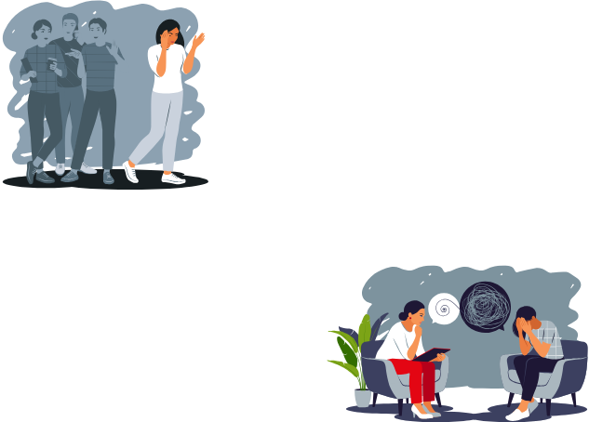

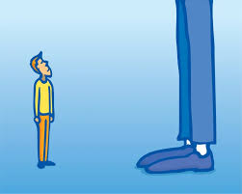
My personal experience

Slide 16
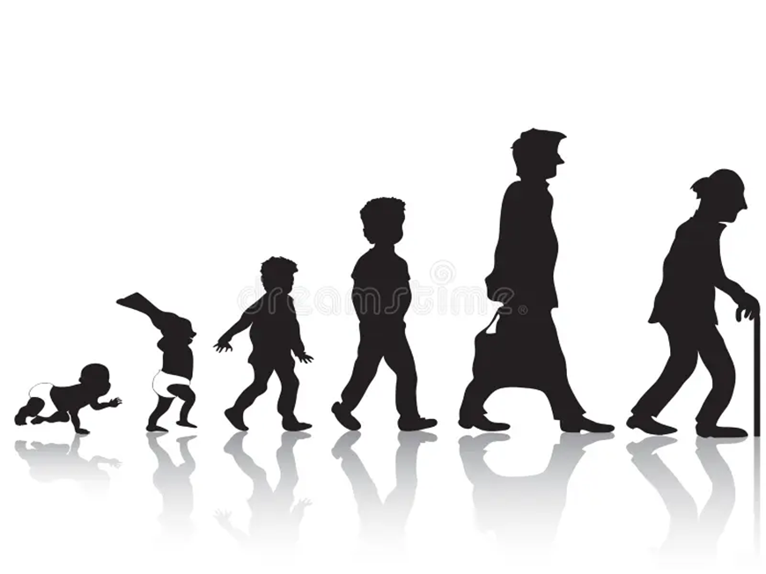
Adult services
They disengage.
Labelled as “hard to reach”.
They lose trust.
And in worst case scenarios, end up being lost to the system.

Slide 17

When services don’t align with the whaiora’s needs, they fail them.
Which leads to them feeling:
Unheard
Unseen
Unsupported

Slide 18
Youth co-design isn’t a luxury – its ESSENTIAL

Slide 19

In Northland, we are already seeing the positive impact…
Real feedback
Higher engagement
Stronger whaiora-clinician relationships
More effective resources
Better outcomes overall
“always helpful and caring people”
“always so nice to people. Are always there for people”
“Made my day better”
Always showing people that you care about their mental health

Slide 20

Lived experience isn’t just something to acknowledge- its something to embed.

Slide 21
Before i say my goodbyes...
A video recommendation from the NZ queen of lived experience herself
and
2 quotes

Slide 22
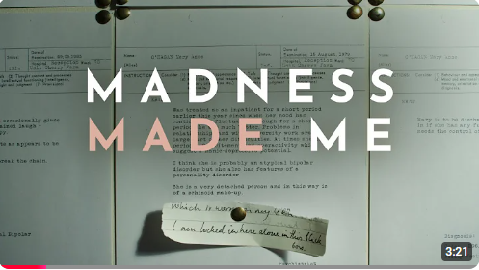
Madness made me – Mary O’Hagan
A hugely powerful short YouTube clip talking about Mary’s personal lived experience
-highly recommend!

Slide 23
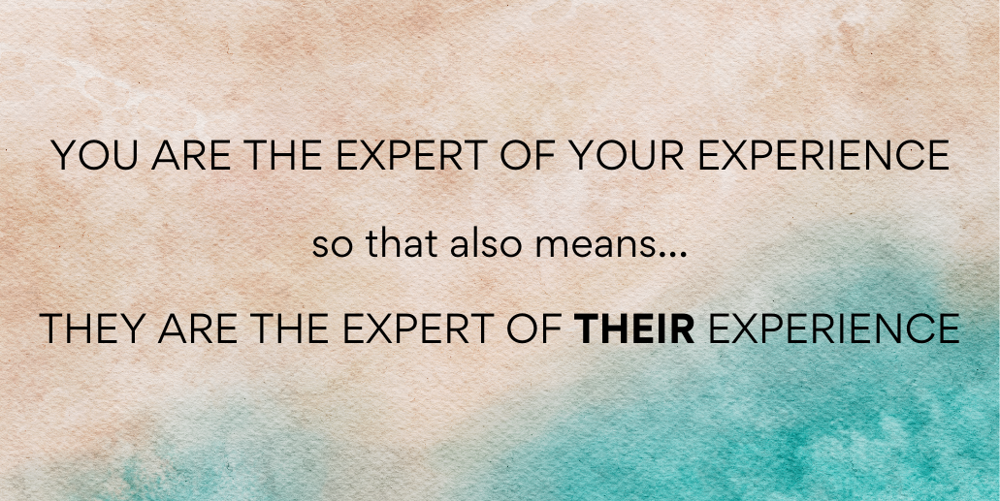

Slide 24
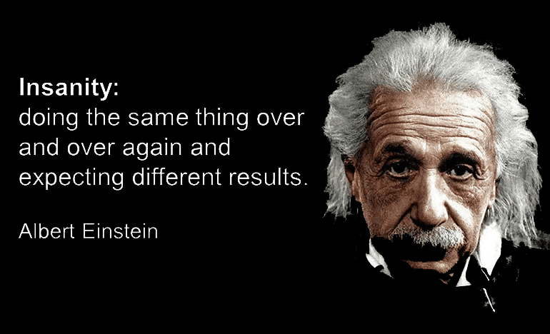
How can we expect change, if we don’t first implement it ourselves.
It wont to hurt try : )

Slide 25
My final message to you...

