Slide 1


CHIRP in the Hutt
Child Health Integrated Response Pathways Meeting
Dr David Chinn, Child and Adolescent Psychiatrist, ICAFS
Stacey Jamieson, Team Leader, ICAFS
Dr Jess Allen, Community and Developmental Paediatrician

Slide 2

Overview
What and who is CHIRP?
Why CHIRP?
Describe how CHIRP works with examples
Positives and challenges of CHIRP
Learnings from CHIRP
Is CHIRP for you?

Slide 3
What is CHIRP (Child Health Integrated Referral Pathways)?
CHIRP is a structured weekly interagency meeting
Runs 8-9am every Friday
Face to face with zoom option
Standing invitee list
Terms of reference
Discuss referrals for children presenting with complex behavioural/developmental/emotional issues
Example GP referral discussed - Can you please see Miss S a 7 year old, her mother is concerned she has symptoms of ASD, ADHD and anxiety.

Slide 4
Who attends CHIRP?
Members | Child Development Service Team Leader and/or rep Paediatric Outpatients - Associate Clinical Nurse Manager Infant Child Adolescent and Family Mental Health Service (ICAFS) Oranga Tamariki Hospital Liaison Social Worker Resource Teacher Learning and Behaviour (RTLB) cluster managers Ministry of Education Learning Support Service Managers Public Health Nurse representative Gateway coordinator Gateway/Developmental Paediatrician Yourway Kia Roha service co-ordinator Guests and students on request

Slide 5
Why CHIRP?
Our Purpose For the individual/ whānau | Ensure referral goes to most the appropriate service Reduction of number of appointments Reducing inequity of access Creating clear pathways to a coordinated multi-agency response

Slide 6
Why CHIRP?
Our Purpose For services | To provide a forum for discussion of referrals to ensure referrals go to most appropriate services Reducing waiting lists by ensuring the right referral pathway is used Reduce and identify service gaps Education about service entry criteria Increasing service collaboration

Slide 7
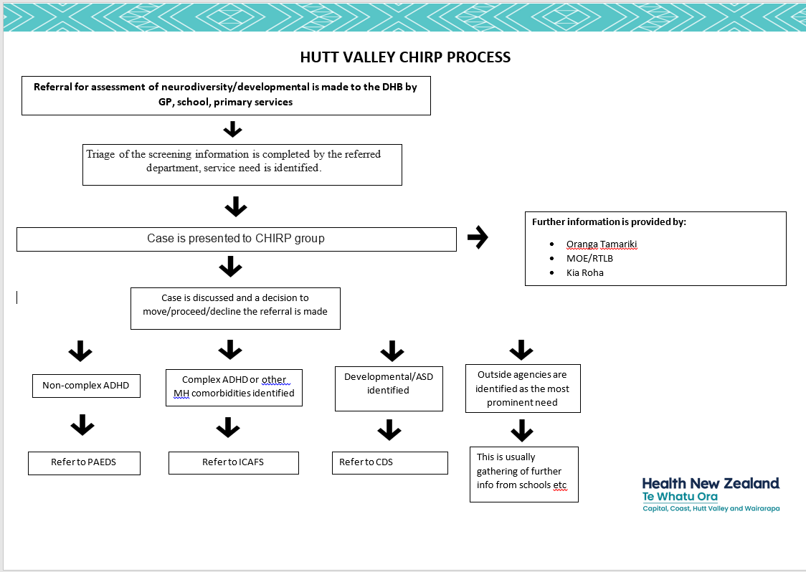

Slide 8
Format of CHIRP
Opening karakia
Introductions/whanaungata for new members
Everyone gives number of cases/questions
Cases
Service updates
Closing karakia

Slide 9
Consent
Most often we have consent from parent/caregiver
With consent we still provide the minimal amount of info to answer the question
If care and protection concerns exist then we can share information without consent when in the best interest of the child

Slide 10
Types of questions/cases
Is X known to any services?
Where is X on the waitlist?
X has been referred with ADHD are they known to Oranga Tamariki or Education?
We are having trouble locating X, are they attending school?
X is new to the area, have the appropriate referrals been made locally?
Who is the ICAFS clinician involved?
What is the email address for MOE psychologist Rachel in Stokes Valley?

Slide 11

Record keeping
When presenting give Name, Age, Dob, School and query
Note on single clinical portal with actions
Brief minutes/ actions shared with group

Slide 12
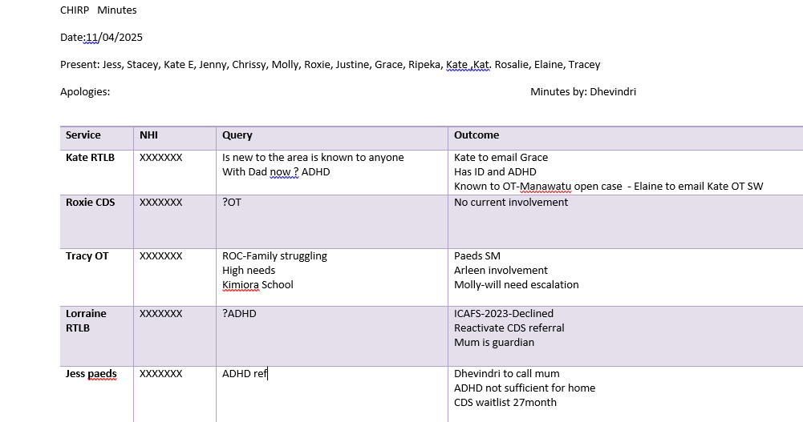

Slide 13
Number of Referrals Presented to CHIRP by month
Average 9-10 cases a week
Range 2-22

Slide 14
CHIRP - ADHD Assessment example
Paediatrics
(minimalist)
ICAFS
(comprehensive)
vs

Slide 15
Hutt Valley 6-15 Years
If likely uncomplicated ADHD, request non-acute paediatric assessment. Include a completed caregiver form.
If likely complicated ADHD:
with a co-existing developmental disability e.g., autism spectrum disorder, intellectual disability, refer to request non-acute paediatric assessment. Include a completed caregiver form in all referrals..
without a co-existing developmental disability, refer to Infant, Child, Adolescent and Family Service (ICAFS). Include a completed caregiver form in all referrals.
If ADHD-like symptoms in the context of emotional, sexual, or physical abuse or neglect, consider reporting to Oranga Tamariki and/or discuss with on call paediatrician
Hutt Valley 16-17 years
Refer to Infant, Child, Adolescent and Family Service (ICAFS). Include a completed caregiver form in all referrals.
If ADHD-like symptoms in the context of emotional, sexual, or physical abuse or neglect, consider reporting to Oranga Tamariki

Slide 16
Management for a Child aged < 6 years
The diagnosis and management of ADHD with medication is uncommon in this age group.
In general the efficacy and tolerability of medication is diminished, relative to older children
If suspicious of ADHD:
consider watching and waiting until early school years.
direct the parent or caregiver to useful resources
Incredible years
Triple P parenting programs
Whāraurau– Parent and Teacher Programmes/Te Taunaki Mātua Pouako
Evidence for diminished ADHD Sx and improved functioning with parent/family training
If any concerns about delayed or disordered development, with or without ADHD symptoms consider requesting Child Development Services.
If primary concerns about behaviour, without development concerns:
provide information about available social support, e.g. Birthright and Family Works.
For behavioural problems confined to preschool or school, encourage parents to discuss with the education provider in the first instance.
For mild to moderate behavioural problems, consider referral to a parenting programme

Slide 17
Caregiver form - Behavioural Information
Child’s Name: Date of birth: Ethnicity:
Name of school/preschool and year level:
Please describe what is concerning you about your child’s behaviour:
How does this impact on your child’s schooling and home life?
What (if any) interventions have been tried? (e.g., parenting programme, counselling)
Has your child harmed themselves or others as a result of their challenging behaviour? Yes/No
provide details :
What is your child’s home situation? (e.g., siblings/family relationships, parental separation)
Do you have any concerns about your child’s:
development? Yes/No
provide details:
mental health (e.g., depression or anxiety)? Yes/No
provide details:
sleep (e.g., bedtime routine, restless sleep, snoring)? Yes/No
provide details:

Slide 18
Caregiver form - Behavioural Information
Does your child have :
a hearing or visual impairment? Yes/No
a learning disability? Yes/No
provide details:
any other medical conditions? Yes/No
provide details:
Is there a family history of medical or mental health issues? Yes/No
provide details:
Additional information
please provide any further information
Form completed by____________________ Relationship to child ______________ Date _____________
Do you agree to your child being discussed at an interagency meeting to gain further information from health, education, and social services (including Oranga Tamariki)? Yes/No
Do you consent for Te Whatu Ora Capital, Coast and Hutt Valley contacting your child’s school to request further information? Yes/No

Slide 19
CHIRP Positives
Whanaungatanga - relationships helpful in everyday work
Encourages collaboration
Shared group responsibility to find best solution for each case
Understanding of other services perspectives and limitations
Quick way to check understanding and get sector updates
Paediatricians or ICAFS clinicians may join for a case as needed
Well received by families and young people

Slide 20
Challenges
All our services are under pressure
Although we may want to work more together this may not be possible due to service constraints
Important to time keep and keep conversation to only what is required
We may identify that a professionals meeting is required and then decide who would be needed at this.
IT changes have hindered our integrated approach

Slide 21
Learnings
Highly valued by those who attend with high attendance rate
Great for building relationships
Needs thoughtful management and chairing at times
No funding but everyone sees this as helpful in their daily work
Jobs at the meeting are shared out and often done at the time
Ideally would have one referral hub with dedicated triage resource

Slide 22
Further considerations
Does meeting together highlight inequities between service provisions?
How do we advocate for those inequities to be addressed in an effective fashion?
How do we balance in-person versus virtual attendance?
Are there other agencies/professionals we would want to attend? Would additional primary care input be helpful, if possible?
How could we include the voices of those with lived experience?

Slide 23
Is CHIRP for you?
Does it make sense for the geography in your area?
Do you have many referrals that are not clear which service they should be seen by?
Are the other agencies willing to meet weekly or fortnightly, or do you have another meeting you could add on to?
Do you think it would enhance your service?

Slide 24

Patai/Questions

