Slide 1
Regional KPI Benchmarking Forum: Rotorua
Arana Pearson, Consumer engagement advisor Mental Health and Addiction Quality Improvement Programme
10 April 2025

Slide 2
Questions to ask ourselves
Are we reporting the right measures in the right way?
How are we engaging consumers at all levels : design, development, delivery, and review?
How does Key Performance Indicators drive action for change in Mental Health?

Slide 3
Questions to ask ourselves
What will I commit to follow up on after today?

Slide 4
Our context: what do we think of mental health services?

Slide 5
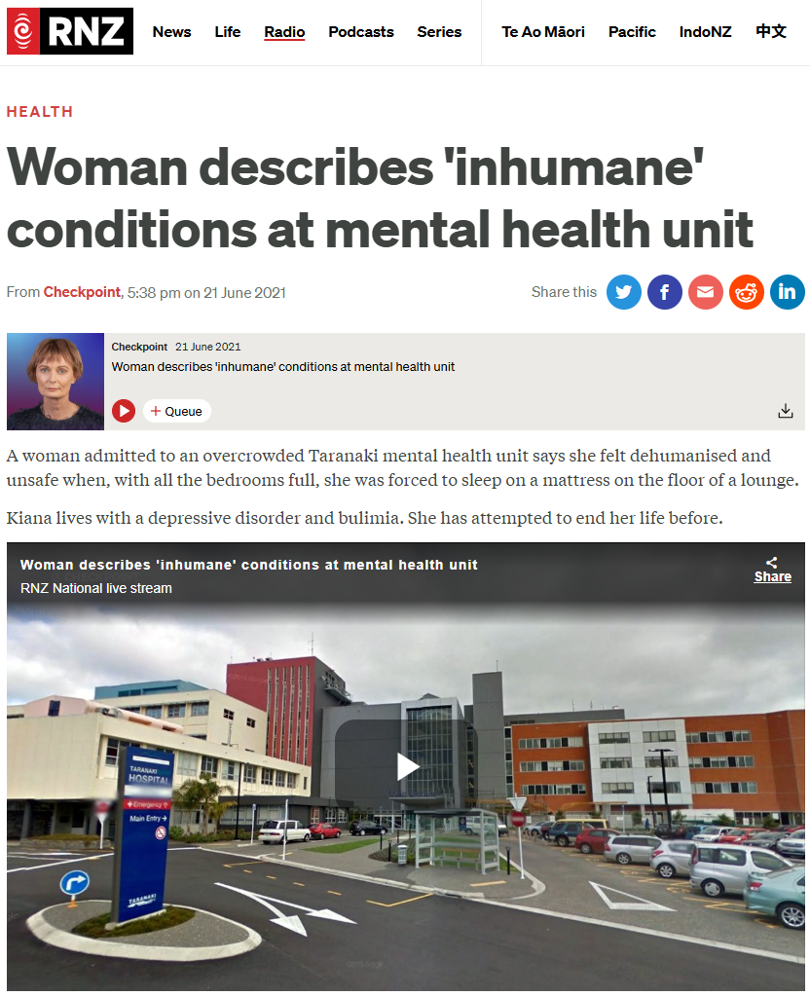
Woman describes 'inhumane' conditions at mental health unit | RNZ

Slide 6
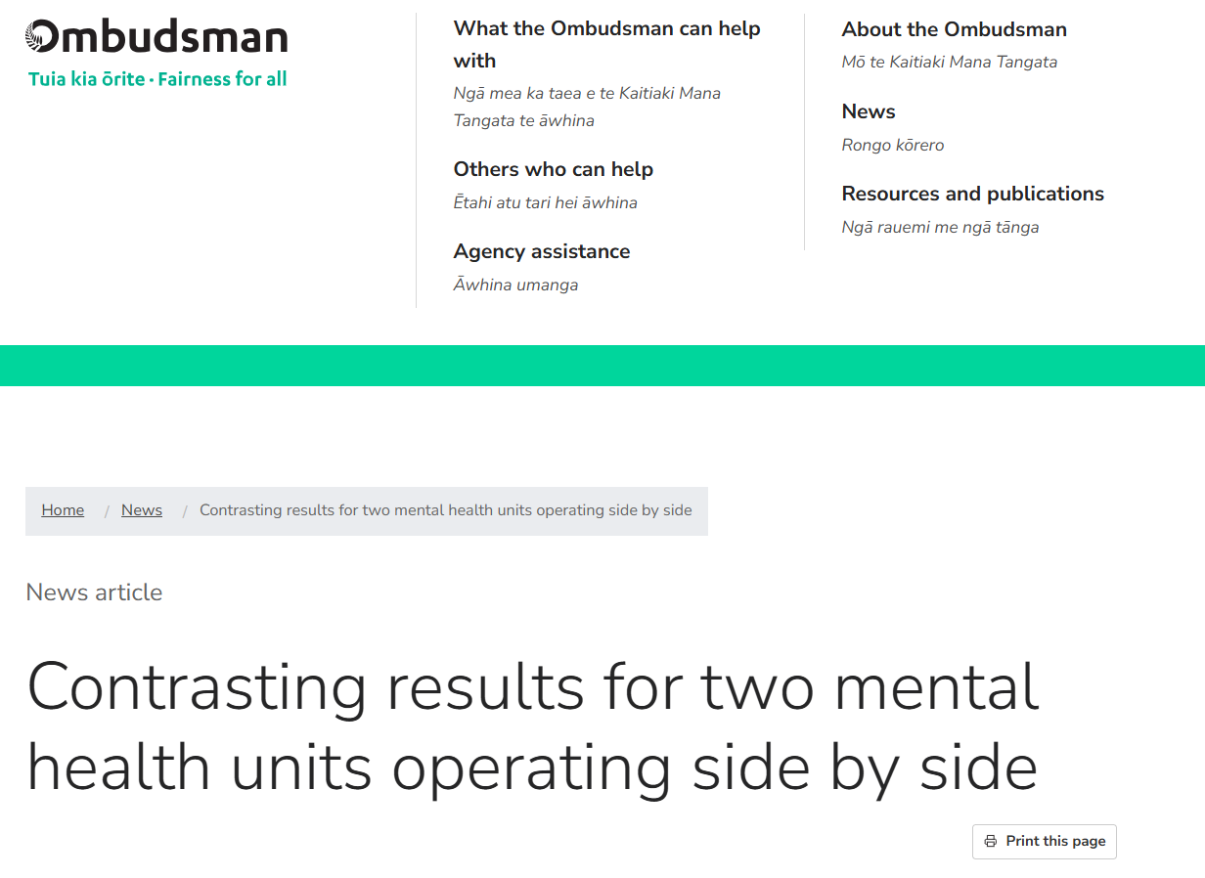

Slide 7
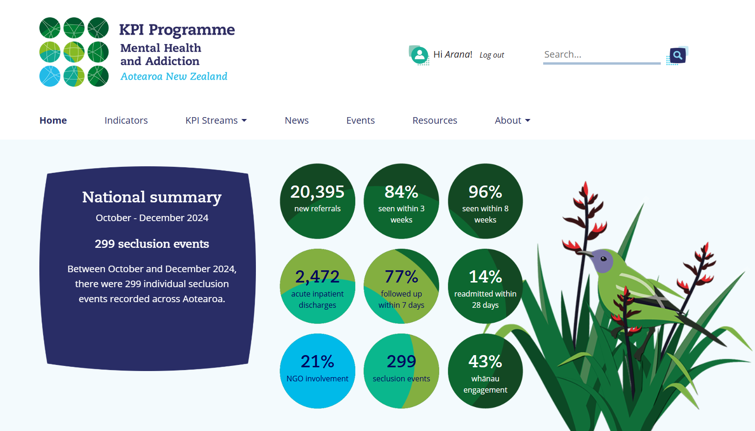
KPI Programme
https://www.mhakpi.health.nz/

Slide 8
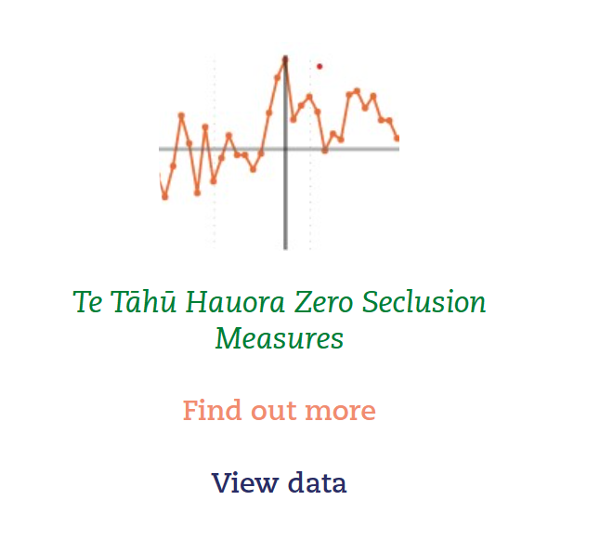

Slide 9
What we learned from the Zero seclusion: Safety and dignity for all project
There were opportunities for consumer and peer led quality improvement to add to our driver diagram
There were opportunities to develop a consumer kit of resources to add to the change package
We needed a tripartite suite of approaches to get a result: clinical, cultural, and consumer led
A consumer engagement driver diagram assisted in driving consumer led outcomes in the project

Slide 10
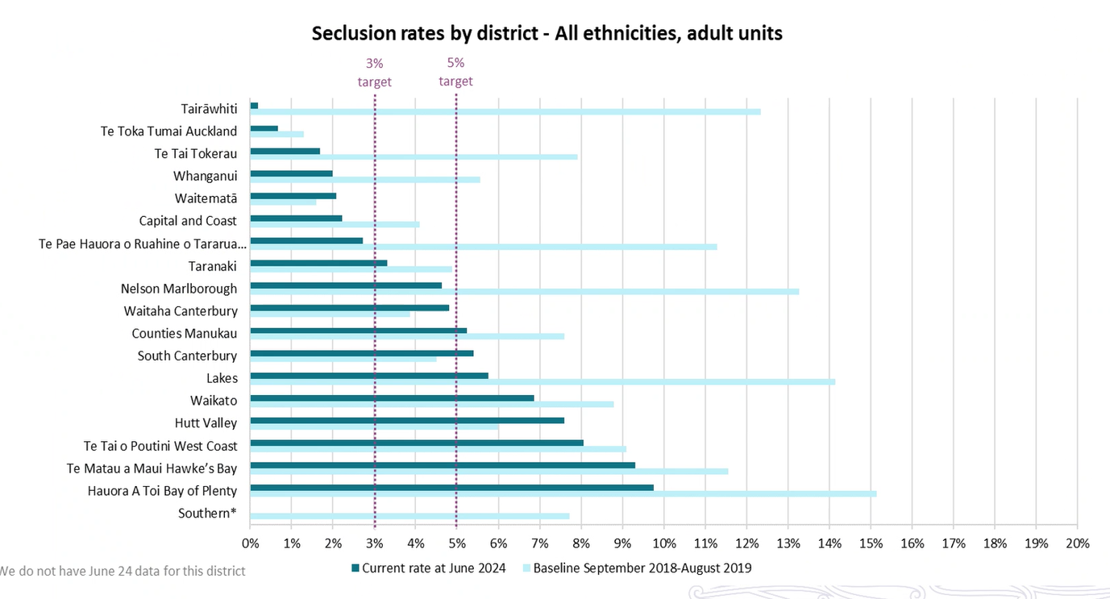

Slide 11
Here is the link to the change package, and the Consumer kit is on page 18 of this document
Zero seclusion: Safety and dignity for all – change package | Aukatia te noho punanga: Noho haumanu, tū rangatira mō te tokomaha – mōkī aroha | Te Tāhū Hauora Health Quality & Safety Commission (hqsc.govt.nz)

Slide 12
KPI Programme
21 percent referrals from mental health services to NGO
https://www.mhakpi.health.nz/

Slide 13
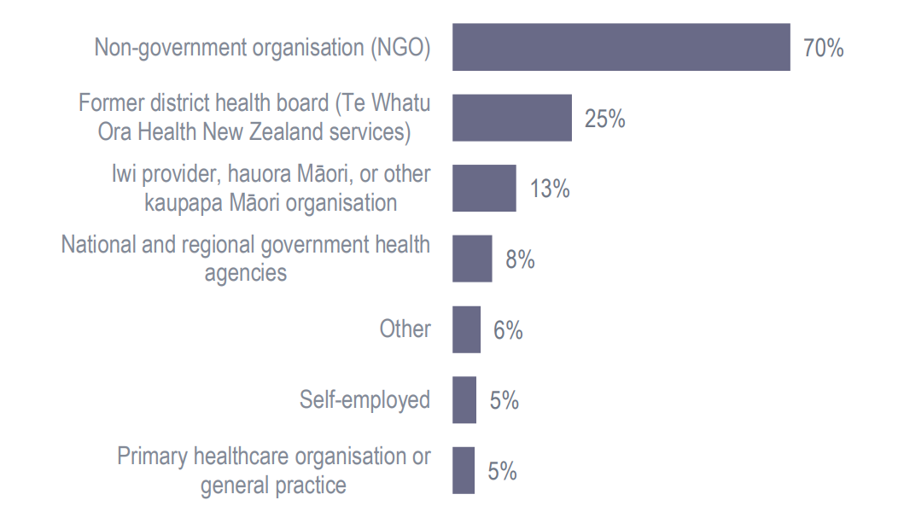
Where is the peer support workforce found? Te Pou Workforce survey 2022
https://www.tepou.co.nz/resources/cpsle-workforce-survey pg 27

Slide 14
Participatory action research – what is it?
Emphasizes collaboration and participation by the people affected most by the practice
Aims to empower those most impacted by the practice
Disrupts traditional power dynamics by allowing communities to take a lead in framing questions, designing methods, and analyzing results
Takes action to improve things and produce outcomes

Slide 15
Questions to ask ourselves
Are we reporting the right measures in the right way?
How are we engaging consumers at all levels : design, development, delivery, and review?
How does Key Performance Indicators drive action for change in Mental Health?

Slide 16
Questions to ask ourselves
What will I commit to follow up on after today?

Slide 17

Ngā mihi | Thank you
For any follow up, contact Mr Arana Pearson
E: arana.pearson@hqsc.govt.nz
P: 021 574 754
W: www.hqsc.govt.nz
Notes:
Are there any reflections or questions?

