Slide 1



Whanaungatanga
Value of Relationships (VoR)
Terri Cassidy
15 May 2025

Slide 2

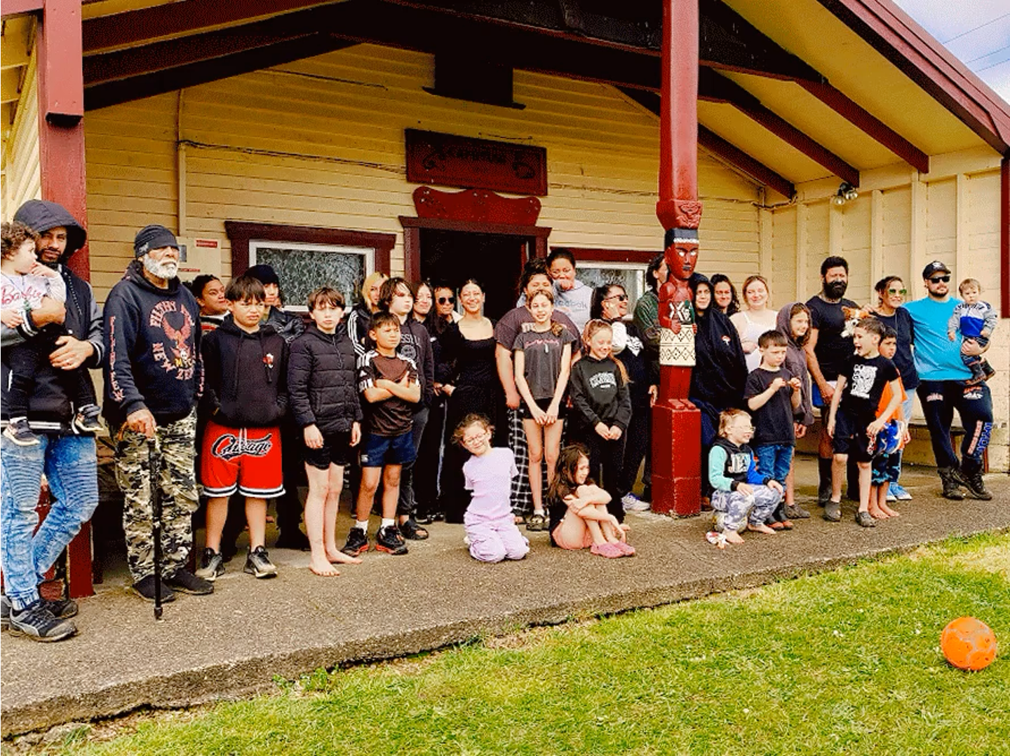
Ko Tainui te Waka
Ko Ngāti Maniapoto te iwi
Ko Ngāti Kaputuhi te hapū
Ko Pukeroa te maunga
Ko Mangapu te awa
Ko Kaputuhi te whare tūpuna

Slide 3

He po kua moea
ao ake ano ana
kei te matahūhura te ata ki te ao
As we awaken to a new morning, we envision a world where potential is realised, aspirations are pursued, and the brilliance of the Māori workforce shines forth
Ngamaru Raerino 2021

Slide 4
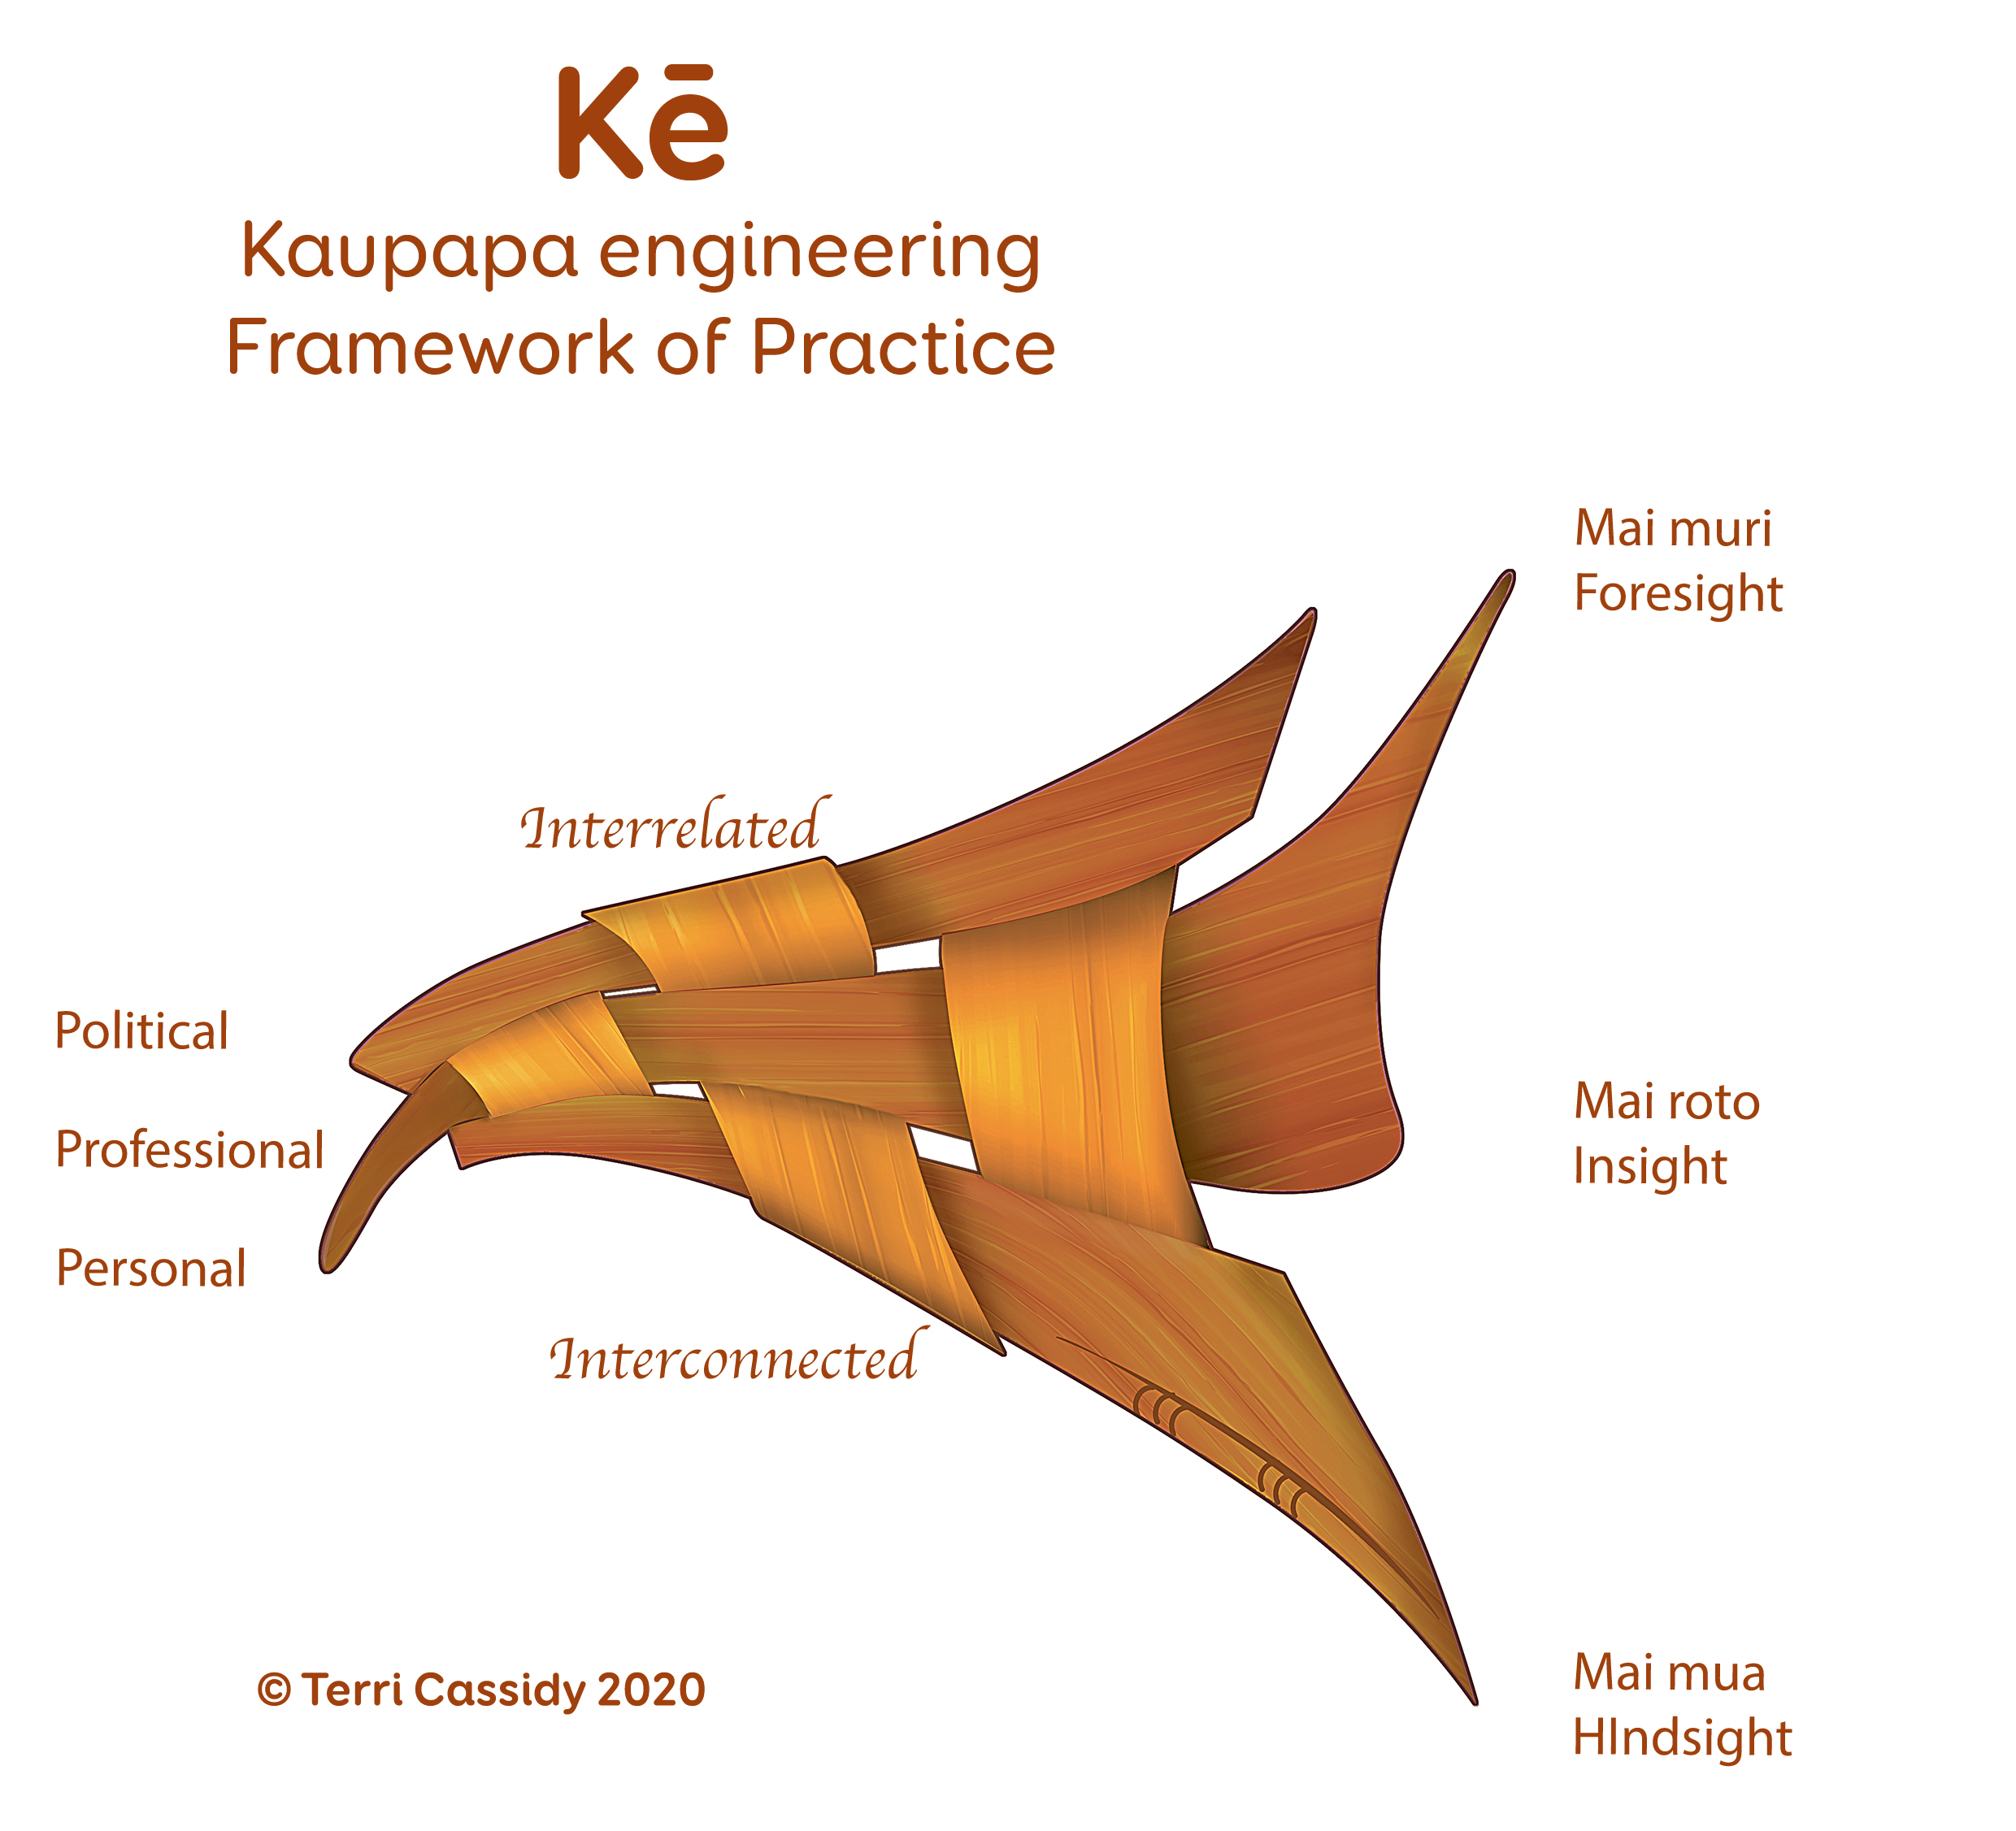
Create a transformative ecosystem where the Māori workforce thrives, awakening a ripple effect of inspiration and wellbeing throughout whānau and communities – oranga whānau.
Igniting and unleashing the potential of the Māori workforce
Notes:
Our vision is to embrace the metaphorical journey from the night to the dawn, symbolising growth, renewal, and the emergence of new opportunities. As we awaken to a new morning, we envision a world where potential is realized, aspirations are pursued, and the brilliance of the Māori workforce shines forth - "He po kua moea, Ao ake ano ana, kei te matahūhura te ata ki te Ao."

Slide 5
Whakapapa – Genealogy, Building a solid foundation
We value the wisdom of our ancestors, intergenerational knowledge transfer and the continuous exploration of new ideas, blending the traditional with the contemporary.
We acknowledge the interconnectedness of our actions and their impact on the world around us.
Whakawhanaunga – Meaningful collaboration
Cultivating collaborative relationships with Māori communities, iwi, individuals and organisations to ensure our initiatives align with their aspirations and needs.
Manaaki – Uplifting others
Actively contribute to positive social change and advocate for the rights and aspirations of the Māori workforce.

Slide 6
Kaupapa Māori workforce development is more than growing capability and capacity.
It involves simultaneously considering individual, organisational, and systems approaches to developing (and sustaining) a workforce grounded in Māori ways of thinking, knowing, doing, and being that is fit for purpose.
Adapted from Jacobs, R., & Hawley, J. (2009). Emergence of Workforce Development: Definition, Conceptual Boundaries, and Implications. In R. MacLean & D. Wilson (eds.), International Handbook of Technical and Vocational Education and Training. Amsterdam: Kluwer.

Slide 8
Logic Model for Value of Relationships
Notes:
Why are relationships important? What are the features of good relationships?
Feedback from stakeholders of the Collective stakeholders indicates that relationships are the underpinning, driving force for change – without them, there would be nothing to hold the community together and progress it forward towards a more positive future. Relationships, in the context of Whānau Ora and the Collective, are critical to effective engagement and service delivery, because they:
It’s the glue that links services, programmes and people together
Aid transparency and accountability Support a more whānau centred approach
Open up the door to new opportunities and ideas
Can make or break an outcome
Aid positive transformation
Connect people and services – enabling the consolidation of resources
Provide the base on which needs are identified, supports are put in place and needs are met
Enable whānau to access a wide range of, and more appropriate, services and supports to meet their needs
Bring skills and knowledge – and opportunities to share these for the benefit of whānau
Support sustainable change.
The features that make up good and effective relationships (i.e., how do you know one when you see one?) were identified as:
Genuineness: real; sincere
Reciprocity: there is a mutual or cooperative interchange of favors or privileges
Tika: following tikanga in Māori and professional terms; right according to nature and purpose of the engagement
Pono: integrity; honour; truthfulness; mana enhancing (on the premise of valuing culture)
Aroha: compassionate; non-judgmental; congruent thoughts, feelings and actions; respectful
Empathy: ability to feel and share another person’s emotions
Openness and honesty.

Slide 9
When we work in kaupapa Māori ways… …we get kaupapa Māori outcomes
When we enact these principles…
…whānau experience…
…leading to better results…
…better service outcomes...
…and better whānau outcomes.
Whānau:
Whānau led
Confidence in selves
Oranga Whānau
Rangatiratanga – whānau reclaim and have confidence in their own rangatiratanga
Tika, Pono Aroha
Quality engagement
Confidence in the service
Strengthened cultural identity
Buy in to messages
Quality relationships
Increase in health literacy
Kotahitanga
Quality experience
Make sustainable changes
Confidence & courage to make changes
Matatau ana te whanau Whānau are experts in their own reality
Service:
Rangatiratanga
Access to the right supports
Recognise whānau contribution to individual health & wellbeing
Achieving goals
Tū pakari
Whānau are thriving and healthy
Affirmation of being Māori
Understand whānau realities, dynamics
Mahi-a-whānau – collective focus
Recognise wairua contribution to health & wellbeing
Mana Ora Vibrant community leadership
Participation in the community
Tapa wha – whole person
Interconnectedness – within provider; between the organisations and other wider sector

Slide 10
Quality of relationships | Inter-personal relationships between kaimahi & whānau | Inter-personal relationships between provider kaimahi | Inter-organisational relationships | Sector relationships (wider system: funders, Whānau Ora, Health & Social Services, Māori, Iwi)
Tino pai rawa atu | Relationships are reciprocal; whānau are responsive to staff, and vice versa. The relationship is conducive to whānau driving their own self-actualisation. The relationship is supportive of whānau maintaining their wellness. | Relationships are reciprocal; staff are responsible and accountable to each other. Relationships are centred on the interests of whānau wellbeing. Relationships consistently reflect and uphold the kaupapa | Relationships are reciprocal; providers are responsible and accountable to each other. Relationships are centred on the interests of whānau wellbeing. Relationships consistently reflect and uphold the kaupapa | Relationships are reciprocal; funders and sector are responsible and accountable to each other. Relationships are centred on the interests of whānau/hapu/iwi wellbeing. Relationships consistently reflect and uphold the kaupapa
Tino pai | Relationships are mana-enhancing. They support whānau feeling affirmed and validated, building confidence and pride. | Relationships are mana-enhancing. They support staff feeling affirmed and validated, building confidence and pride. | Relationships are mana-enhancing. They provide a firm foundation for leaders and staff to create and seize opportunities. | Relationships are mana-enhancing. They provide a firm foundation for leaders and staff to create and seize opportunities.
Pai | Relationships are meaningful and purposeful. They are also trusting, tika, pono, aroha, genuine, honest, open. | Relationships are meaningful and purposeful. They are also trusting, tika, pono, aroha, genuine, honest, open. | Relationships are meaningful and purposeful. They are also trusting, tika, pono, aroha, genuine, honest, open. | Relationships are meaningful and purposeful. They are also trusting, tika, pono, aroha, genuine, honest, open.
Āhua pai te haere | Whānau and kaimahi have built a relationship, good enough to start identifying underlying issues. Relationships are respectful and professional. | Kaimahi have respectful and professional relationships with one another, good enough to provide a professional service to whānau. | Relationships between providers are professional and respectful, good enough to present a united front to whānau, even if some tensions are being resolved behind the scenes. | Relationships are professional and respectful.
Kore pai | Relationships that just tick the box, will get you by, but not good enough to achieve real engagement. | Kaimahi interpersonal relationships are not good enough to provide a professional service to whānau (for example, tensions between staff are evident to whānau visiting the service). | Providers are not on the same wavelength in terms of kaupapa. They are looking after their own interests first, instead of the interests of whānau. As a result, whānau receive mixed or contradictory messages. | Relationships between funders and the sector (and/or within the sector) are unprofessional or disrespectful.
^{[1]} Tika: following tikanga in Māori and professional terms; right according to nature and purpose of the engagement. Pono: integrity; honour; truthfulness; mana enhancing. Aroha: Compassionate; non-judgmental; congruent thoughts, feelings and actions; respectful.
Notes:
Figure 3: Framework for assessing quality of relationships
Why are relationships important? What are features of good relationships? What are the success factors and challenges?
What did the Collective, at all levels (including funder, and whānau) invest in relationships for Whānau Ora?
What did we gain from our investment in relationships? How good are our relationships? To what extent were the relationships worth the investment (or not)?
How can our relationships be improved? What can we do differently?

Slide 11

whanaungatanga is represented through the ngahere whakawhanaunga in action.
Notes:
It is an ecological system that is required to maintain the balance of relationships in order for the parts of the system survive. Ngahere connects with, and has its’ own whakapapa and mana that has been passed down throughout the generations. It recognises that everything is inter-related highlighting the need connect the various parts, to work with each other in order for the ngahere as a whole to flourish; the collective good.

