Slide 1

Engaging Family Whānau
Presenters:
Anna Ashton Consumer Advisor
Sarah Tomes Family-Whānau Advisor

Slide 2
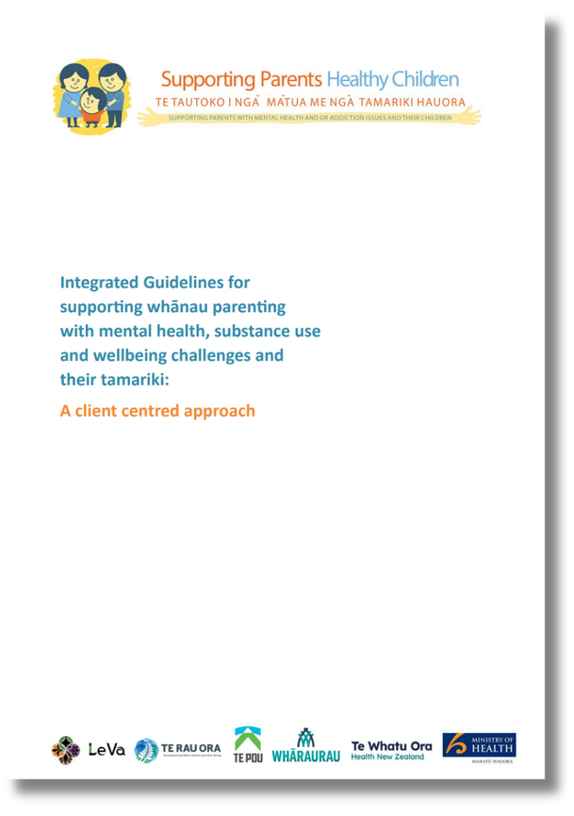
HOW WE WORK
The purpose of our committee is to improve outcomes for family-whānau supporting a loved one accessing SMHS.
Based on the Supporting Parents Healthy Children guidelines but we widened our scope to cover all types of family-whānau (not just tāngata whai ora with tamariki).
Our staff are really busy but we wanted to ensure representation across the service clusters so we have a more flexible committee structure to support this and maintain our momentum.

Slide 3
HOW WE WORK
Advisory Group:
  Consists of Family Champions (clinicians who promote Family-Whānau Engagement in their service), Social Work, Lived Experience, NGOs, Quality, Pukenga Atawhai.
  Develops family-whānau engagement initiatives based on group member feedback and discussion.
  Having NGOs as part of our Advisory Group helps us break down silos in our area and creates a more reciprocal relationship.
Engine Group
  Representatives from each of the above.
  Capacity to carry out initiatives and reports back to the Advisory Group.

Slide 4
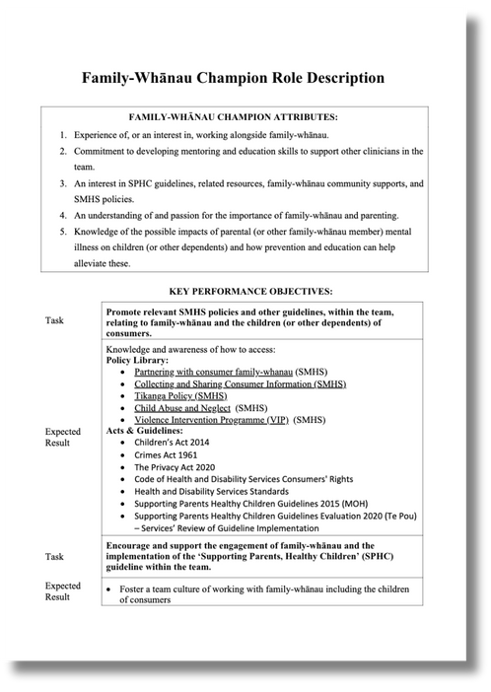
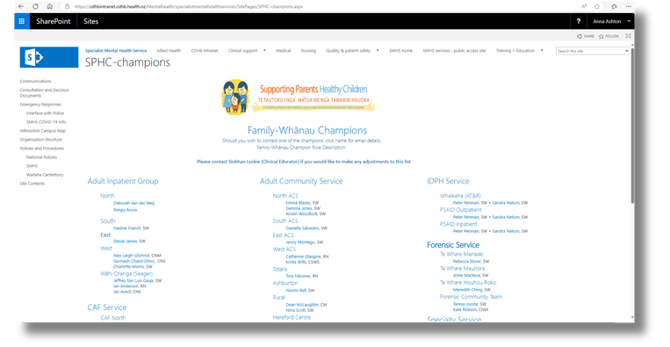
FAMILY-WHĀNAU CHAMPIONS
What are Family-Whānau Champions?
  Experienced at working alongside family-whānau.
  Committed to mentoring and educating team members.
  Interest in SPHC, SMHS policies, and supports for family-whānau.
  Understanding of impacts of mental health and addiction on family-whānau.
We keep a register of Family-Champions in each service on our Intranet page. Other clinicians can reach out to them to ask about resources, policy, and other information shared in the Advisory Group (e.g., updates from NGOs).

Slide 5

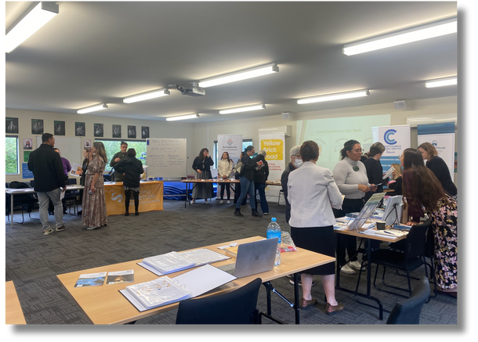
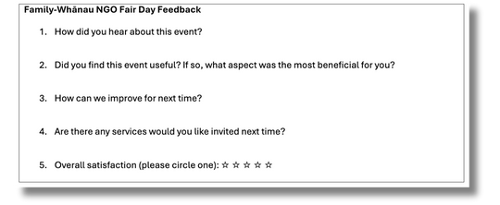
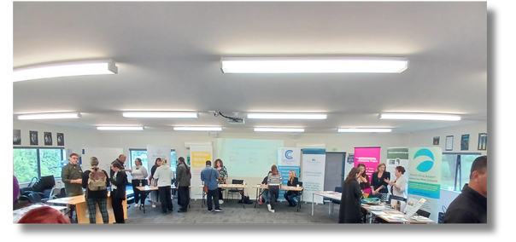
FAIR DAY
We held an NGO Fair Day where SMHS staff could drop in between 12-4 and connect with family-whānau focused NGOs including:
  Yellow Brick Road
  He Waka Tapu
  Ka Puta Ka Ora Emerge Aotearoa
  Family Drug Support
  The Collaborative Trust
  Odyssey House
We also had two SMHS stalls:
  Pukenga Atawhai
  Lived Experience (on behalf of the committee)
A highlight of this event was the tikanga provided by Pukenga Atawhai at the opening, which set the tone for our engagement with each other.

Slide 6
FAIR DAY
41 out of 45 people who completed feedback forms gave us 4-5 stars!
We learned a lot about what made the event successful:
  Drop in style event gave staff more opportunity to attend and helped with the flow so NGOs could speak with more people.
  Committee members sending out emails and putting up posters in break rooms got the word out well.
  The main constructive feedback is that we needed more space (it gets loud)!
Staff appreciated:
  Networking (putting names and faces to organisations).
  Collecting resources for family-whānau.
  Reminders about what exists in the community.

Slide 7
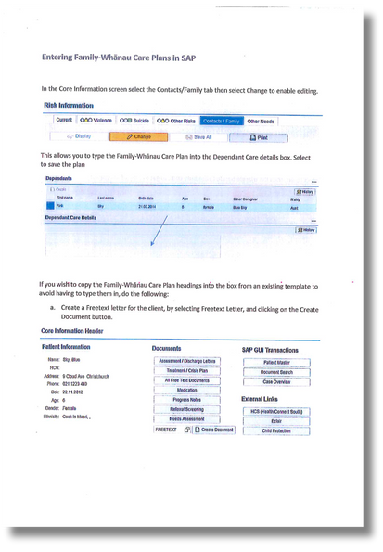
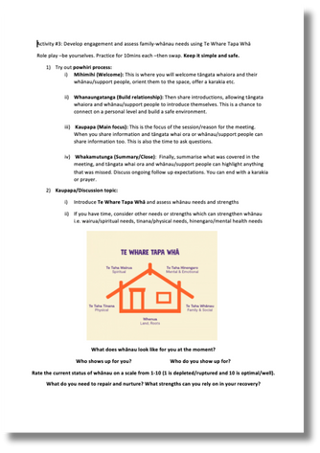
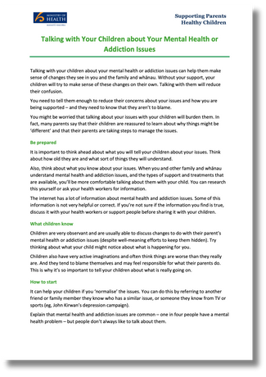
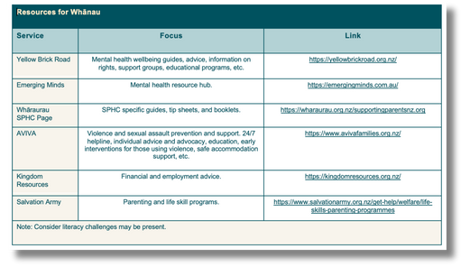
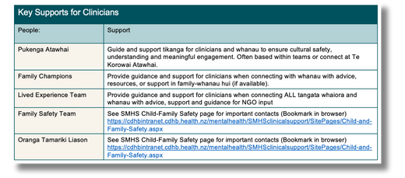

PROFESSIONAL DEVELOPMENT
Our Training Unit provides a number of courses that enhance skills for working with family-whānau.
Family-Whānau Skills for All SMHS Clinicians has been re-designed recently by a working group from our committee and is facilitated by clinicians and lived experience so our staff are resourced to meet all their obligations to family-whānau, which includes adding them in treatment plans, providing supports, and holding hui.
Single Session Family Consult and the Family Violence Intervention Programme go more in-depth on the specifics of holding family-whānau hui and safeguarding vulnerable people.

Slide 8

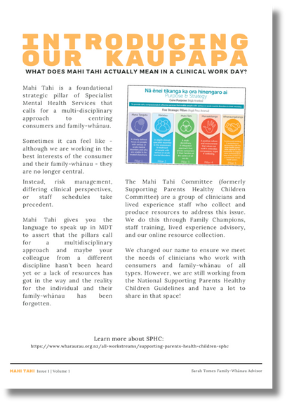
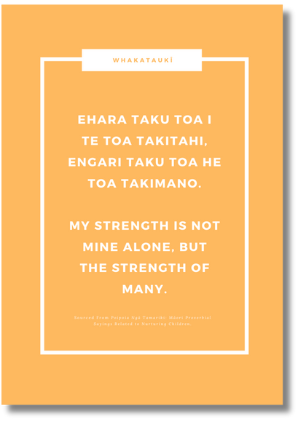
NEWSLETTER
To support our Family-Whānau Champions we send out regular updates covering topics such as:
  NGO updates (e.g., referral and waitlist information)
  Training (e.g., new dates, online courses)
  Lived experience perspectives (e.g., engagement strategies)
  Resources (reviewing and recommending)
  Upcoming events (e.g., family-whānau info evening)
  Portfolios (e.g., Family Safety Team, Champions, Pukenga)
Our first few newsletters were just emails with links to resources and bullet-point lists of updates. However, they still helped us filter information across the sector.

Slide 9
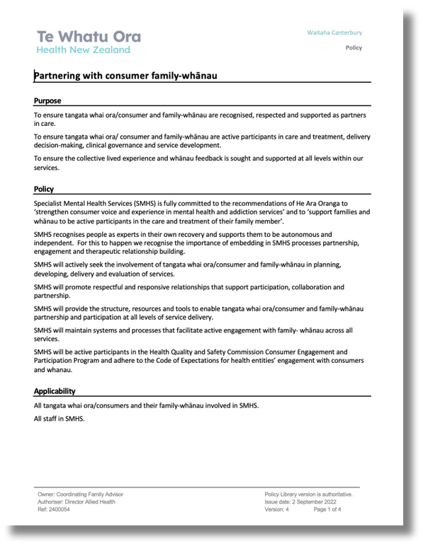
DOCUMENT REVIEWS
It’s important that our key documents at SMHS reflect the reality our staff, tāngata whai ora and family-whānau are seeing. Therefore, we have been tapping in to the experience and knowledge our Advisory Group members hold. We have a great mix of people across different roles, professions, and service clusters.

Slide 10
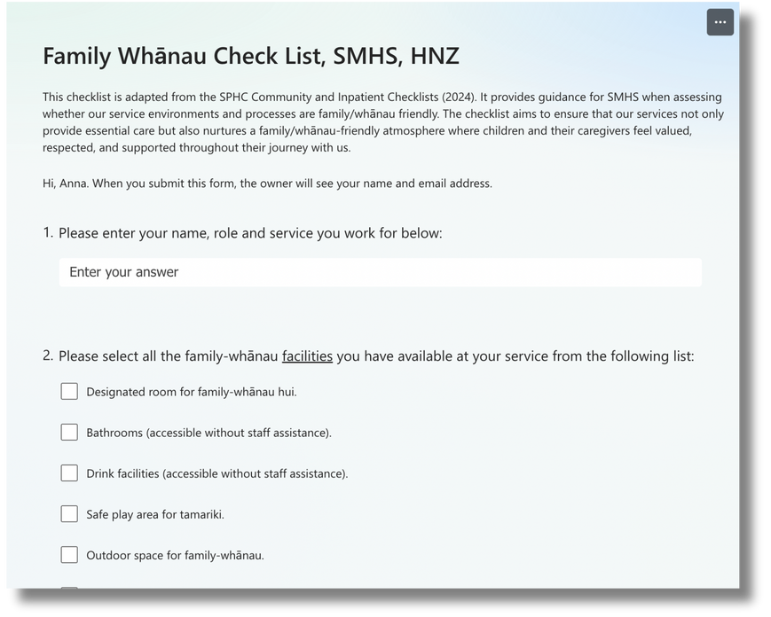
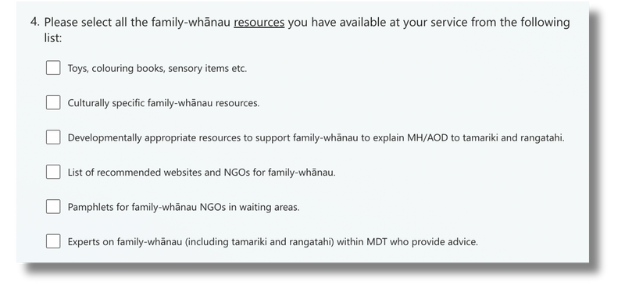
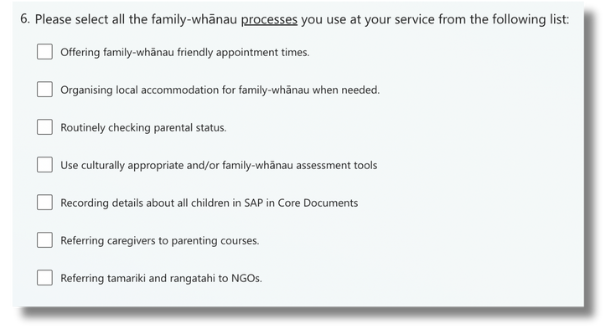
AUDITING
We have recently made an audit checklist (adapted from existing examples) for our Family-Whānau Champions to use.
Audits like this give our Advisory Group the information needed to develop solutions and our Engine Group and Family-Whānau Champions specific actions to take to make improvements. It’s also nice to be able to celebrate areas that are doing well.

Slide 11

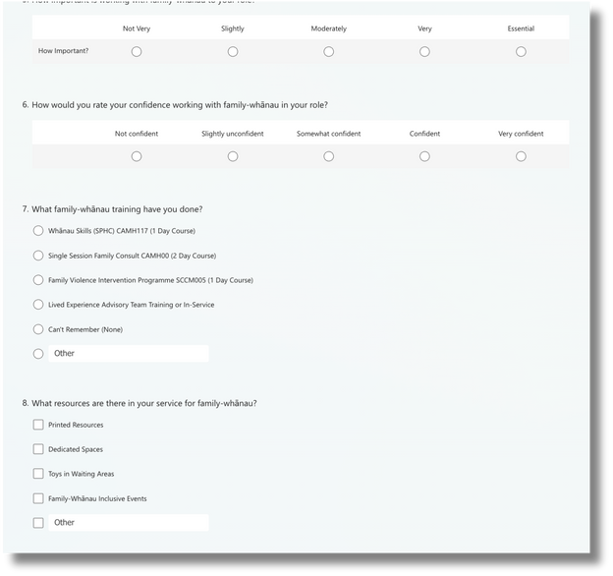
SURVEYING
To measure our efficacy and provide direction for initiatives we have a staff survey.
We are able to pinpoint which areas or professions have specific barriers or training needs that we can address.

