Slide 1


Collaboration across agencies : using data and relationships to create new services
Presenters:
Marina McNamara & jennifer Hoolihan
from Health action trust

Slide 2

About Us
HEALTH ACTION TRUST
Working in health promotion and peer support for close to 40 years
Many of our services have been first of their kind in Aotearoa
COMPASS Community Peer Support and Advocacy
Nikau Hauora Hub
Kotuku Crisis Respite
Emergency Department Peer Support
Youth Wellbeing Service
www.healthaction.org.nz

Slide 3
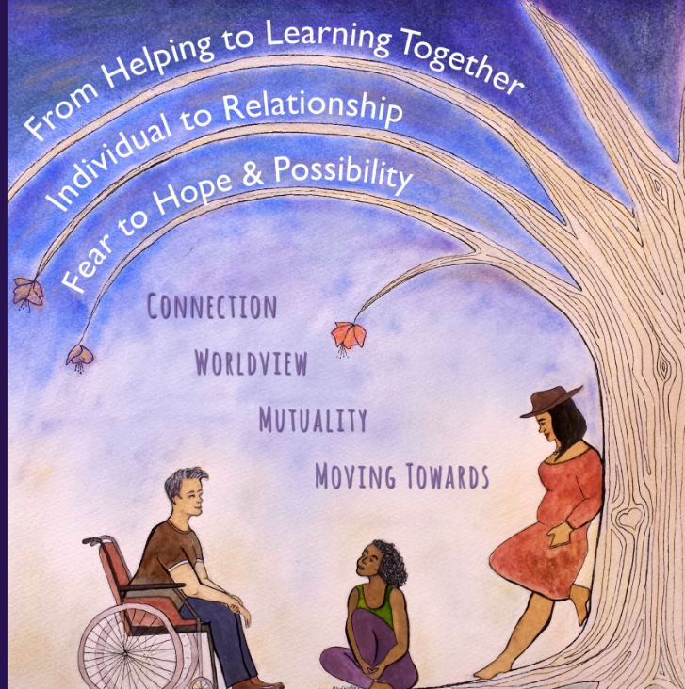
Our Approach in our mahi is based on:
Intentional Peer support
3 Principles & Four Tasks
" It's all about Relationships"
"Hearing the person"
"Multiple Truths"
Shared responsibility
Solution focused working towards something.
Trust, Respect, understanding people's worldviews
Working together being open about what you need & open to learning together.
www.intentionalpeersupport.org

Slide 4

The back story
How did we know there was a need out there?
We used qualitative and quantitative data!

Slide 5
Noticing there was a need…. Then collecting data to back it up
Our ED team saw 586 young people in a year
210 were mental health presentations
Why were so many young people not receiving support?
Where are the gaps in our systems/services?
What was our capacity to plug those gaps?
How do we support people over the transition times?
Who could we partner with, what is the biggest impact we could make?

Slide 6
We saw that the biggest need in our community was to support young people no matter where they were in their journey.
iCAMHS had a waitlist that frustrated them and the people waiting on the service
ED peer team saw 210 youth not engaged with services/didn’t meet threshold for services
Strict YPMHA criteria meant young people outside of moderate or engaged with secondary services couldn’t access peer support

Slide 7
We used our relationships
One of the blessings of working in a smaller town is that everyone is connected..
We met with iCAMHS to pitch our idea
iCAMHS were very willing to work with us.
Approached our contract manager about changes to our age range. And got it signed off.

Slide 8
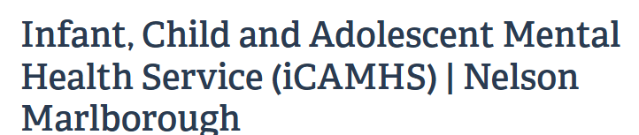
Timeline
April 2024 First initial meeting with ICAMHS
April 2024 Approval from Funders to reduced age range and the ability to receive referrals from ICAMHS.
May 2024 Memorandum of understanding first signed for age range 16+- outlining responsibilities of both parties.
Training session with icamhs staff about our service. Blurb and photo of our peer support worker.
Meetings to discuss referrals and barriers.
Oct 2024 Updated Memorandum of understanding signed for age range 14+ for three months.
Jan 2025 approval from our funders for another year as requested from icamhs and Health Action Trust
Need more time to evaluate outcomes and data for this project.
11 icamhs referrals to date
7 self-referrals aged 16+ not under icamhs
ICAMHS/Health Action Trust – Peer support Pilot project/Collarboration

Slide 9

Feedback from the young people we have supported.
The young people loved working with someone close to their age
“It is easier to relate to you because you’re young as well”
“I did not know a young person could do a role like this”
“I feel like you understand me better than someone who is older”
“I really want to do a job like yours”
“Can you tell me how you got into your role?”

Slide 10
Feedback from the young people we have supported
The young people really enjoyed the peer approach
“It's hard to open up to clinicians who expect you to be vulnerable with them when they don't tell you anything about them”
“It's nice that I don’t have to explain the process to you because you already know”
“Clinicians know so much about you before you even meet them, it is weird walking into that”
“It is so hard to navigate the mental health system, thank you for being a voice on the other side"- parent of young person.

Slide 11
Feedback from
From the iCAMHS perspective, overall, we feel this has been a success so far. We started with an age of 16+ and from this we saw a small number of referrals. We agreed to drop the age to 14+ we have seen an increase in the demand and referrals have increased.
The feedback from the youth engaged with Peer support has been positive and has also bridged a gap in communication with the care managers at iCAMHS overseeing their care. This likely would not have happened if we did not have this role. This only improves the patient journey which was the aim of the project.
This has also connected iCAMHS with Health Action Trust which only enhances the opportunities for youth in our community.

Slide 12

Internal COMPASS Community peer support self-referrals
Our community mobile team receive internal referrals from our peer support team in the ED from tangata whaiora who would like support in the community. This took a wee while to get going but since we started this March 2024, we have received 69 referrals to our community team some of which have ongoing support within the community. We hope by offering this support that it may give a wrap around supportive approach reducing the need for admission and supporting holistically to ensure all needs are met and empower them to feel connected with the wider community.

Slide 13








Our other collaborations
Te Whare Ma

Slide 14

Summary
So many of us out there working in NGOs get protective of the work that we are doing.
We are all scrambling for the same funding, which can lead to patch guarding.
Its tough place out there, when we let go of control and truly work together, we can inspire and create support for more people. Together we are stronger.

Slide 15

Thank You
A big thank you to Susan Murray ,Emma Erikson from iCAMHS Nelson for going out on a limb and trying something new and different, and the team for promoting our services and sending through referrals.
A massive thank you to Stacey Limmer our contracts manager who was able to make changes at lightning speed
Shout out to KhinKhin Maung our peer support worker who blazed the trail with this new initiative and poured her heart and soul into it
Thank you Health Trust management for allowing us to think outside the box ,go for it and make it happen!
Questions?
ThePhoto by PhotoAuthor is licensed under CCYYSA.

