Slide 1

Surviving the Barrel-wave
Ensuring improved health outcomes in our communities
Dr Andrew Darby Clindella Stirling
CD – Integrated AMHS AMHS Ops Manager
Notes:
Introduce self and topic Surfing the Tsunami: Ensuring improved health outcomes in our communities
We are Community Health and Addictions Services- based in Hamilton.
This work was predominantly focused on the Central Waikato Mental Health Teams but did have wider effect on some of our speciality services which are also centrally located.

Slide 2
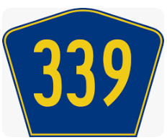
Challenges
Overloaded Adult MH Sector Team
  high clinical caseloads
  unclear expectations of service criteria
  unrealistic caseloads
  unrelenting referral demand
  staff “voting with their feet”
  unclear expectation of purpose of clinical meetings
Notes:
Clin - October 2022 we commenced a project to alleviate the pressures our staff were experiencing and the concern that this combined with Workforce shortages and Covid was really having a negative impact on the quality of service we were providing to tangata whaiora and whanau
We had a combined caseload total of 598, 3xfull time Dr’s with caseloads of 128-141 and also part time Dr’s, and keyworkers with caseloads between 15-30. And we had a significant proportion of Tangata Whaiora who were on a waitlist for a keyworker, increasing new referrals, An additional waitlist from clinicians who had left the service and needed to be reallocated. Previous work done to support keyworkers caseloads had capped numbers at 30, so people above this were placed on a keyworker waitlist, but assigned to a DR with wellbeing calls to check in with them.
We had waitlists for psychology and ADHD also.
There was had a high number of staff resignations, and were finding it challenging to fill these positions as well.
There were still referrals coming in that needed to be assigned, but to confuse this we had 601 open referrals to deal with, some had not been closed so our data was not accurate.
We needed to review our process’s as well as there was no clear purpose for the clinical meetings, and we needed to be sure that all of those on our caseloads were been reviewed, and discussed by MDT. Been really clear about the purposes of meetings to assist with transition and flow, and interventions to manage risk.
Central South waitlist of 339, awaiting allocation of a keyworker!

Slide 3
Managing Risk cont/…
Prioritisation matrix implemented
  Referrals
  Waitlist
  Caseloads
Caseload flow
  CD + MDT, CNM/ACNM review
  Prioritisation matrix essential
  Expected date of transfer (EDT)
  Barriers to transition of care
Notes:
Clin- We had reduced staffing getting down to only 1 registered nurse in the team we needed to do some focus on recruitment, at that time able to employ a staff member to support managers with recruitment outside of HR-Recruitment.
We need to focus on staff wellbeing- this was done by the review of caseloads, by keeping them up to date with what was happening, and workshops to gather feedback.
Waitlists- High waitlists of tangata whaiora requiring keyworkers, Dr’s who were over capacity so again reviewing and putting transition plans in place.
Referral clean up- We had a number of open referrals which were influenced data, so extra admin hours and then clear processes put into place to reduce this reoccurring.
Data informed operations- Ways to view and manage our waitlists and information tools which Virginia will talk about further on in the presentation.
Thankyou, will handover to Andrew Darby.

Slide 4
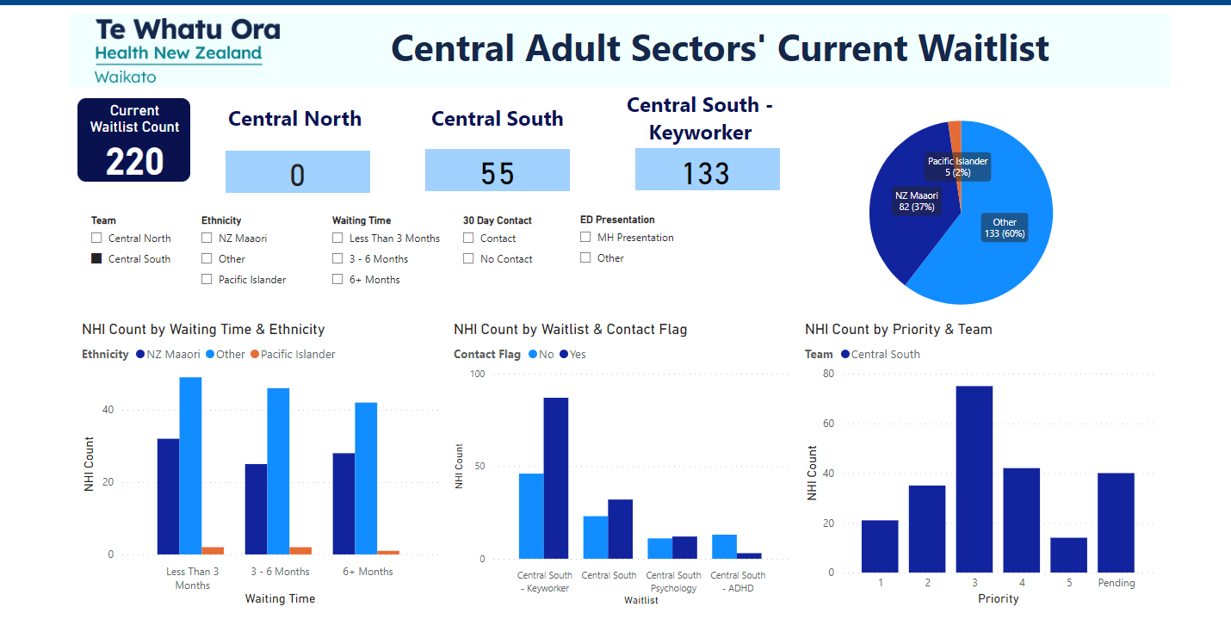
Notes:
Clin - New Mental Health Dashboard on power bi- gives our service clear visibility about our waitlist and its breakdown.
Ability to drill down to specific details – NHI, Contact stats, time of waitlist, domicile- was it a specific team. Ethnicities

Slide 5
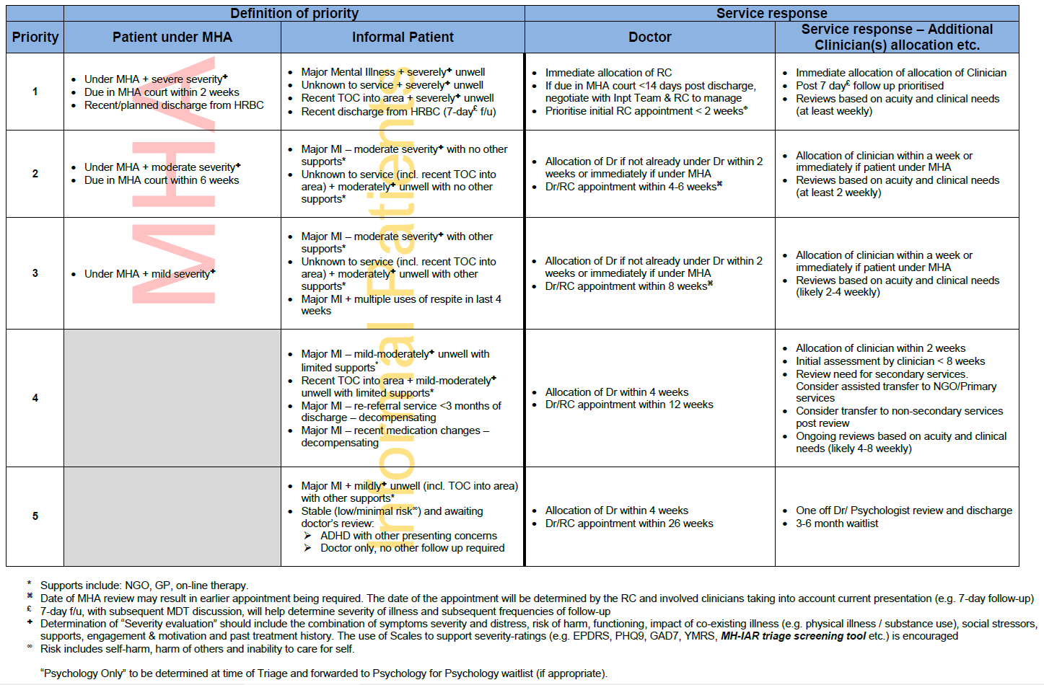
Notes:
Andrew

Slide 6
WorkFLOW
Referrer
Triage
Community Team
Notes:
Initial time commitment +++ (get over the hump)

Slide 7
Aligned and consistent leadership
Operationalisation of criteria for WHOLE AMHS
  Directors, Operations Managers, Charge Nurse Managers/Team Leaders & associates, Directors Nursing & Allied Health
  CD Actively involved in Team practice
  Team engagement, commitment and buy in
  EDT
  Barriers to T/F
Notes:
Initial time commitment +++ (get over the hump)

Slide 8
Outcomes
Notes:
Initial time commitment +++ (get over the hump)

Slide 9
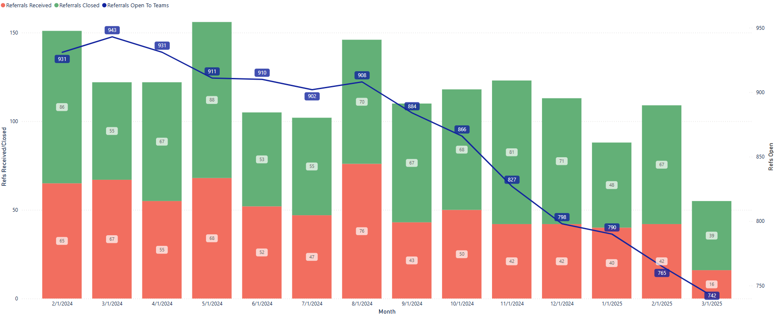
Central Sectors Referrals

Slide 10
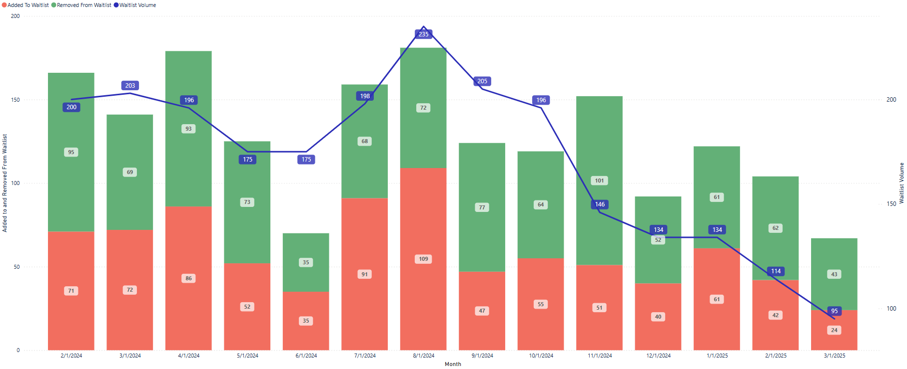
Central Sector Waitlist

Slide 11
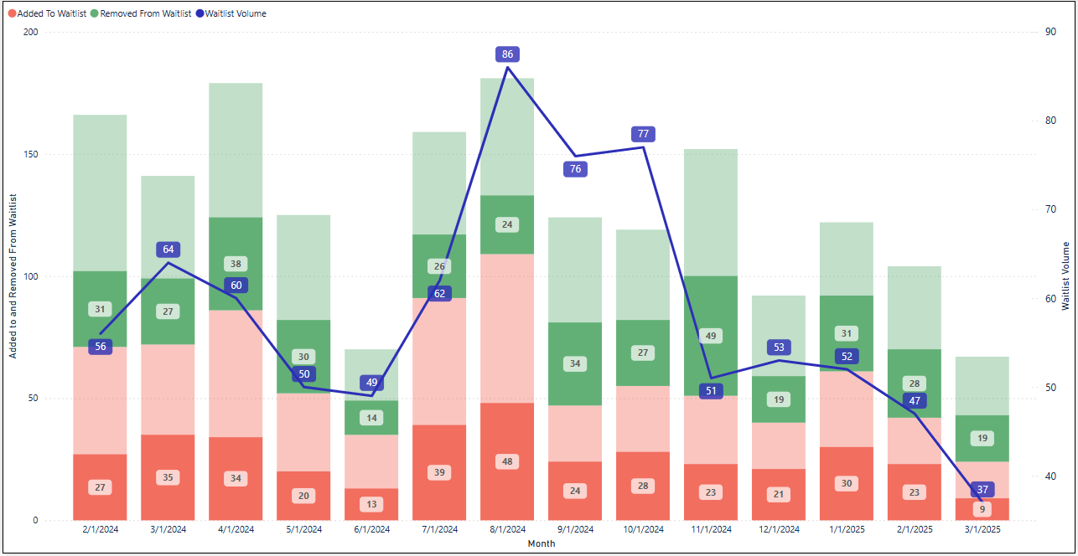
Māori - Central Sectors Waitlist

Slide 12
Transfer of care
Notes:
Initial time commitment +++ (get over the hump)

Slide 13
Notes:
A clear diagnosis. (89%)
A clear description of current treatment (100%)
A clear description of the treatment the GP needs to provide. (100%)
A clear description of the treatment that others need to provide (89%)
A clear description of the treatment the GP needs to provide at times of decompensation. (100%)
A clear description of what AMHS will provide at time of decompensation. (96%)
A clear description of the treatment that others (patient, family, NGO) will provide at time of decompensation. (87%)
A description of progress whilst under adult mental health service. (79%)

Slide 14
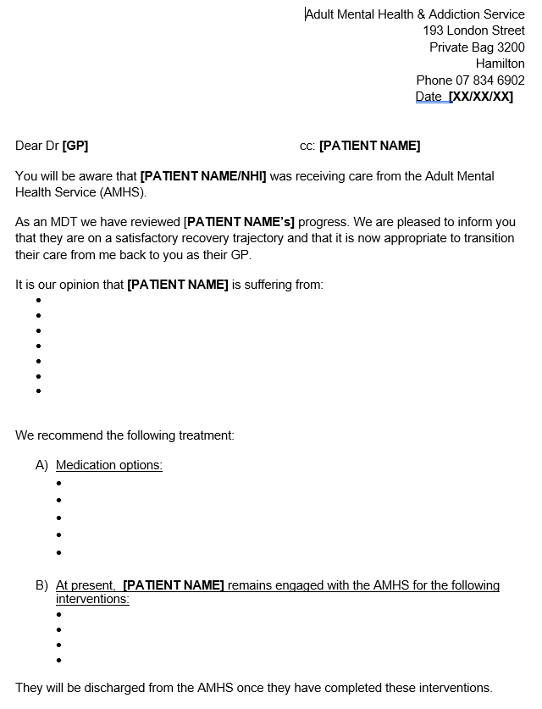

Slide 15
How do we sustain this?
Notes:
Clin
Work to do on our EDD. “Discharge planning starts on admission”
My plan- New recovery planning and ensuring goals for recovery
Retention of staff- successfully recruited so how do we keep the staff we have employed
Ensure the new culture/practices are embedded, include regular review
Monitor waitlists for changes- now possible as our data is clean, and easily accessible.
Consideration of increasing access from those currently considered to be priority 4 or 5

