Slide 1
Young People and Punitive Deterrence – does it work?
Enys Delmage

Slide 2
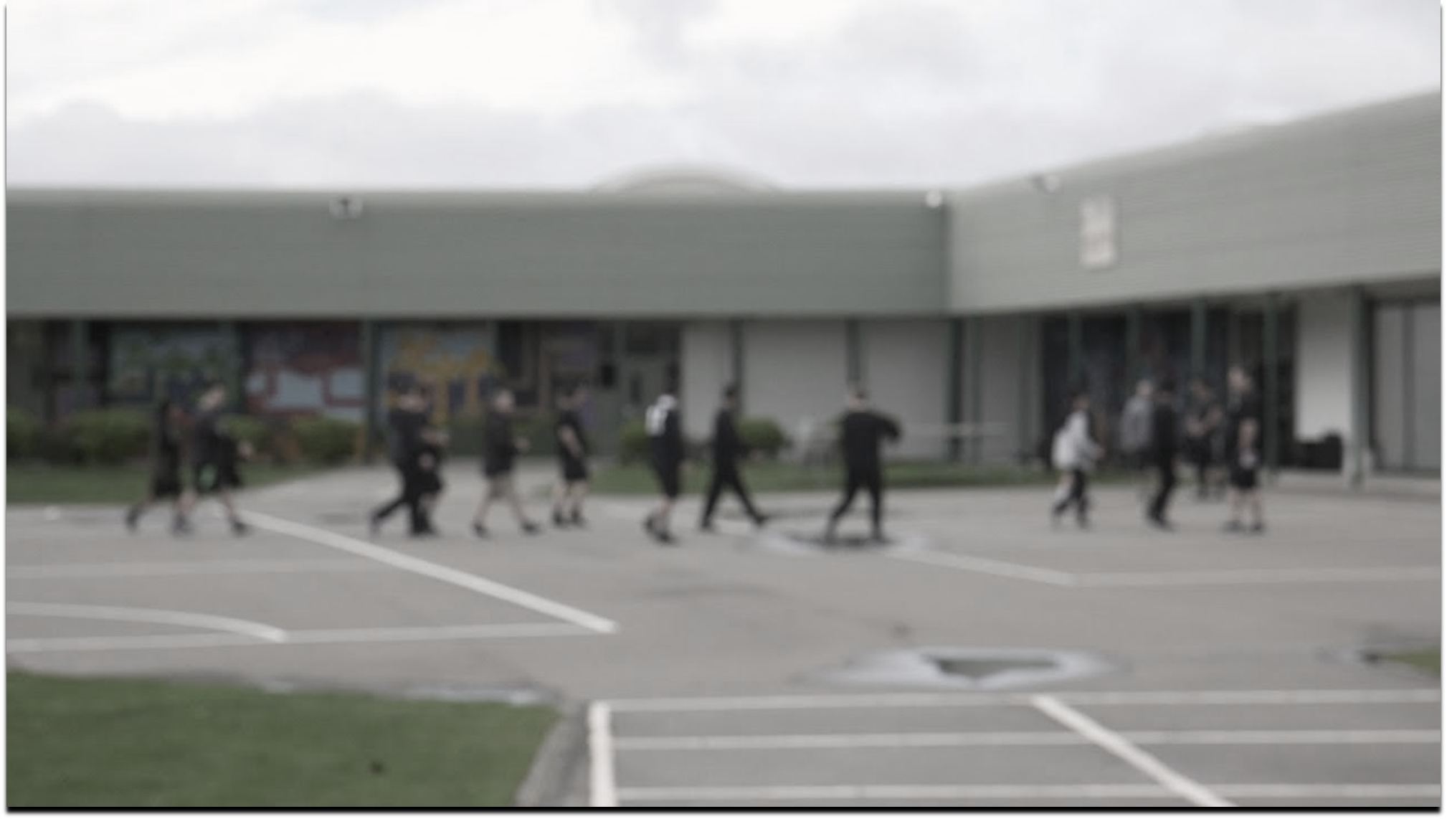
“One of the first signs of the beginning of understanding is the wish to die. This life appears unbearable, another unattainable. One is no longer ashamed of wanting to die; one asks to be moved from the old cell, which one hates, to a new one, which one will only in time come to hate.”
Franz Kafka

Slide 3
What do we mean by deterrence?

Slide 4
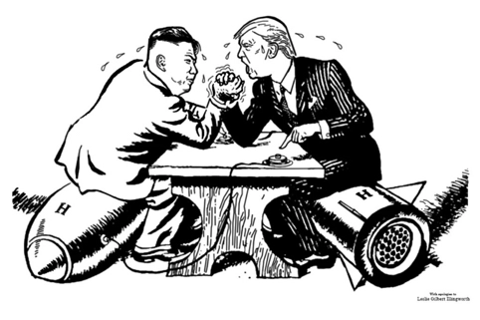

Slide 5
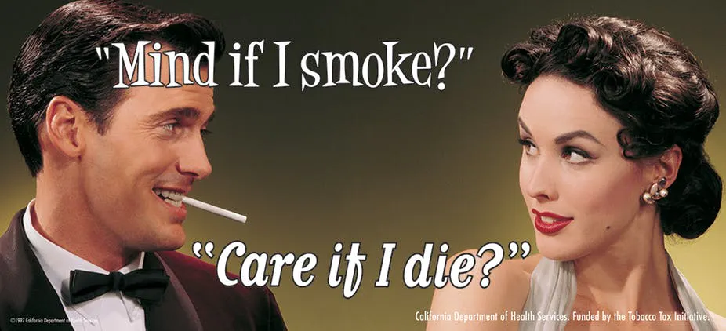
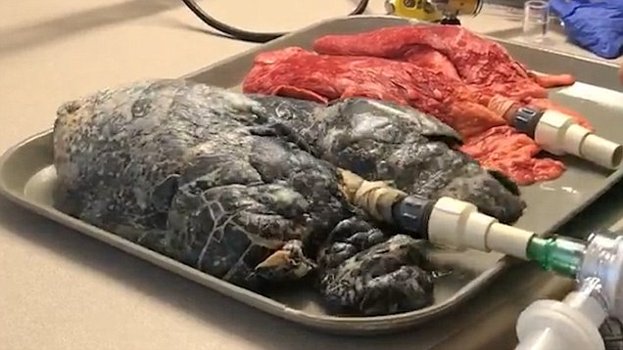

Slide 6
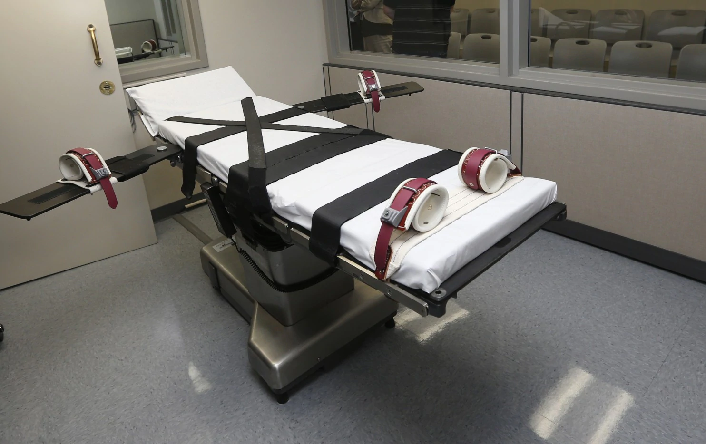

Slide 7
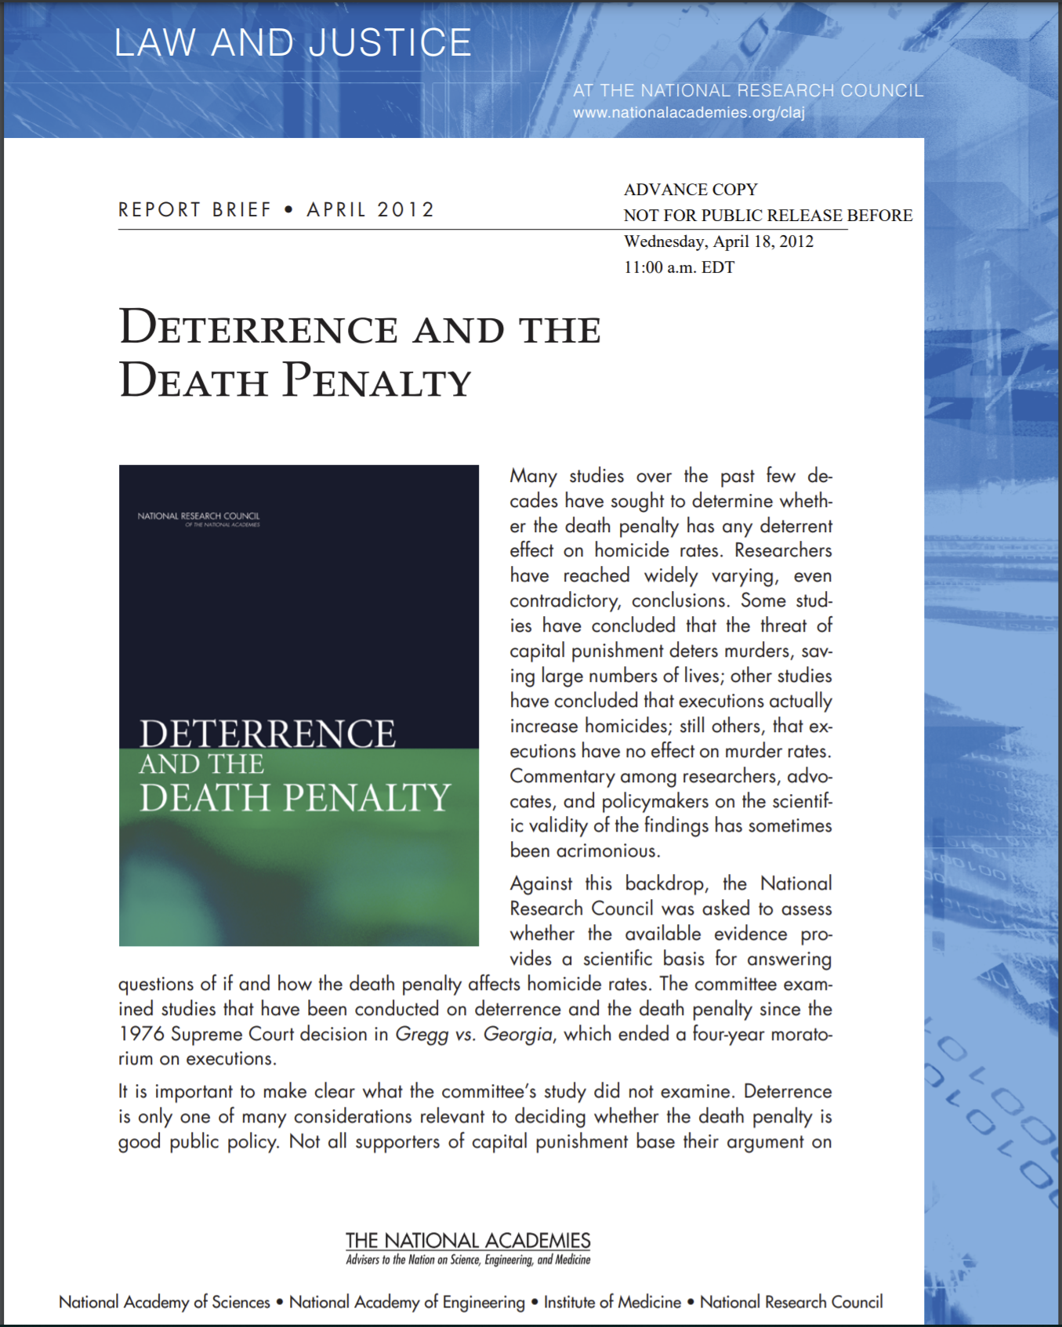
National academy of sciences
No legitimate studies showing that the death penalty has any effect on homicide rates

Slide 8
What do we mean by deterrence?
Discouraging an action through punitive consequence which instils fear
General – deterrent effect aimed not at the offender but at wider society;
Driven by expectation that the threat of similar punishment will factor in future decision-making
Specific – deterrent effect aimed at individual who has offended;
Driven by expectation that the experience of punishment itself will act as a salutary lesson which would give pause for thought for any future offending from the individual

Slide 9
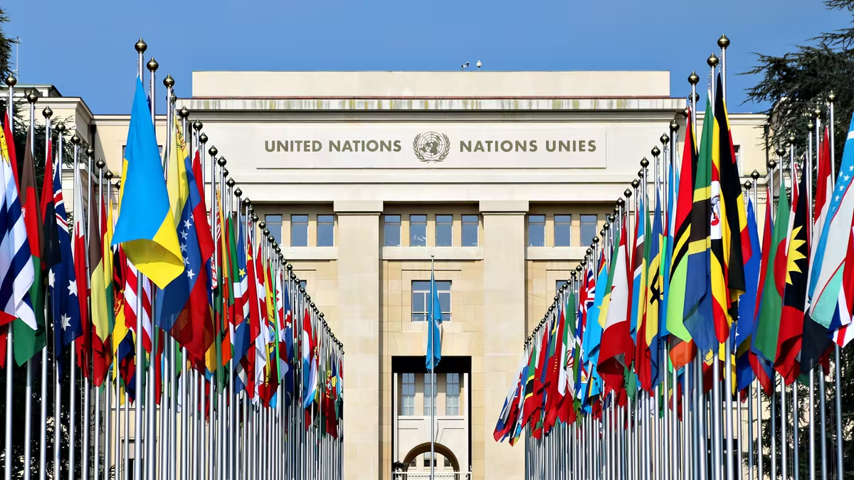

Slide 10
Why is general deterrence a problem for the un?
United Nations 1989 Convention on the Rights of the Child
Primary international instrument concerning the treatment of children
196 of 197 countries around the world are signatories…

Slide 11
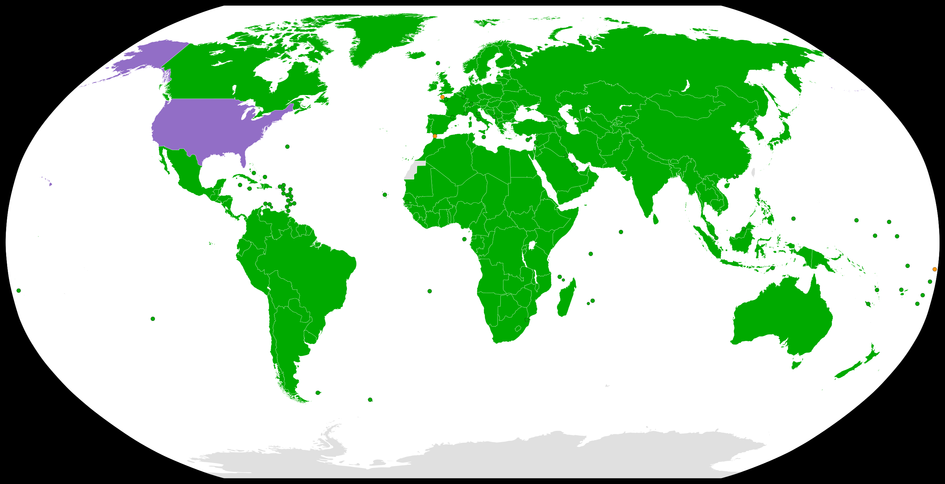

Slide 12
Why is general deterrence a problem for the un?
United Nations 1989 Convention on the Rights of the Child
Primary international instrument concerning the treatment of children
196 of 197 countries around the world are signatories…
Article 3 of the Convention requires courts of law to ensure that in all decisions concerning children, “the best interests of the child shall be a primary consideration” (United Nations, 1989) – a principle enshrined in national law in many countries
General deterrence is not focused on the individual

Slide 13
Why is specific deterrence a problem for the un?
May lead to stigmatisation
UNCRC general comment 2019: “Exposure to the criminal justice system has been demonstrated to cause harm to children, limiting their chances of becoming responsible adults”
Labelling effects highlighted by UN General Assembly (1985)

Slide 14
“Beijing Rules”
Rule 5 of United Nations Standard Minimum Rules for the Administration of Juvenile Justice (the “Beijing Rules”)
“Juvenile justice systems shall focus on the well-being of the child” (United Nations General Assembly, 1985)
Commentary to the Rules clarifies that merely punitive sanctions shall be avoided
Article 40 of the Convention highlights the “desirability of promoting the child’s reintegration and the child assuming a constructive role in society” (United Nations, 1989)

Slide 15
UN General assembly
Detention should be used as a last resort and for the shortest appropriate period of time (United Nations General Assembly, 1985: Article 37(d); United Nations, Article 17(1)(b))
UN Special Rapporteur (2015:74): lengthy sentences are “grossly disproportionate and therefore cruel, inhuman or degrading when imposed on a child” in terms of the physical and psychological harm caused by them

Slide 16
Under what conditions can deterrence work?
Need to know that offending may lead to punishment;
Person must want to avoid the sanction;
Person will be able to objectively weigh up the pros and cons of offending;
Person must be able to alter their behaviour in light of 3)

Slide 17
Adult research – harsher sentencing
Institute of Criminology (Cambridge University), commissioned by Home Office - comprehensive analysis of large studies on deterrence for adults:
“…the studies reviewed do not provide a basis for inferring that increasing the severity of sentences generally is capable of enhancing deterrent effects” (Von Hirsch, 1999).
Smith et al, 2002 – meta-analysis of 117 studies (some including juvenile data) – no relationship between harsher sentencing and reduced crime rates
Similar results found in other studies since then (Ritchie, 2011; Austin, 2016)
Serious crimes like homicide – rational decisions rare – offences often occur under influence of drugs and alcohol or in states of heightened emotion (Teevan 1976; Wright 2010)

Slide 18
Why might deterrence be ineffective with adults?
Certainty of apprehension, not the severity of the ensuing legal consequence, is by far the more effective deterrent (Antunes & Hunt, 1973; UK Home Office 2001; Nagin, 2013)
Majority of adult offenders in one study did not know what potential sentence they faced at the time of the offence and did not consider the potential sentence before acting (Austin et al, 2016)
Sociological view:
Individuals, rather than relying on a logical appraisal of outcomes which deterrence theory (a form of expected utility theory) would rely upon, seem instead to make choices consistent with decision heuristics theory, which draws on self-image, identity, and immediate circumstances
Individuals will act in accordance with their sense of citizenship and the likelihood of immediate apprehension rather than conducting logical analyses of actual benefits, costs, or longer-term risks (Schneider, 1990)

Slide 19
Juvenile research
Almost no studies demonstrating that deterrence is an effective strategy in reducing youth crime (Johnson, 2019)
Evidence shows no or equivocal deterrence effect, or even an increase in offending in areas with harsher sentencing (Baron and Kennedy, 1998; Doob and Cesaroni, 2004; Fagan et al 2003; Jensen and Metsger, 1994; Lochner, 2003; Myers; 2001; Peterson-Badali et al, 2001; Ruhland et al, 1982; Singer and McDowall, 1988)
Pathways to Desistance study (Loughran et al, 2015) - 1,354 individuals who had committed serious offences as children and were followed up for seven years post-conviction
No meaningful reduction in offending or arrests in response to more severe punishment (e.g., correctional placement or longer stays)
Children often have scant knowledge about penalties and tend to think about the penalties only after the event (Nacro, 2020)
Corrado et al, 2007: 507 incarcerated children over a six-year period - 71.5% of participants reported that they had not planned to commit the offence for which they had been incarcerated

Slide 20
Why might deterrence be even less effective with children?
Children often act spontaneously and are naïve to the types of punishment that could be meted out (especially for a first offence) (Wright, 2010)
Deterrence impact in children seems weaker with more serious offences, and with poverty, drug use, association with antisocial peers and a lack of social constraints (Baron et al, 1998; Greilich et al, 1982)
5 states study (USA) (2018): children “did not reduce their propensity to commit subsequent crimes as a function of their perceptions of the certainty or severity of punishment” but those with a greater sense of citizenship were substantially less likely to continue committing criminal acts (Schneider, 1990)
Punitive approaches may simply retraumatise the child (especially where it involves removal from home, distancing the child from their home, removing their liberty and placing them in often brutalising settings at a formative age in terms of brain development) (Lambie et al, 2013)
Periods of incarceration add to pre-existing disadvantages and disengage the individual from their family and community, which can hinder the processes of social reintegration thought to reduce recidivism (Bateman et al, 2013)

Slide 21
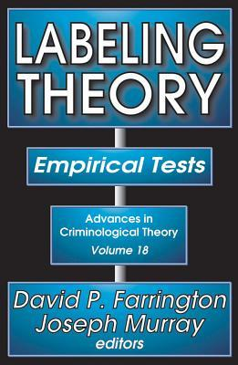
labelling
Even low-intensity contact with the youth justice system may serve to increase recidivism and create an antisocial identity in the child (Farrington et al, 1978; Krohn et al, 2014; McAra et al, 2007; Murray et al, 2014; Petrosino et al, 2010)

Slide 22
What are the judges saying?
US Supreme Court: “the absence of evidence of deterrent effect is of special concern because the same characteristics that render juveniles less culpable than adults suggest as well that juveniles will be less susceptible to deterrence” (Roper v Simmons, 2005 – see also Graham v Florida, 2010; Miller v Alabama, 2012; Montgomery v Louisiana, 2016)
Johnson v Texas, 1993: the “likelihood that the teenage offender has made the kind of cost-benefit analysis that attaches any weight to the possibility of execution is so remote as to be virtually nonexistent”
Graham v Florida (2010): because juveniles’ “lack of maturity and underdeveloped sense of responsibility…often result in impetuous and ill-considered actions and decisions, they are less likely to take a possible punishment into consideration when making decisions”

Slide 23
What can we do about society’s “abiding faith in punishment”?
Reflect the science:
Children are:
more impulsive (Baird et al, 2007),
more prone to states of heightened emotion (Royal Society; Johnson and Wilbrecht, 2011; Pfeifer et al, 2011; Somerville et al, 2011; Figner et al, 2009),
use drugs and alcohol more frequently (Schramm-Saptya et al, 2009),
make poorer decisions (Benthin et al, 1993; Furby et al, 1992),
are less future-orientated (Greene, 1986; Nurmi, 1991),
comply with peers more readily (Gardner and Steinberg, 2005; Steinberg and Silverberg, 1986; Masten et al, 2009; Newcomb et al, 1993) and
take greater risks (Steinberg, 2007; Van Leijenhorst, 2010)

Slide 24
…and children in the youth justice system?
Grey matter volume deficiencies (Fairchild et al, 2011; Fallon, 2006)
Often traumatised, so more likely to have:
brain structure abnormalities (De Brito et al, 2012; Kolla et al, 2014; Lim et al, 2014; Malhi et al, 2019);
functional differences (McCrory et al, 2013);
specific cognitive deficits (Mills et al, 2019);
an increased risk of impulsive aggression (Kiehl et al, 2001)

Slide 25
What else works?
2019 UK College of Policing study in relation to knife crime:
Multi-agency working and targeting at-risk groups with a public health approach is more efficacious (McNeill and Wheller, 2019)
Systems featuring positive incentives often effective - punishment tends to fail (De Valk et al, 2015)
Methods of instilling a sense of citizenship (Schneider, 1990) – incarceration rarely achieves this due to separation from home area
Restitution programmes – increase self-esteem while repaying the victim – must be done in non-punitive and affirming manner
2-3 year follow-up – higher proportion of children who ceased offending and lower overall offence rate compared with incarceration and traditional disposal methods

Slide 26
Questions?
“The world is a prison in which solitary confinement is preferable.”
Karl Kraus

