Slide 1
How can a mental health workforce pressured by workplace demands be supported to engage in Continuous Quality Improvement (CQI) in mental health services across Aotearoa New Zealand?
Sharon Logan Quality Improvement Te Whatu Ora Waitematā
Date 16 March 2023

Slide 2

Staff engagement in QI
Notes:
CQI important to ensure best practice healthcare, respond to and meet external internal demands ensure patient safety, learn from and prevent adverse events – but CQI remains elusive to healthcare and this maybe particular relevant with the transformations in healthcare with Te Whatu Ora and Te Aka Whai ora.
HQSC 5 national QI projects
HQSC QIF – MFI – need to engage front-line staff
Ideas, got the knowledge work as done, need to engage and include those who will be making changes. We know that right? engage and include those who are doing the work and will be responsible for delivering change
literature clear – and no matter what QI model you look at – staff engagement crucial and an engaged workforce improves patient safety and pat experience

Slide 3

Healthcare staff energy for QI
Notes:
Oh dear Staff engagement in the work setting is understood to occur when there is a balance between job resources and job demands. -
staff engagement in QI is not sustainable when job demands - primarily excessive work pressures - outweigh job resources. Therefore, what do staff need to engage in QI when work pressures are high, and how can barriers be overcome? This question is the focus of a more thorough literature review and thematic analysis.
Healthcare constant barriers to staff engagement and QI – forced into reactive response
The integrative review methodology uses thematic analysis to analyse the reviewed literature, to identify relevant themes in relation to the research question 9 documents/articles (UK, US, Canada, Tanzania)

Slide 4
Staff engagement
Staff engagement in CQI refers to the direct involvement and participation of staff in QI; where staff take responsibility for QI activities, design, implementation and evaluation of outcomes.
Engaged workforce and staff engagement in CQI is a critical component of healthcare safety, organisational effectiveness and is a key strategic priority – favoured approach is transformative QI culture
Notes:
(Dixon-Woods et al., 2012).
Staff engagement is a key priority and is imbedded in Multi level multi system

Slide 5
Key enablers
Strategic Priority - staff engagement in CQI – clear aims and sustained commitment.
Adequate resource: Leadership trainings, QI skills and resource and time
Leadership approach: optimal participative or collective
QI skills and support
TIME
Valuing
Supporting
Empowering
Communication and visibility What are we trying to achieve? How do we know we are achieving it?
Notes:
So when constant barriers in the work place and the ideal QI not being developed – what is essential.
Strategic Priority : staff engagement in CQI. Sustained commitment – needs to be prioritised and commitment to long term – staff need to understand what the objects aims are in order connect to
Adequate resource: Leadership trainings, QI skills and resource and time - need some dedicated resource to training leaders, QI skills and knowledge and essentially for front line staff TIME (biggest barriers
Leadership approach: participative and collective – Rangatira crucial Power sharing, shared decision making, empowerment strongest predictor of engagement in QI (highly skilled autonomous workforce. Building success thought overs.
When staff perceive they are communicated with, valued, supported and involved in decision making, they will engage in QI Appropriate to healthcare – non control and command – which public inquiries in UK have found lead to staff anxiety, impotence and unsafe care environments.
Te Ao Maori Collective strengths: Rangatira (inspirational), vision, group involvement, enabling of others,
Leadership
Participative leadership styles create structural and relational changes in the workplace and empower frontline staff to engage in QI. Leaders can empower frontline staff through QI skills, knowledge and decision-making power; empowerment is pivotal to engage staff in QI.

Slide 6
Structural considerations
CQI to be more centralised
Advocated for and provided QI training to team leaders – everyday QI and cultural change
QI coaching and support
Leadership styles
Cultural Leadership
CQI communication and visibility
Notes:
CQI to be more centralised

Slide 7
What works
Connection
Whaiora and whānau co-design
Clear aim – what's the end point
Bottom up what works? How?
Small sustained changes on daily basis
Flexibility
Translator tools and processes
Time and reflection
Notes:
Connect to the values/energy of the person / group – letting the group go to the energy – energy for change
How to provide tino rangatiratanga? – for Māori by Māori – divisional connection – Māori leadership and whanaungatanga
Connection
Clear aim – what's the end point
Bottom up what works how?
Flexibility
Translator tools and processes
Whaiora and whānau co-design
Small sustained changes on daily
Time and reflection
Connect : why how (whaiora stories very powerful)
Make it simple
Idea of test/trial small scale – one thing once a week etc. what did we find out.
HOW be led by staff – they have the ideas Connect to staff small groups – find out the how – what's worked – how did you find the time?
Make it small -
Conversation, daily, one weight a week.
Build
Its not hard
Organised and follow up
Empowering – finding out how – what do you need for me?? Is that enough?
Use simple messages – consumers and whānau get the stories – let the feedback do the work

Slide 8
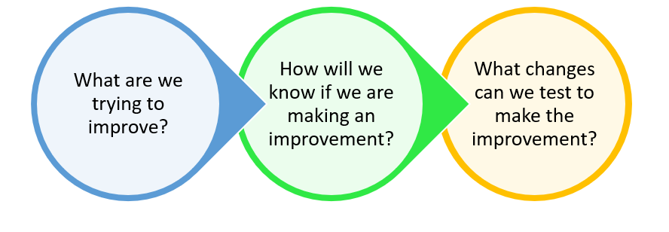
Helpful prompts
Clear Aim
Measurement
Change ideas for testing

Slide 9
Quotes from study
‘At first, staff were resistant to…yet once staff were included in the decisions and learned that they would lead the work and would be provided with the capability and capacity to do so, they became engaged and empowered (Flynn & Hartfield, 2016).’
‘What we’re seeing is a much greater level of ownership for those solutions because they’re being created by the very people that are at the front line delivering the care…And the reason its stickling [is], it’s not only because it’s obviously the right thing to do… it’s the fact that staff themselves have designed the delivery model. So, it’s there, so it’s become their baby. So even when we’re busy they’re still sticking to it (Jabbal, 2017).’
‘Empowerment, support and ownership represent structural and relational changes in the workplace, which are largely attributed to leadership modelling, improved communication and QI training which empowers and gives ownership to staff of QI (Flynn & Hartfield, 2016; Maurer et al., 2018).’
‘There needs to be continuity between what is being said and what is being done. Being told you will be supported and the act of supporting is different to staff perceiving they are supported. Recognising the importance of staff perceptions is important to understanding and sustaining staff engagement; perceptions give permeance to the initiative (Logan 2021).’
‘Progress was reliant on a number of factors that could effect take up…’I don’t think staff are also 100% on the side of their manager…I don’t think they see management are genuine about wanting to engage them. I think that’s the biggest problem (Hewison et al., 2013).’
‘Building and establishing daily staff engagement in QI in busy workplaces through empowerment, ownership and increased support are essential enablers of staff engagement in QI (Logan, 2021).
‘Feedback and celebration. The importance of celebrating success and feeding back tangible improvements that had been made (and linking them directly to the staff engagement process) were considered to be key to success by many of the respondents (Hewison et al., 2013).’
‘…what participating clinicians saw as the benefits, and …what … motivated them….opportunities for an exchange of ideas, giving insight into the working of other teams, time to reflect on their services, providing an opportunity that the teams did not normally have because of work pressures…, a networking opportunity in which mentoring relationships could be formed (Ling et al., 2010).’
Notes:
This includes leaders modelling the engagement approach of empowerment, support and ownership, through this process, staff can build new positive perceptions of their engagement in QI. Engagement in QI creates social, professional, emotional and values change in leadership, frontline staff and workplaces (Hewison et al., 2013; Ling et al., 2010; Maurer et al., 2018)
Dominant enablers, which engage staff to lead QI, are leadership, resources and lasting organisational commitment.

