Slide 1
The Minimum Age of Criminal Responsibility
Enys Delmage

Slide 2
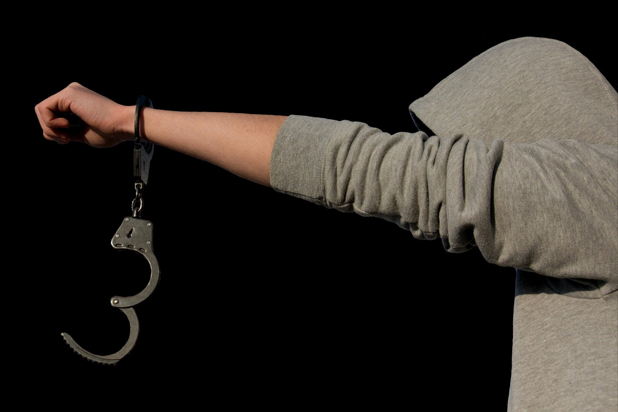
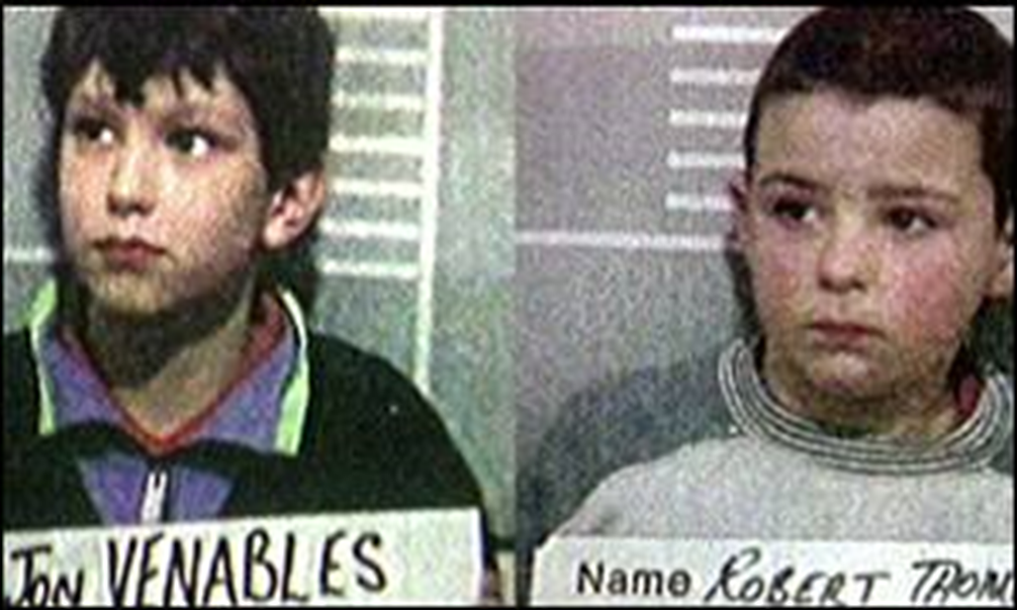
Background
Judge: “…cunning…very wicked…an act of unparalleled evil and barbarity”

Slide 3
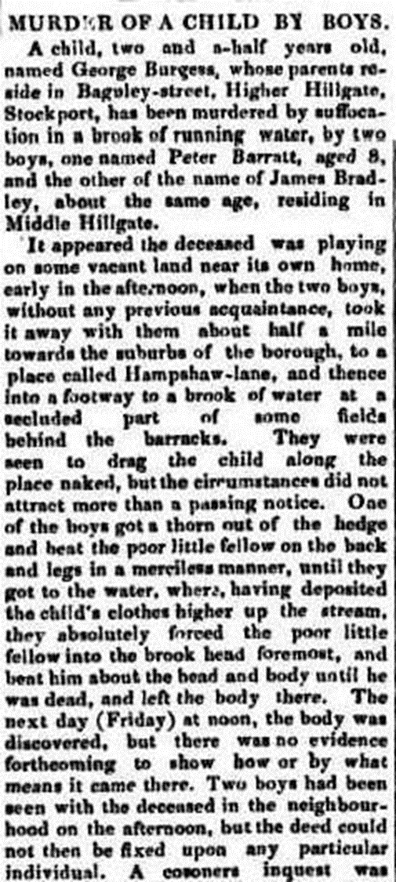
1861 – George Burgess
2-year-old tortured and killed in Stockport by two 8-year-old boys after being abducted by them
High degree of press interest initially
By the time of trial, press opinion was one of optimism re: rehabilitation
James Bradley and Peter Barratt – found guilty of manslaughter – 1 month in gaol and 5 years in reformatory
Judge: “mere babyish mischief”

Slide 4
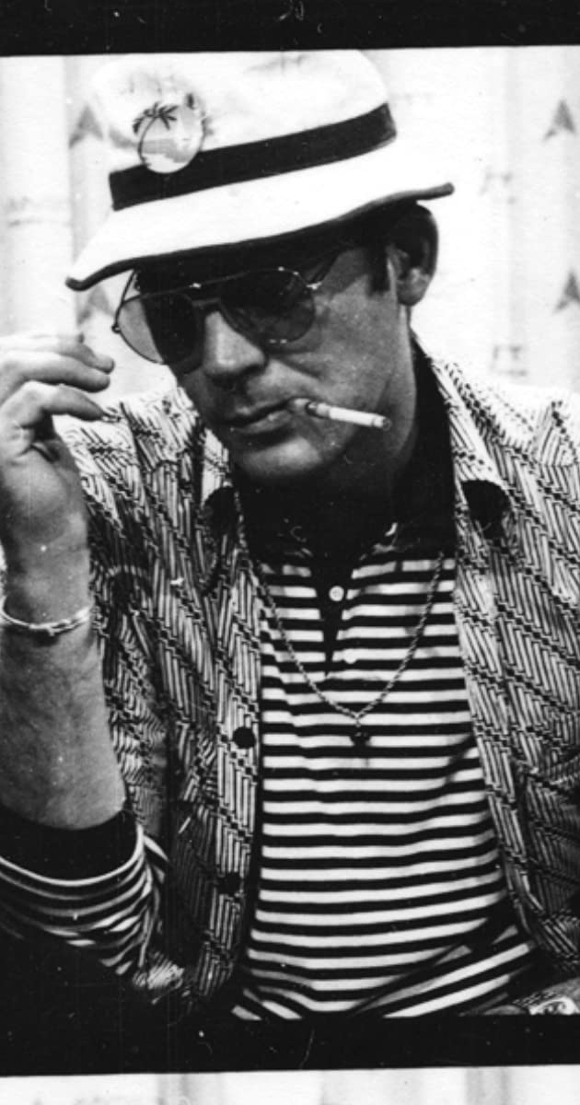
International Heterogeneity
The world is a weird place, despite my efforts to make clear and perfect sense of it.
Hunter S. Thompson

Slide 6
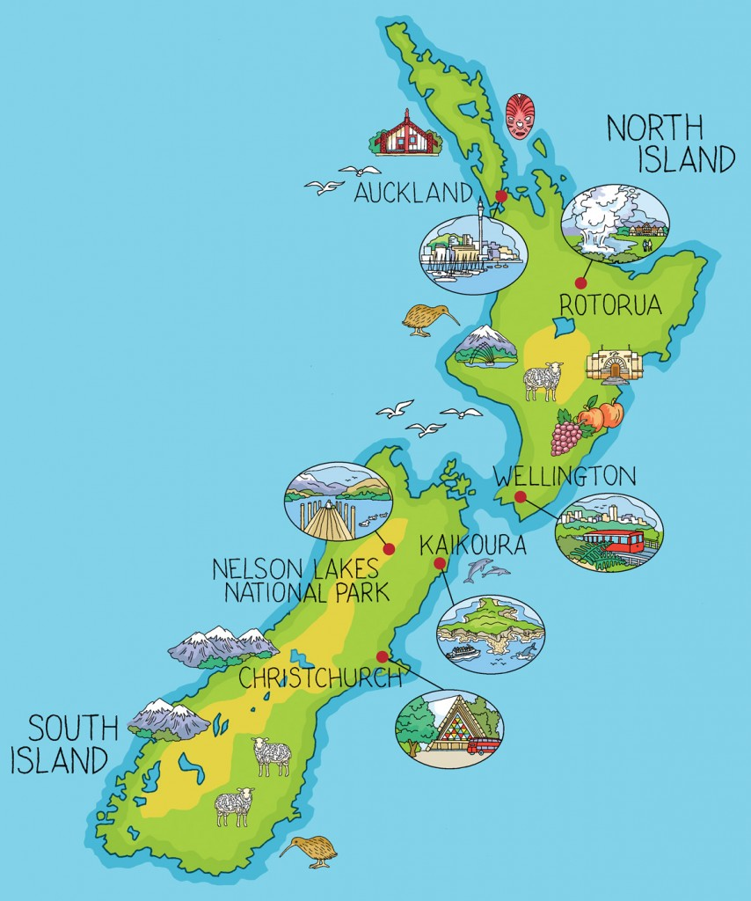
New Zealand
Under 10 – not criminally responsible
10-12 – murder/manslaughter - High Court
Youth Court - 12 and above for serious offences (an offence carrying a maximum penalty of 14 years or life imprisonment) OR an offence carrying a maximum penalty of 10 years imprisonment if previously been convicted of murder, manslaughter or an offence with a maximum penalty of 14 years imprisonment
14 and above for less serious offences
Doli Incapax still applies for 10-14-year-olds

Slide 7
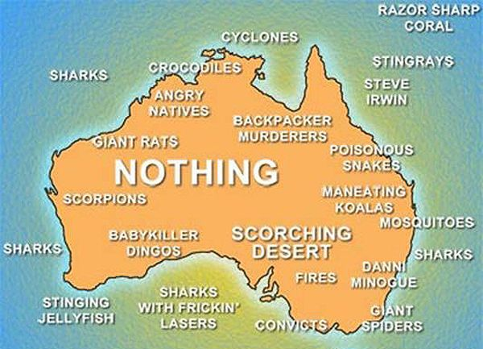
Australia
Currently: MACR set at 10 but with doli incapax for those aged 10-14

Slide 8
Doli Incapax
“Incapable of evil”
Rebuttable presumption – above the MACR (versus conclusive presumption – below the MACR)
Must know that the act or omission was seriously wrong
Poorly tested – often reliant on social worker, teacher, or even parent (not in South Africa – must be psychologist or psychiatrist)
886AD
1619: “An infant of eight years of age or above may commit homicide…and shall be hanged for it…if it may appeare that hee had knowledge of good and evill, and of the peril and danger of that offence. But an infant of such tender years, as that he hath no discretion or intelligence, if he kill a man, that is no felony in him”
Is there a better way to describe developmental immaturity?
Yes
“Developmental Immaturity”

Slide 9
Further weirdness
66 (out of about 220) countries operating doli incapax or analogue
26 countries varying the MACR according to seriousness of offence
10 countries with different MAsCR for boys versus girls
5 countries where Sharia law operates alongside state-mandated or federal law
13 countries with no MACR
At least one country with multiple established legal processes (Gaza – tribal adjudication, military law, precedent and common law)
5 countries with a position yet to be established

Slide 10
Stratification by Offence Type
Albania, Argentina, Armenia, Austria, Azerbaijan, Belarus, Botswana, China, Hungary, RoI, Kazakhstan, Krygystan, Lithuania, Marshall Islands, Republic of Moldova, Mongolia, Northern Mariana Islands, New Zealand, Palau, Russian Federation, Slovakia, Tajikistan, Tibet, Turkmenistan, Ukraine and Vietnam
Types of offences that are deemed “serious” are also highly variable
Some vary by sentence length (from “over 2 years” to “over 14 years”)
Some vary by pre-defined “seriousness” - serious violent offences and sexual offences are included as “serious” whereas petty larceny is not
“When sentencing issues arise, states should not use the gravity of an offence as a justification for lowering the MACR” – UN General Assembly, 2019

Slide 11
Age of Majority
Age at which children can be managed as adults
2015 – India passed legislation allowing children to be treated like adults if their crime was particularly serious (Juvenile Justice (Care and Protection of Children) 2015 Act) – 16-18 year olds can be tried as adults for serious offences (crimes carrying a sentence of 7 years or more)
Passed despite being a violation of the UNCRC and also the Indian Constitution
Triggered by rape and murder of Jyoti Singh (2012) – the youngest person found guilty was 17 and served 3 years in prison – older co-defendants were sentenced to death – several legal attempts made to have the minor tried as an adult but rejected by Supreme Court

Slide 12
Why does it matter? Labelling Theory…
McAra et al (2007), “Youth justice? The impact of system contact on patterns of desistance from offending”, European Journal of Criminology, Vol. 4, No. 3;
Farrington, D. P., S. G. Osborn & D. J. West (1978): The Persistence of Labeling Effects. British Journal of Criminology, vol. 18, s. 277-284.;
Murray, J., A. Blokland, D. P. Farrington & D. Theobald (2014): Long-Term Effects of Convictions and Incarceration on Men in the Cambridge Study in Delinquent Development. In Farrington, D. D. & J. Murray (ed.): Labeling Theory. Transaction Publishers, New Brunswick, s. 209-235.;
Krohn, M. D., G. Lopes & J. T. Ward (2014): Effects of Official Intervention on Later Offending in the Rochester Youth Development Study. I Farrington, D. D. & J. Murray (ed.): Labeling Theory. Transaction Publishers, New Brunswick, s. 179-207;
Petrosino A, Turpin-Petrosino C, Guckenburg S (2010). The impact of juvenile system processing on delinquency. Labeling Theory – Empirical Tests, Advances in Criminological Theory Volume 18, Chapter 6

Slide 13
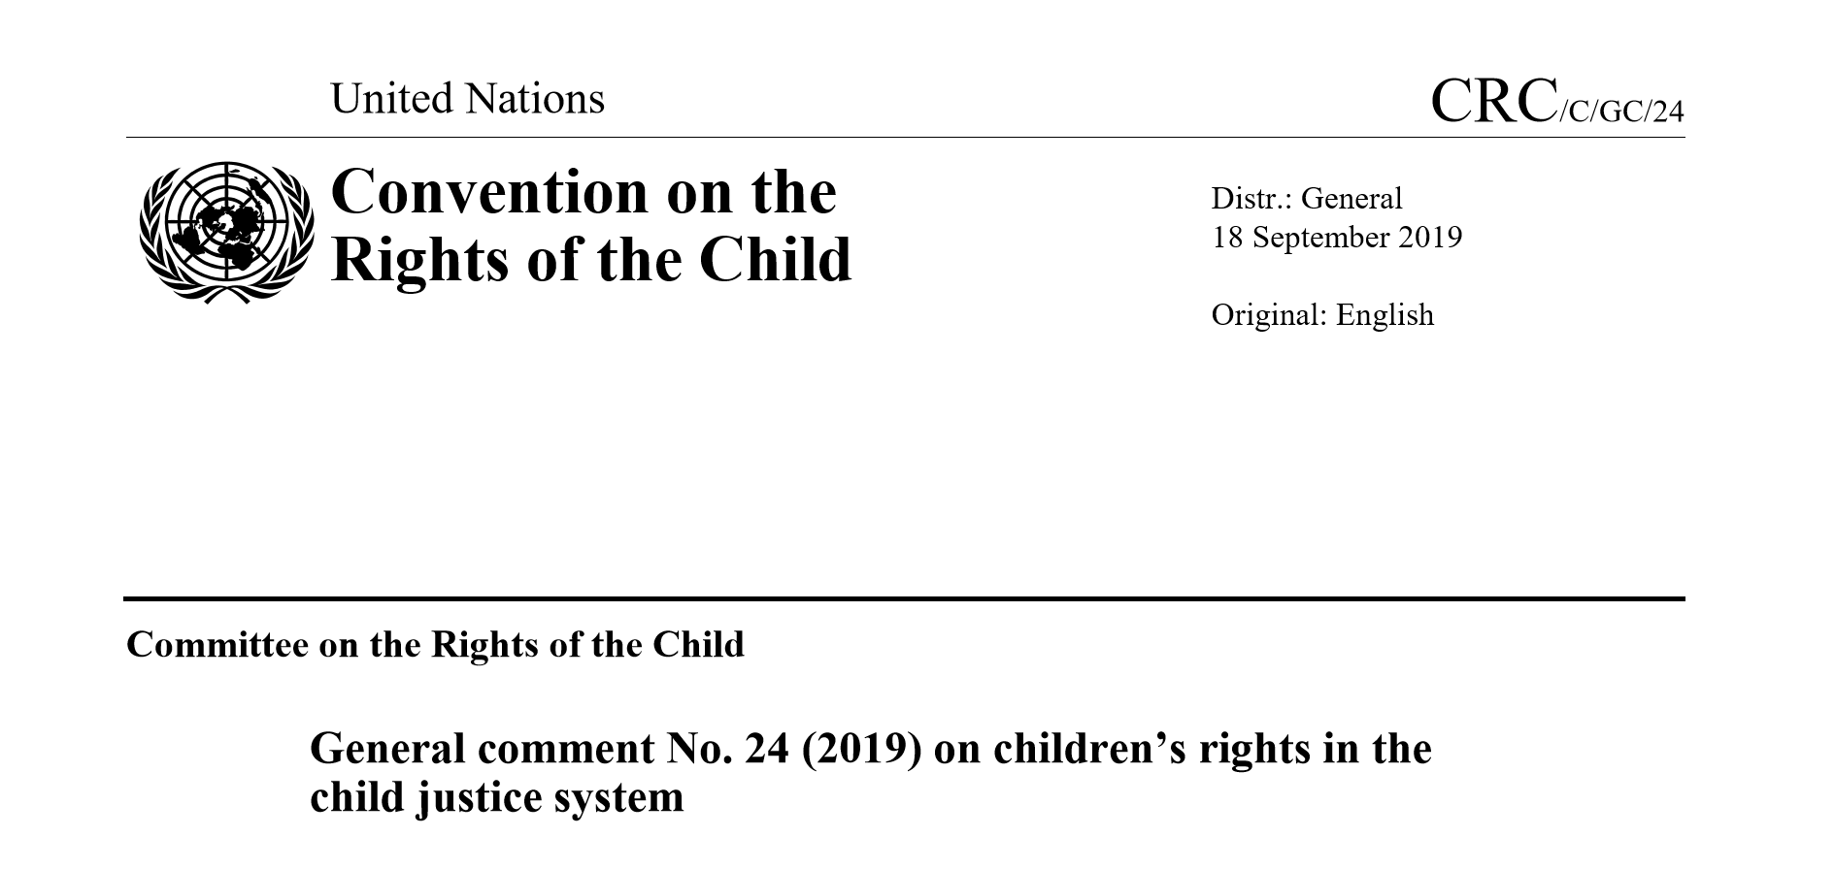
International standards recommend that the minimum age of criminal responsibility shall not be fixed at too low an age level, bearing in mind the facts of emotional, mental and intellectual maturity.

Slide 14
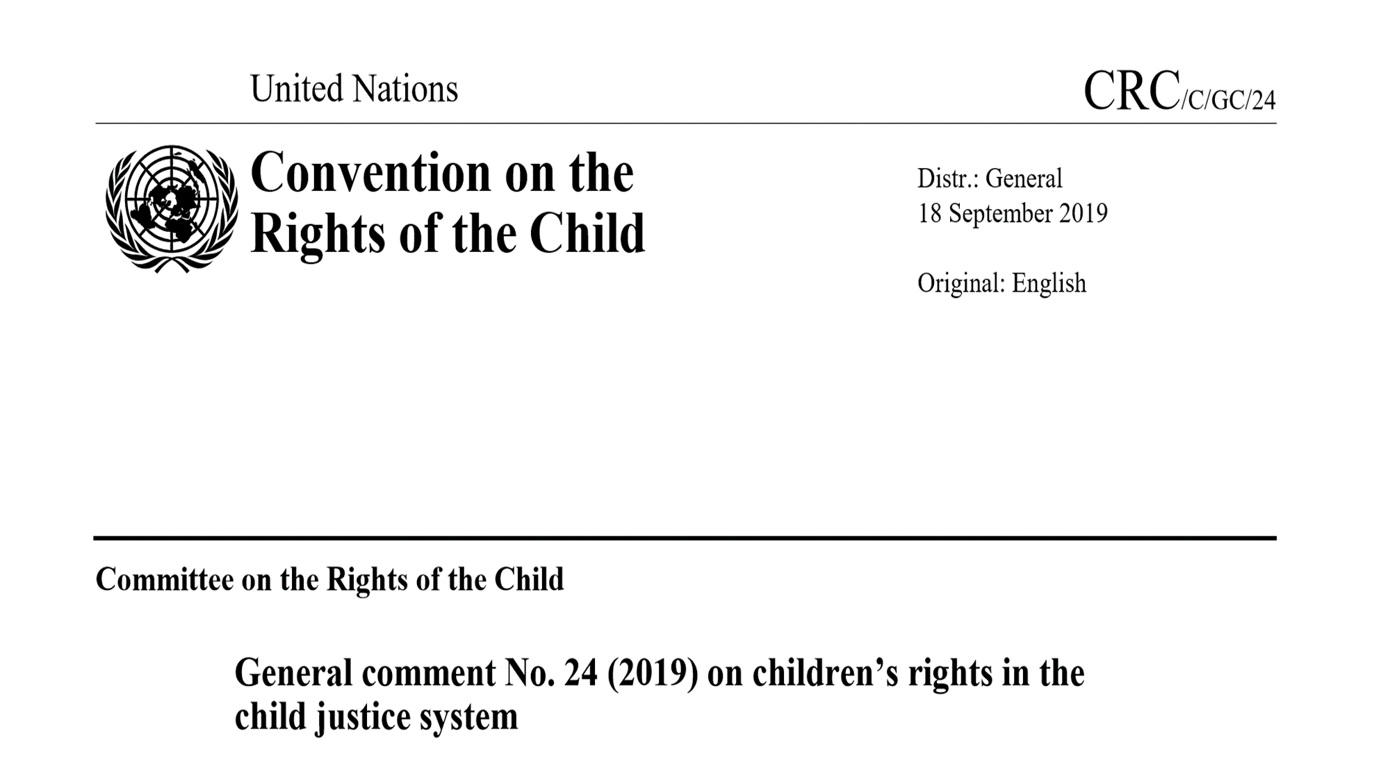
Section C, Paragraph 33, page 9
“In the original General Comment No. 10 (2007), the Committee had considered 12 years as the absolute minimum age. However, the Committee finds that this age indication is still too low. States parties are encouraged to increase their minimum age to at least 14 years of age. At the same time, the Committee commends States parties that have a higher minimum age, for instance 15 or 16 years of age. The Committee recommends that State parties should under no circumstances reduce their minimum age of criminal responsibility, if its current penal law sets the minimum age of criminal responsibility at an age higher than 14 years.”

Slide 15
Economic analysis
Calculation of direct and indirect costs versus direct and indirect benefits is very challenging

Slide 16
Economic analysis – low MACR
Direct cost –
building, maintaining, staffing and supplying juvenile justice facilities, plus managing governance issues/media scandals,
youth courts,
legal costs,
policing costs
Indirect cost –
criminalisation of young people,
institutional unintended racism and sexism,
international condemnation,
poor economic outcome for those who have a criminal history and have been incarcerated

Slide 17
Economic analysis – high MACR
Direct costs –
welfare system expansion, maintenance and governance (probably more expensive than corrections facilities),
family courts,
legal costs,
higher workload for ancillary services such as health and education
Indirect costs –
burnout of welfare staff,
possible added burden on families

Slide 18
Other issues with high or low MACR
Welfare (high MACR) –
no obvious right of appeal/”fair trial”/length of stay;
may give victims and wider society a sense that the child had “got away with it”;
“nanny statism”;
removal of personal autonomy and sense of accountability
Youth Justice (low MACR) –
may damage societal attitudes and our sense of who we are;
heavy impact upon families;
heavy impact upon child’s identity and relationship with authority figures,
perpetuation of racist attitudes

Slide 19
What’s happening in new Zealand and Australia?

Slide 20
What’s happening in Australia?
A.C.T. – supposed to be raising their age to 14 in 2022
Queensland – maybe
Commonwealth/Federal level - Attorneys General – decision postponed until some time in 2022 – may be going for 12
Tasmania – raised their age of detention to 14 – sort of progress? Or a nothingburger…

Slide 21
What’s happening in New Zealand?
Andrew Becroft and Wira Gardiner announced the phased closure of the 4 care and protection residences in NZ – good (in theory)
YJR estate has expanded - bad
The vast majority of children deprived of their liberty in NZ are in YJ Residence beds

Slide 22
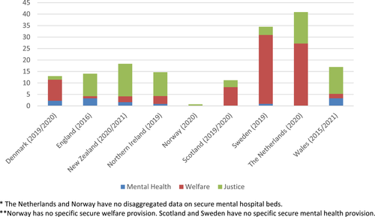
Secure beds per 100,000 young people…

Slide 23
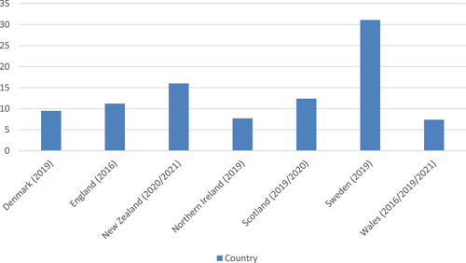
Overall rates of detention per 100,000 young people…
https://onlinelibrary.wiley.com/doi/full/10.1002/cbm.2234

Slide 24
What’s happening in New Zealand?
Raise the Age campaign - https://amnesty.org.nz/raise-the-age-of-criminal-responsibility
OCC – 16; RANZCP branch – 14 (https://www.ranzcp.org/news-policy/news-archive/news-archive-2021/call-to-raise-the-age)
Collaboration between Amnesty International NZ, the OCC, me, James Knight and Kris Gledhill; wider group of “interested parties”
Submitted thematic report to Children’s Rights Alliance (August 2022)
Any volunteers to join would be appreciated!
Doli also needs a refresh…”developmental immaturity”?

Slide 25
questions

